Slide 1
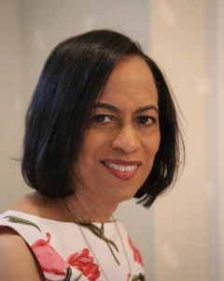
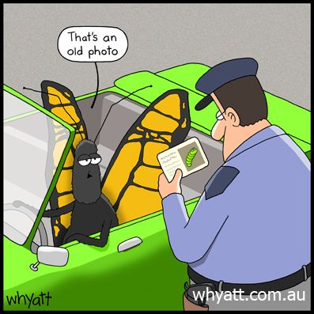
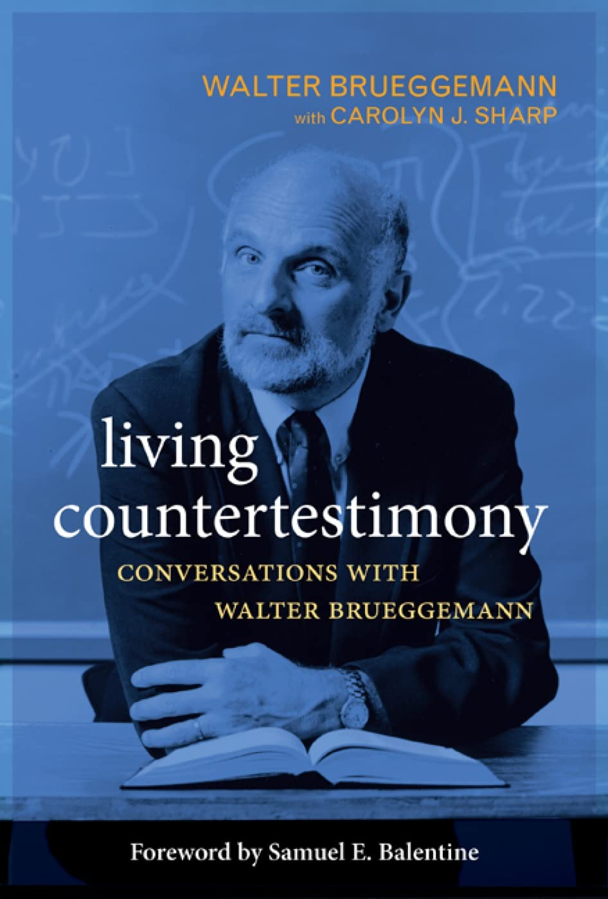
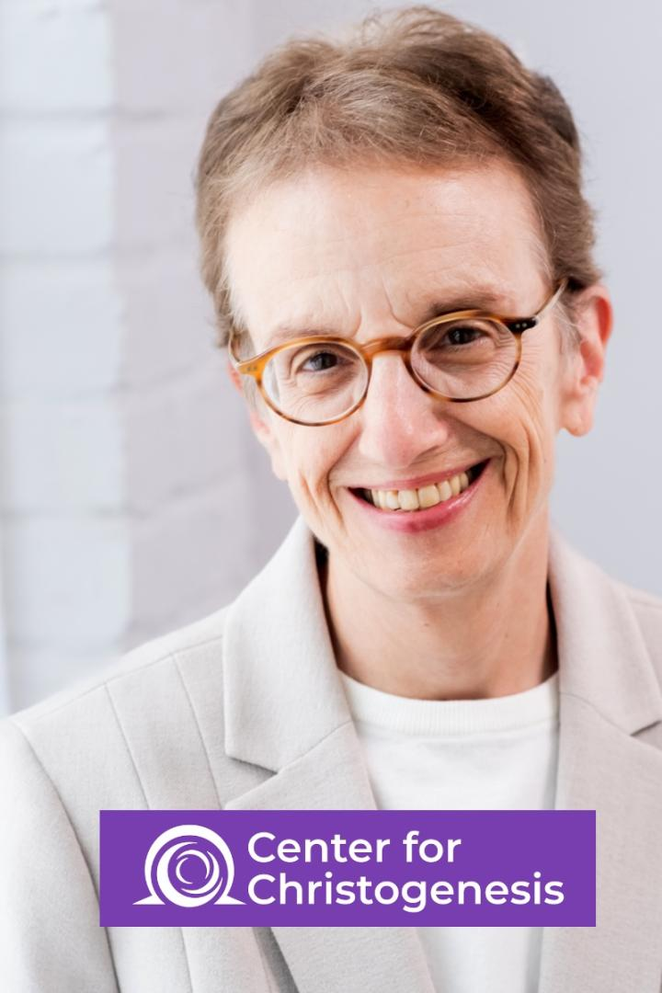
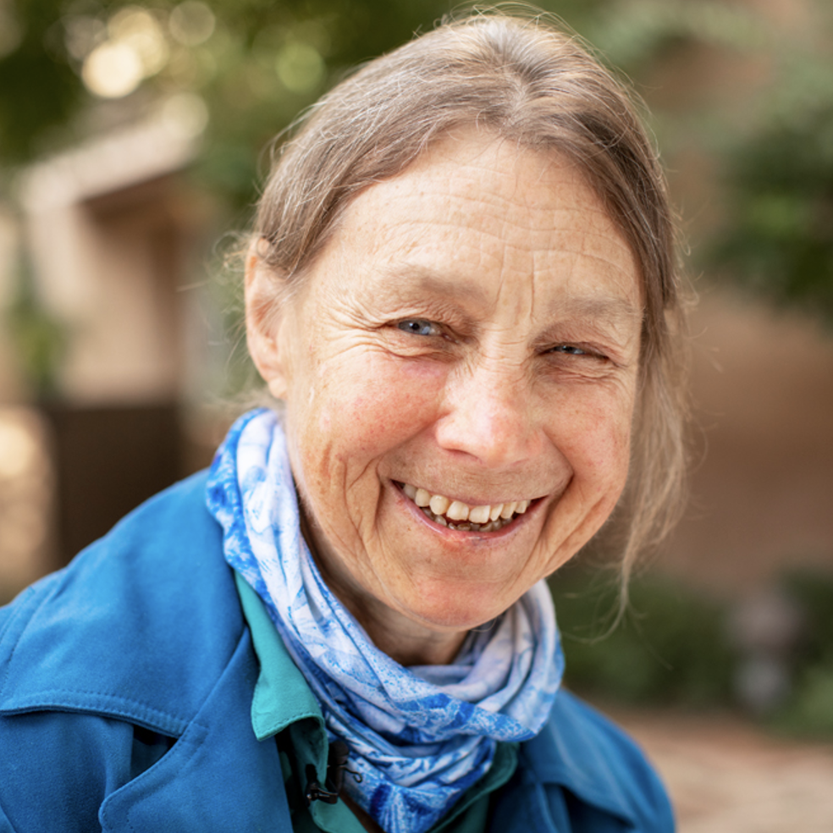
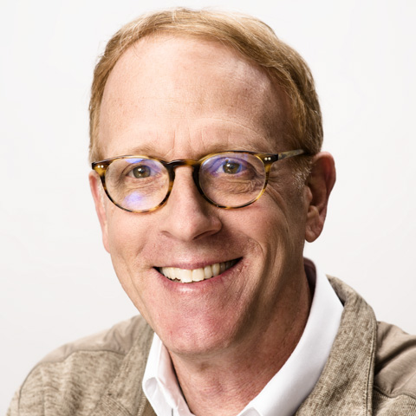
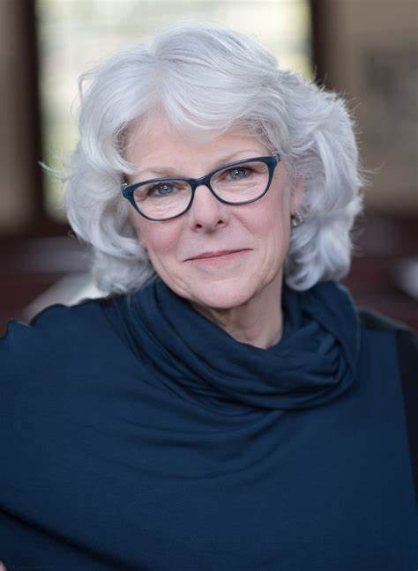
Contemplation Transforms; Let Me Count the Ways
Transformed Prayer, Persons, Theology, & World; the Energy of Contemplative Christianity 3
The story/journey, first
The Superpower Process, second
The Countertestimony, third
Contemplative Outreach Birmingham, April 11, 2026
Ed Bacon, revedbacon@gmail.com

Slide 2
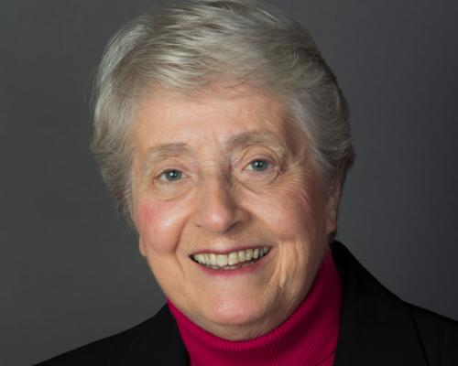
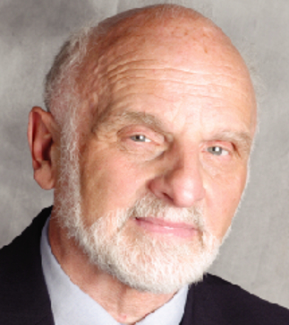
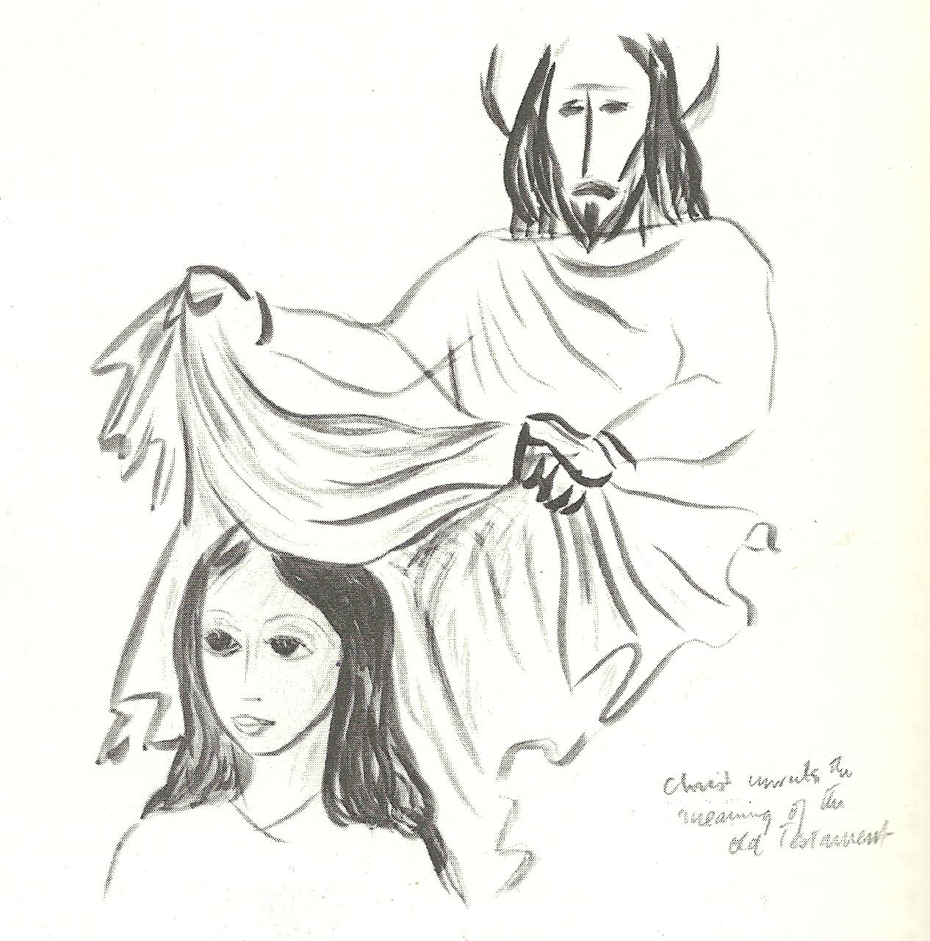
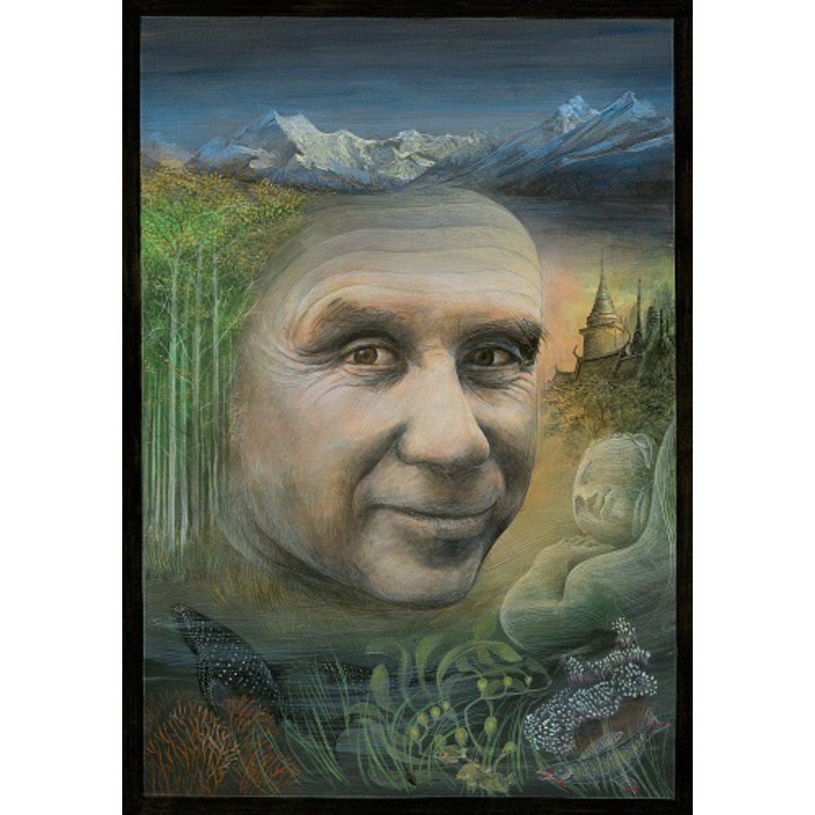
“Wisdom/Sophia Texts” as Countertestimony for a different experience of God
Hebrew Bible scholar Walter Brueggemann describes Wisdom-Sophia as ancient Israel’s “countertestimony” to a different way of experiencing the living God. Brueggemann distinguishes Israel’s “core testimony” in the Bible, where God is “highly visible, evoking terror in the enemy and praise in the beneficiaries of [that] ‘action’” – from Israel’s “countertestimony” as voiced in the Wisdom tradition, where God’s presence is felt.(Walter Brueggemann, Theology of the Old Testament: Testimony, Dispute, Advocacy (Minneapolis, MN: Fortress Press, 1997)p. 346 At moments of profound uncertainty and crisis, Wisdom cries out from the crossroads, giving reassurance especially to the “little,” the “poor,” the forgotten ones. Her Presence sustains and accompanies her children in exile.
“…renowned biblical scholar Sandra Schneiders suggests that just as images of the self and world can be healed, “so can the Godimage. It cannot be healed, however, by rational intervention alone.” If “it is the imagination which governs our experience of God,” and further, that our religious and social imaginaries cry out for the healing of patriarchal deformations, is not the remembrance of Sophia the most promising resource in the tradition for doing so? What the believing community sorely needs, Schneiders concludes, is a therapy of the religious imagination. Sandra Schneiders, Women and the Word: The Gender of God in the New Testament and the Spirituality of Women (New York: Paulist Press, 1986)
To think prophetically in our times is to pray for a word of hope where things look hopeless, for a renewed sense of Presence where God feels absent, for a memory of healing and liberation where relationships seem broken or coercive beyond repair. This remembering of our deepest identity in God, I believe, is what Merton discovered in the music of the Wisdom tradition. Something new and wordlessly ancient ever waits to be born into the world, something beautiful, in the very flesh and spirit of our lives: Sophia.
The power and pregnancy of sacred symbols and stories, suggests Merton, lay in their capacity to recover our primordial human dignity, to open “the believer’s inner eye, the eye of the heart, to the realization that he must come to be centered in God because that, in fact, is where his center is.”
“The Wisdom of God, Sophia, comes forth, (Thomas Merton, ESF 65; Christopher Pramuk, Sophia 304). Do not be afraid, she says, for you bear in your very selves the spark of the divine, the dignity and co-creativity of God. Love takes us by the hand, and opens the doors of another life, another day. https://merton.org/ITMS/Seasonal/48/48-3Pramuk.pdf

Slide 3

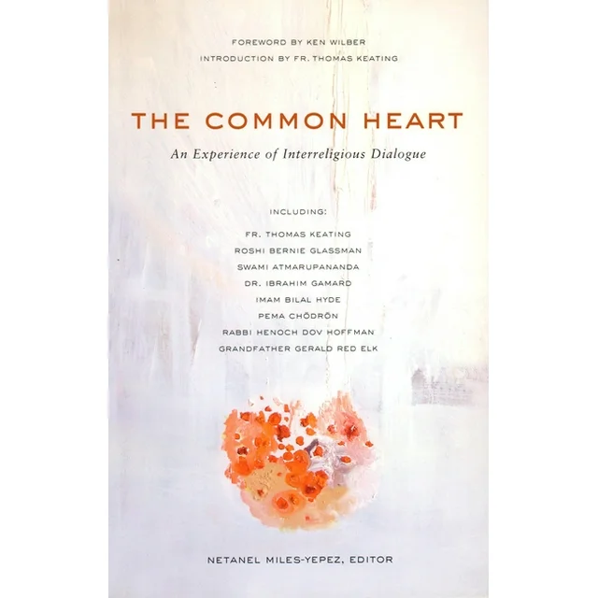
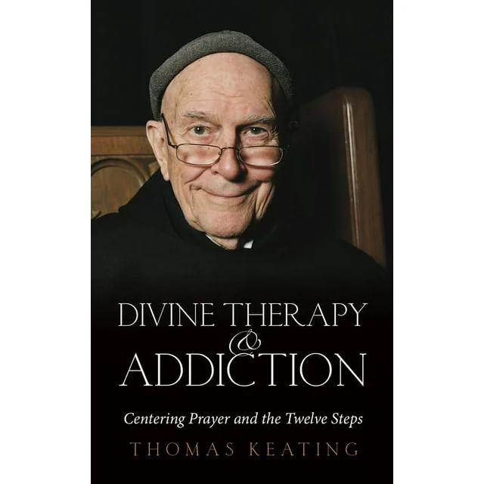
The “12 steps of Alcoholics Anonymous” is Wisdom Literature
“Most spiritual traditions have a wisdom literature. Alcoholics Anonymous, it seems to me, is a spiritual tradition….(the issue) is how well each generation …assimilates and interiorizes the basic wisdom that is enshrined in the Twelve Steps and the Twelve Traditions.
“There is nothing new about reading an inspired text in a special way – with a certain discipline and reverence – that prepares the faculties – body, soul, and spirit – to access the GOAL of EVERY SPIRITUAL PRACTICE, which is INTIMACY WITH THE Divine….
“In the great spiritual traditions of the world, there are many sacred texts like the Vedas, and Upanishads in Hinduism, the Buddhist Sutras, the Qu’ran in Islam, the Hebrew bible, and the New Testament – just to mention a few….
“…reading an inspired text in a special way is a highly tested and broadly experienced procedure for interiorizing the wisdom of a particular tradition. We are talking about the Twelve Steps of AA, which if not a sacred text at least is a very important text. After all, it presents people with the choice of life and death. So we better listen carefully to it.
The process of accessing divine intimacy presupposes how to read the texts of AA in such a way that our human faculties – body, soul, and spirit – are prepared to receive the gift of wisdom that the authors and the community of AA are trying to pass on.”
“The Interview” between Tom S., an alcoholic and Thomas Keating, Thomas Keating, Divine Therapy and Addiction; Centering Prayer and the Twelve Steps, pp. 181-182

Slide 4
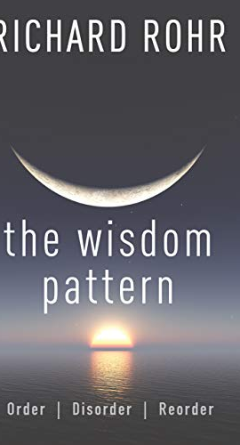
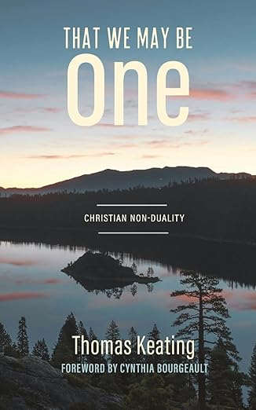

What Do We Call This Reordering? (Since the Wisdom Pattern is “Order, Disorder, Reorder”)
How do we refer to this new understanding of Christianity and Religion?
Mystic?
Contemplative? Contemplative Christianity?
Contemplative Transformation?
Nondual Consciousness?
Nondual Christianity? Are nondual and contemplative the same reorientation from “separate individualism and heaven”?
Christ/God and the least of these are one?
“In brief, reading (I might say, "devouring") this book, and hearing your insightful thoughts and reflections on Thomas Keating's work, has given me hope that there may yet be a place for me within Christianity. Truly, I was simply previously unaware of the existence of Christian mysticism. And, I feel moved to proceed to see how I might enrich my spiritual life by more fully exploring some of these thoughts and concepts; a more embracing, more transcendent experience within the traditions and forms of the Episcopal Church and of Non-Dual Christianity.” (from a parishioner in Chatanooga)

Slide 5
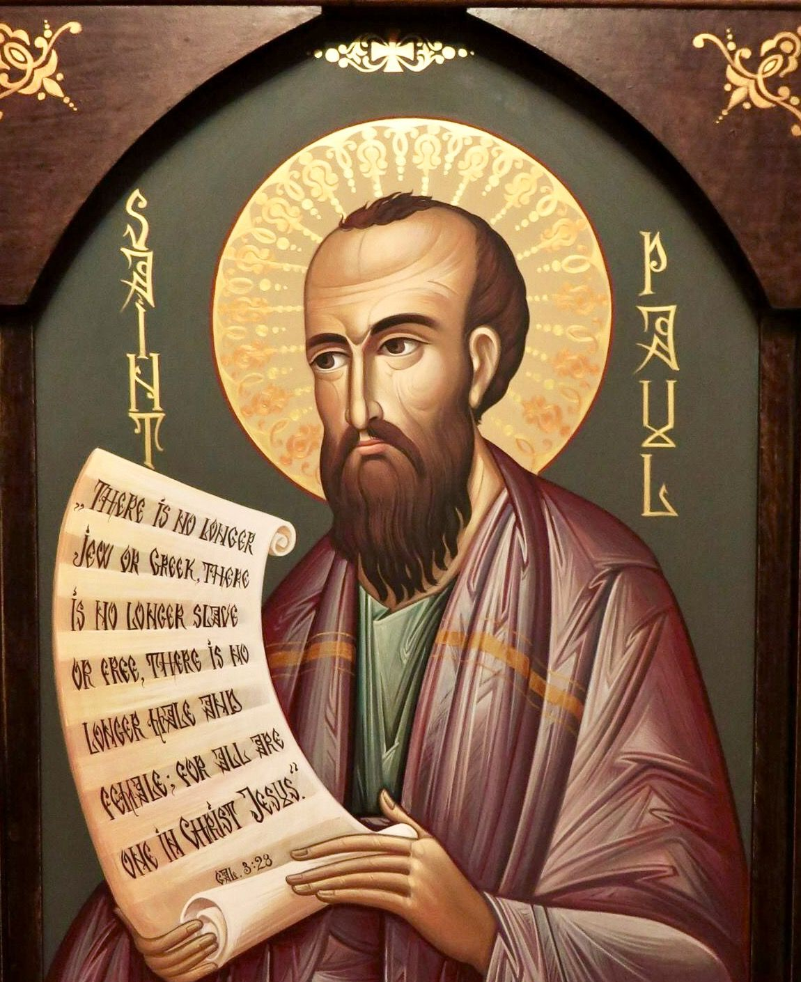
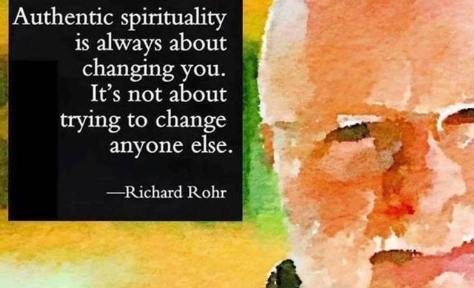
Richard Rohr’s Seeing Paul’s Letters as Written from the Consciousness of Mysticism. Transformed from dualistic to nondual thinking.
Paul is probably one of the most misunderstood and disliked teachers in Christianity. I think this is largely because we have tried to understand a nondual mystic with our simplistic, dualistic minds.
The Christ whom Paul met was not identical to the historical Jesus; it was the risen Christ, the Christ who remains with us now as the Universal Christ.
In Galatians, Paul describes his pre-conversion life as an orthodox Jew, a Pharisee with status in the Judean governmental board called the Sanhedrin. The temple police delegated him to go out and squelch this new sect of Judaism called “The Way”—not yet named Christianity. Saul (Paul’s Hebrew name) was breathing threats to slaughter Jesus’ disciples (see Acts 9:1–2). He says, “I tried to destroy it. And I advanced beyond my contemporaries in my own nation. I was more exceedingly zealous for the traditions of my fathers than anybody else” (Galatians 1:13–14). At that point, Paul was a dualistic thinker, dividing the world into entirely good and entirely bad people. (JEB emphasis)
The Acts account of Paul’s conversion continues: “Suddenly, while traveling to Damascus, just before he reached the city, there came a light (JEB: Beloved Energy Light) from heaven all around him. He fell to the ground, and he heard a voice saying, ‘Saul, Saul, why are you persecuting me?’ He asked, ‘Who are you, Lord?’ The voice answered, ‘I am Jesus, whom you are persecuting’” (Acts 9:3–5).
Paul must have wondered: “Why does he say ‘persecuting me’ when I’m persecuting these other people?” This choice of words is pivotal. Paul gradually comes to his understanding of the Body of Christ (1 Corinthians 12:12–13) as an organic, ontological union between Christ and those whom Christ loves—which Paul eventually realizes is everyone and every thing. This is why Paul becomes “the apostle to the nations” (or “gentiles”). (JEB: Keating and Merton: God IS everyone and everything. Barbara Brown Taylor’s Luminous Web)
This enlightening experience taught Paul nondual consciousness, the same mystical mind that allowed Jesus to say things like “Whatever you do to these least ones, you do to me” (Matthew 25:40).
Richard Rohr's Daily Meditations, “Paul: A Christ Mystic,” Sunday, August 10, 2025

Slide 6
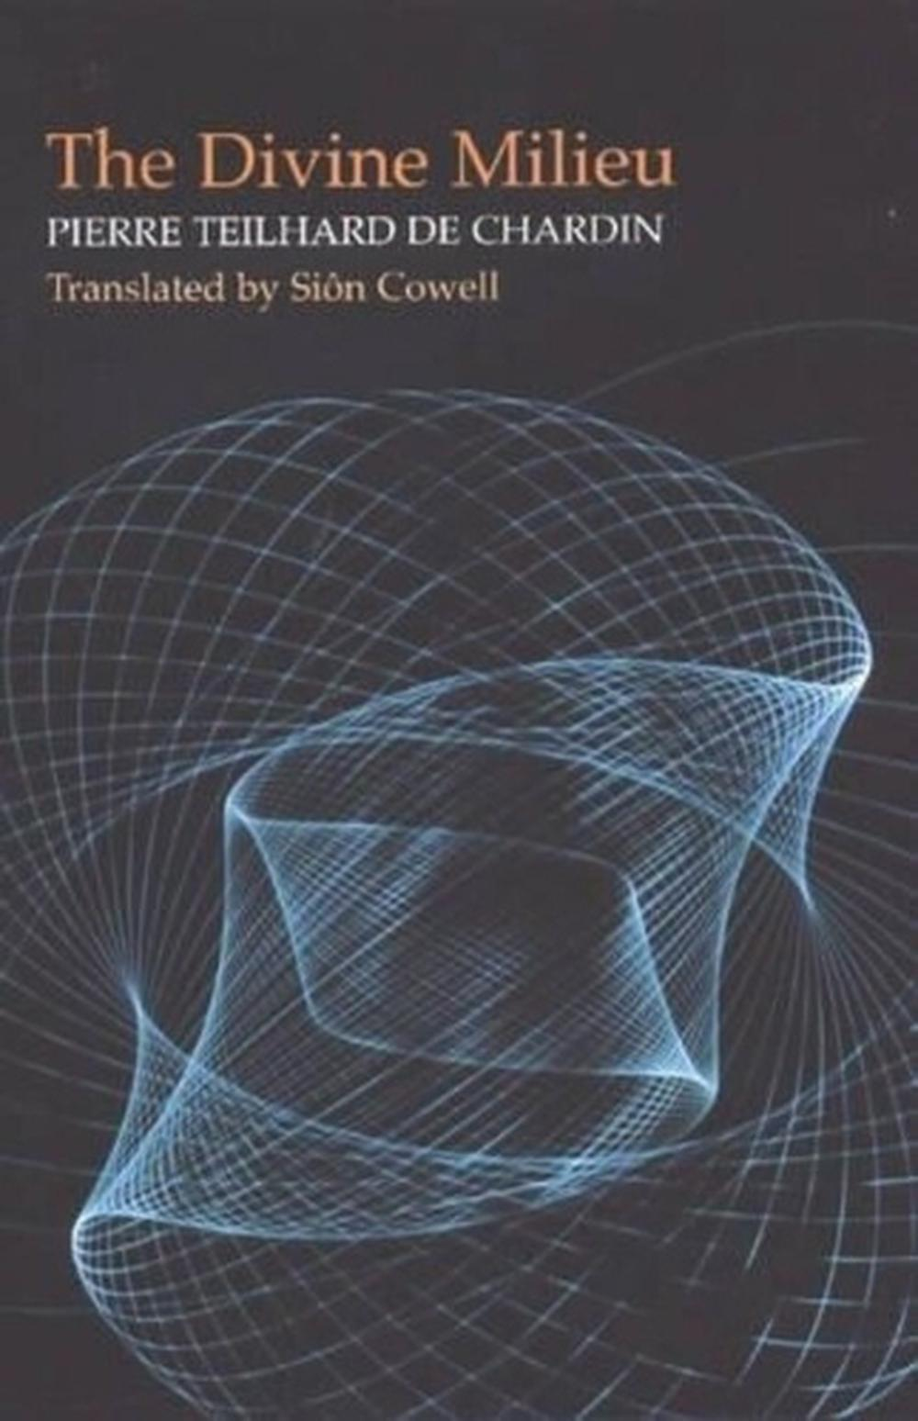
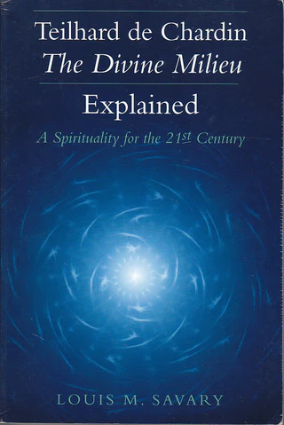
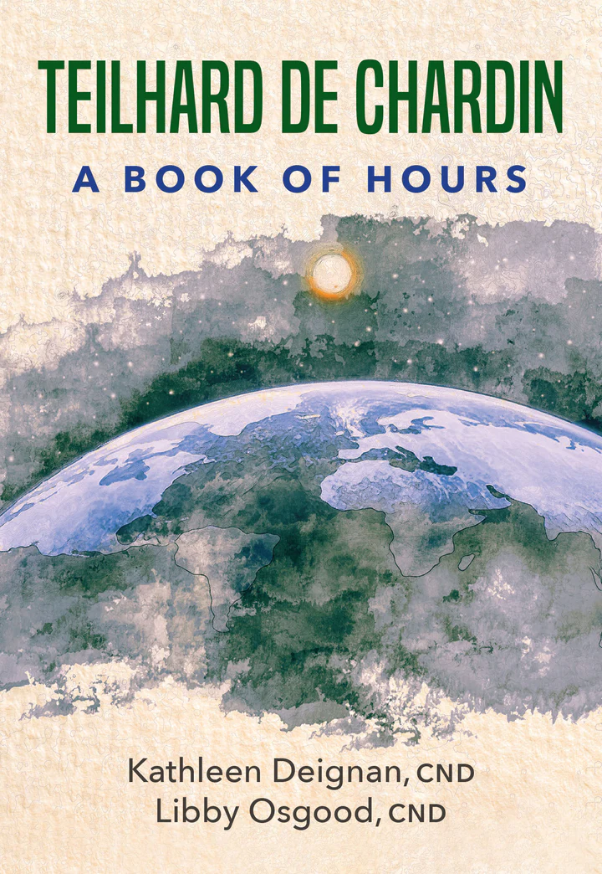
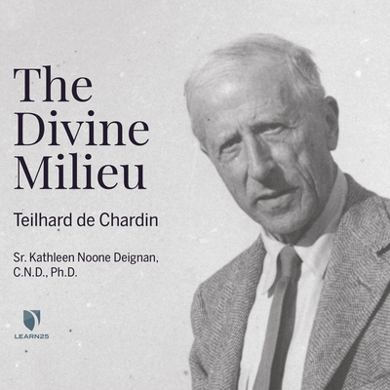
A Changing Understanding of Prayer.
Prayer as “consent,” “assignment” with a different vibration (Teilhard’s Divine Milieu)
Prayer as not asking God to do something. “Listening” for God changing you. A Changed Consciousness that is bio-chemically-electrically magnetically experienced, enabling Consent to God’s Healing, Promissory, “Here Am I Send Me” vibration.
Jesus, be also the Savior of human unity.
Compel us to discard our pettiness and venture forth,
Resting upon you, into the uncharted ocean of charity,
Teilhard, Divine Milieu, 146, Hours, 54
God is not a thing.
For us God is eternal discovery and eternal growth.
The one point at which the divine milieu may be born,
for each of us , at any moment
is not a fixed point in the universe,
but a moving center which we have to follow
like the Magi their star.
That star leads each of us differently, by a different path,
in accord with our vocation.
But all the paths which it indicates have this in common:
That they lead always upward.
Teilhard, Divine Milieu, 139; Hours, 124-125

Slide 7
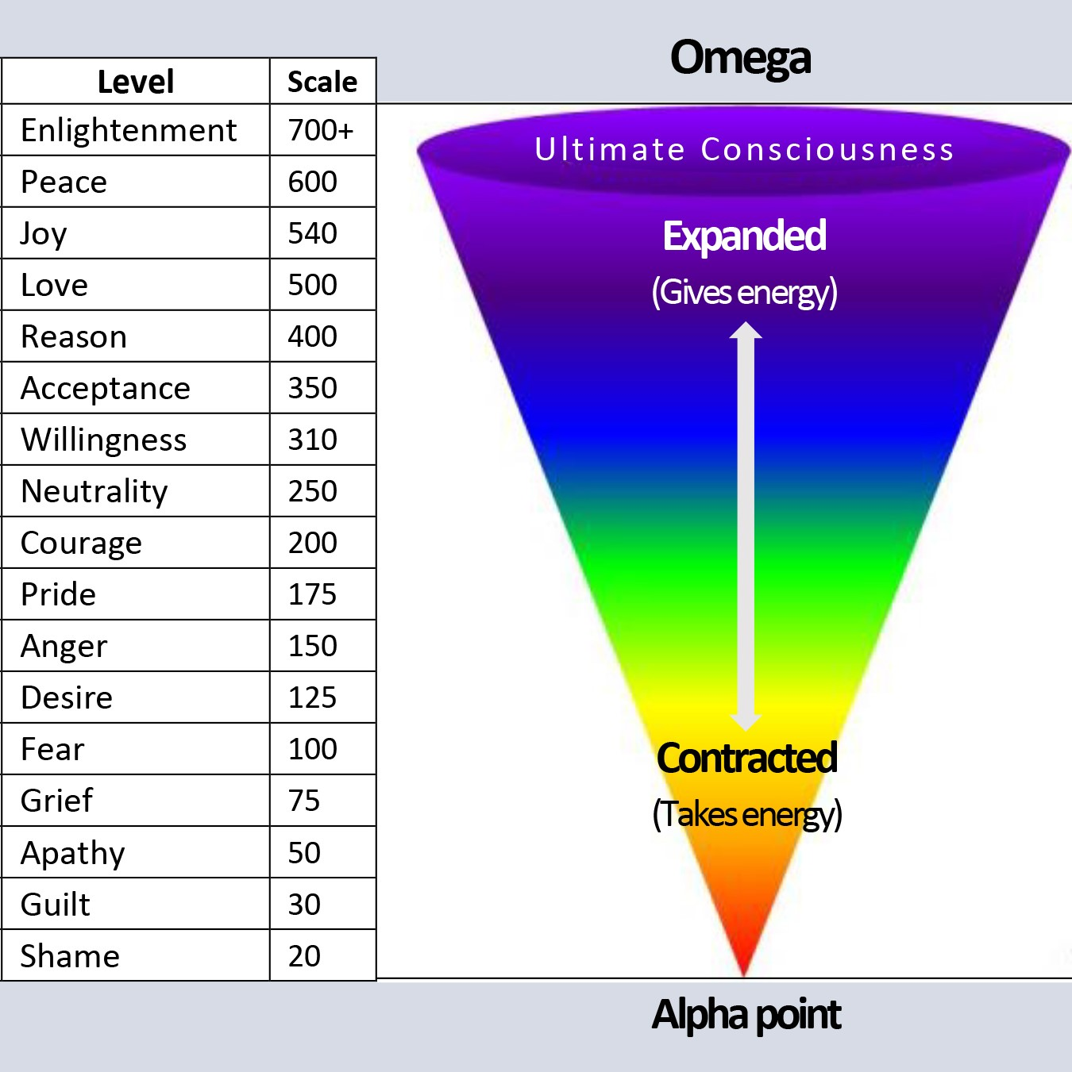
The Evolution of Centering Prayer: from personal spirituality to planetary assignment
A departure from traditional moral teaching
A gradual restructuring of consciousness that overturns the illusion of a separate “I,” or autonomous self-center. (Bourgeault, Keating, xvii)
In general, Bourgeault raises the question of “from what level of consciousness is a person doing theology, preaching, teaching, and doing theological reflection?” This is strikes me personally about both my living and my Calling. I would add from what level of consciousness is someone’s mantras coming from? (pp. xiii-xiv)
“In those last thirty years, he quietly added a whole new tier to his teaching. Where the first and more familiar tier takes us through the initial phases of spiritual awakening and psychological spadework up to the watershed traditionally known in Christian teaching as the “transforming union,” the material awaiting us in this second tier takes us from that unitive threshold into some of the deeper and more subtle nondual waters. These include 1) the dark night of spirit, 2) objectless awareness, 3) unity consciousness, 4) the transcendence of perceptual dualism, 5) direct perception of the Unmanifest, 6) the evolution of consciousness and 7) the meaning of no self. (p. xvi)
ONENESS became Keating’s watchword for his final spiritual transformation. His pastorate became the cosmos. His inner circle became the entire human family. This tier yielded a new field of interspiritual dialogue. He became a COSMOGONIC MYSTIC.
Oneness was experienced inwardly as a state of consciousness and outward as a state of PLANETARY HARMONY and COOPERATION (xiii)

Slide 8
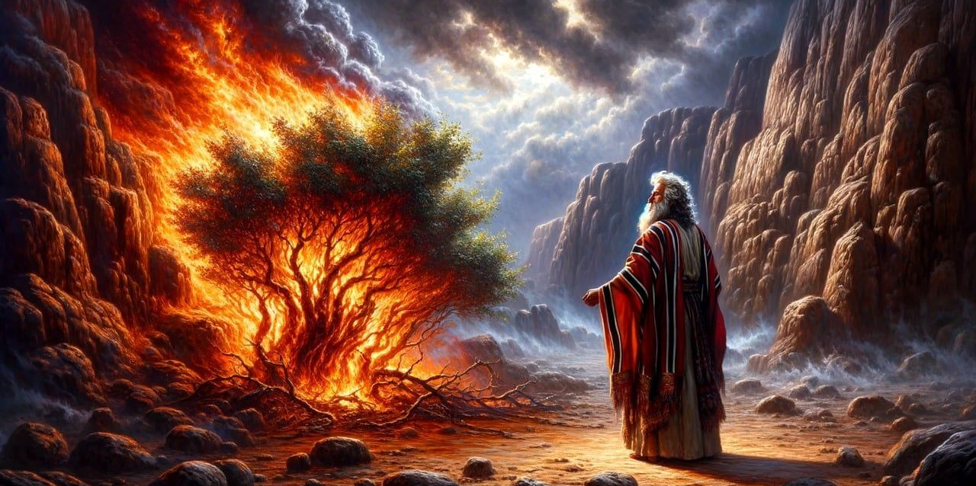
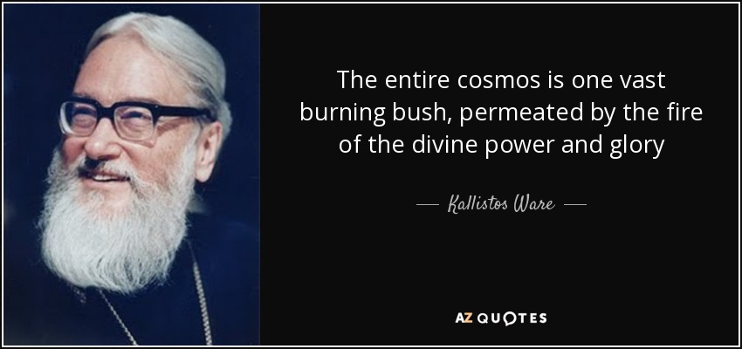

DAILY ASSIGNMENT to restructure human and ecosystemic affairs on the planet from Cosmic Burning Bush Experiences. Consciousness Expansion means a “sense of oneness” expansion AND PLANTETARY RESPONSIBILITIES
What was so amazing is that Keating was the architect of Centering Prayer which already in its “Tier 1” thinking was spiritually stunning: He initiated a “contemplative revival” with a “bold new psychological roadmap. He changed the Christian contemplative delivery system. Then he evolved further.
Consciousness expansion involves “sense of oneness” expansion (p. xvii) And that involves planetary responsibilities (what Teilhard calls “planetization” JEB note it is a Burning Bush recruitment and assignment.
SOOO
Oneness in Tier 1 is understood as a “state of spiritual consciousness.”
Now, in Tier 2 Oneness is seen as the “necessary new baseline for restructuring of human affairs if our fragile and bewildered planet is to survive….” (p. xviii)
So, the fruits of transformation first tasted in contemplation must be put to service for the world.”
The “flowing oneness” of “late Thomas Keating (last 5 years of his life) in contemplative practice is no longer a private privilege but a COLLECTIVE EVOLUTIONARY RESPONSIBILITY (p. xix)
JEB: Responsibility and DAILY ASSIGNMENT to restructure human and ecosystemic affairs on the planet.

Slide 9
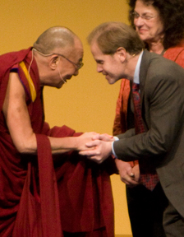
Changing your Brain.
Heart Mind Institute
Did you know your brain actually changes when you sit still for just minutes a day? It took 2,500 years and a few fMRI machines for the world to learn what the monks knew all along. (An fMRI machine scans and maps brain activity and changes.)
Here’s what the scans show: Meditation shrinks your fear response.
In a landmark Harvard study, Dr. Sara Lazar found that just 8 weeks of meditation reduced the size and reactivity of the amygdala — the part of your brain responsible for stress and fear. The result? A calmer baseline, not just during meditation, but all the time.
Meditation quiets mental noise.
Yale’s Dr. Judson Brewer discovered that meditators show decreased activity in the default mode network — the source of rumination, regret, and self-referential thinking. Meditation breaks the cycle of overthinking. Meditation boosts your emotional resilience.
Dr. Richard Davidson has shown in multiple studies that meditators recover more quickly from stress and emotional upset. Their fMRI scans show faster regulation and more balanced engagement of the prefrontal cortex — the brain’s command center for focus and decision-making. Meditation keeps your brain young.
Another Harvard study revealed more gray matter in key brain areas among meditators, including the hippocampus (memory), posterior cingulate (self-awareness), and TPJ (empathy). That means meditation helps you stay sharp and emotionally agile as you age.

Slide 10
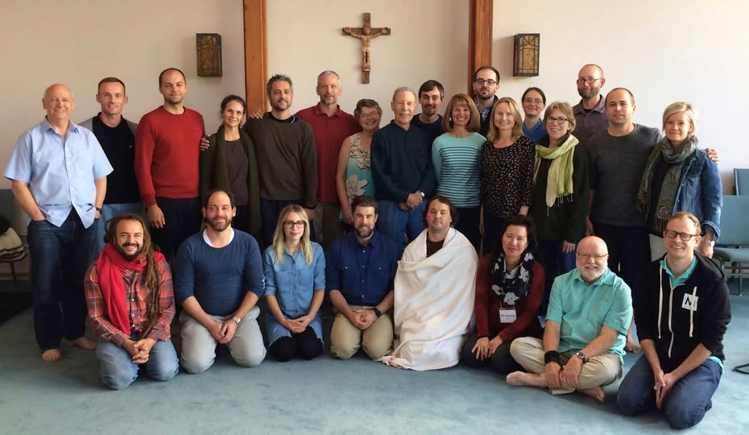
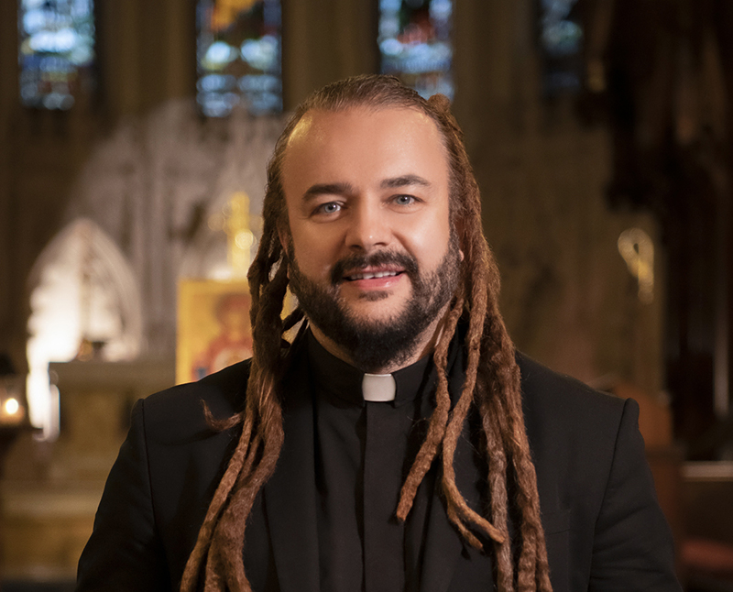
“For Christians, it is to be a kind of fifth Gospel: to become the word of God and to manifest God empty of self and full of God.” Thomas Keating, The Human Condition. p. ix (JEB: Jesus wants me for a sunbeam.)
When I re-discovered Father Thomas, for the first time, saw the brilliance of his teachings on Centering Prayer and receptive silence. Re-discovering his teachings changed everything for me, for within months, I was moved into a receptive way of being, where the gift of God’s presence began visiting me in unexpected times and places.
The practice of Centering Prayer was especially helpful in my work with unhoused youth on the streets of New York City, where I was able to understand that I needed to show up for street youth in the same way that I was showing up for prayer. My posture of receptivity allowed me to bear witness to the pain of the world in a new way. My being okay with putting all I knew aside and being in the state of contemplative not-knowing, helped me to not get in the way, so that the Divine could be the one who initiates action. Ultimately it helped me to understand that “prayer and activity are not enemies” and that our actions, especially actions for healing and justice, when done in this contemplative way can unite contemplation and action and become engaged contemplation. Adam Bucko, “Foreword,” Thomas Keating, God Is All In All; An Evolution of the Contemplative Spiritual Journey, posthumously published book of Keating’s talk given at the 2012 Annual Conference of Contemplative Outreach in Snowmass Colorado, p. xvii
Especially in the last couple of years of his life, sometimes one got a feeling that his joke, “I am trying to forget about myself,” had been realized, as there seemed to be very little left of ‘him.’ What was visible, instead, was a transparent frame through which the Holy Presence could shine…..May his words infuse you with courage to say “yes” to becoming God’s partner in transfiguring this world. p. xix
From the introduction: “The editors offer you our prayerful support as you consent ever deeper to the presence and action of God – dying to a limited separate-self sense and becoming deified in Christ. May you be blessed with grace in place of grace as your grow in humility to experience the grandeur of life and welcome it in all its many phases. May you be transformed in Christ for the greater good of all creation. We are not our own; we belong to everyone else.” p. xi
Bucko in The Mendicant (summer, 2025, CAC):The Christian contemplative movement started with Jesus withdrawing into solitude and then returning to live out what he saw and heard in that quiet place.

Slide 11
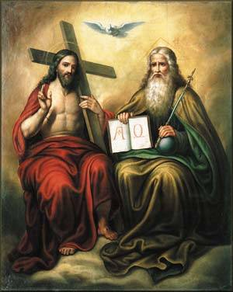
Away from a distant, male gendered being sitting up there in the heavens. “the consequences of an externalized deity that becomes replaced by ideological absolutes.” (Delio’s blog 3/20/26)
“Thomas Keating departed radically from the presentation of God we met in his earlier teaching. In the 1980s, when Thomas’s first books and videos were beginning to appear, God was still very much framed within the classic Western model. God was always “he,” a father figure, and Thomas’s initial focus during the earlier years of his teaching was to shift that image away from a fearsome father – the wrathful God who has caused so much misery and woundedness for Western seekers – to a “divine therapist”; supportive, trustworthy, and a hundred percent behind us in our journey of transformation.” Bourgeault, Thomas Keating, p. 68
“Now, at the end of the journey, Thomas is in a very different place. God coinheres, interpenetrates everything, the ocean-in-drop and drop-in-ocean constantly exchanging in a dance of endless fecundity. God is not the ‘author’ of creation, removed and overarching; the whole thing is God. There is not a single place in all creation where God is not, because God is creation itself, endlessly outpouring, endlessly receiving itself back.”
Bourgeault, Thomas Keating, pp, 68-69

Slide 12
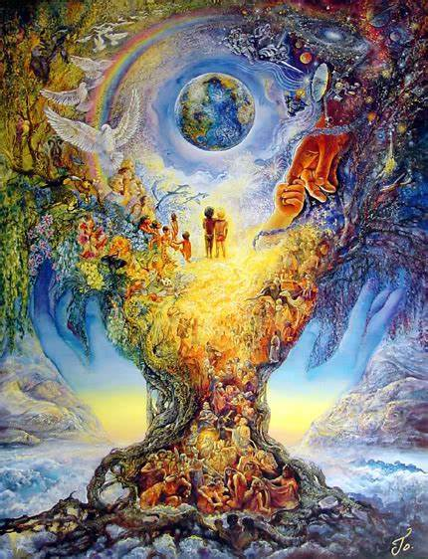
The whole thing is God. There is not a single place in all creation where God is not, because God is creation itself
This message: Each pixel of consciousness, each sentient life, adds to the fullness of manifest love. The Eternal Unmanifest is also gradually individuating. Our wee human journey has not been for naught. Nothing is forgotten or lost. resonates with all of Thomas’ teaching and his “steady encouragement to grow, risk the pain, trust in the ultimate goodness,” that all parts of his 75 monastic years had been offering up. This message is not only about us entering the journey of life but “the silence” that enters time, “during the ‘sufferings, fears and little deaths’ that are part of the burden of finitude and then returning to the Unmanifest bearing the transformed fruits of its temporary incarceration in time.” (Bourgeault, Thomas Keating, p. 67 (JEB: We AND the Silence, the whole, are made mysteriously “wholer” – ZOE. This is the essence of incarnation; the holy enters finitude.)
Our human journey from formlessness to form has three phases: 1) preexistence, 2) existence, and 3) postexistence. But “Where we come from is not where we ultimately wind up,” Thomas intriguingly implies.” We return from that life journey that includes “sufferings, fear, and little deaths we call our life is over in the blink of an eye and is “no longer to ‘the silence of pre-existence’ but to ‘eternal life.” p. 66 ( JEB’s Easter sermon about three kinds of life culminating in zoe life, a new form of life than ever existed before, abundant life, the kind of life Jesus brought back from the grave.”) It is a change in the “heart of divine reality,” Thomas suggests between the lines “As we work and struggle and gradually individuate, as we willingly ‘die our little deaths,’ incrementally the ocean enters the drop and comes to know itself not only in infinite oneness but in infinite particularity. p. 66
JEB: Absolutely every mini human event contains within it the macro infinite divine flow of oneness. Eternal life, zoe life is being realized in every suffering, pain, and death.

Slide 13
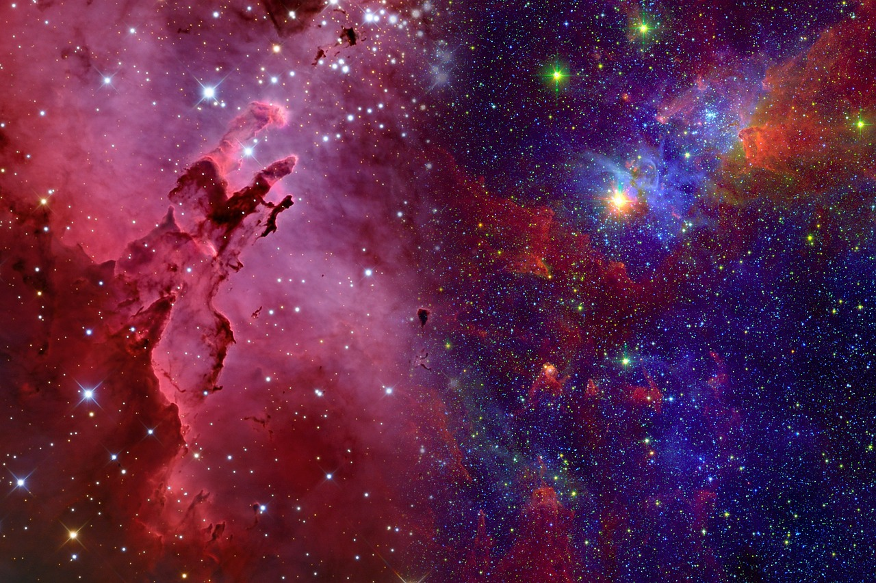
From the Divine Therapist to the sense of flowing oneness
“It is tempting to say that Thomas’s understanding of God evolved dramatically over the last thirty years of his life, and while I think that is largely true, it is not unqualifiedly so. Even in his earliest writings there are already passages that fully anticipate the sense of flowing oneness emerging from these late texts. (Richard Rohr, “Buddhism, Hinduism, Sufism, Indigenous, and Christianity—all religions—oneness is their nature. Amen.” [1] Thomas Keating, Fr. Thomas Keating’s Last Oracle (Contemplative Network: 2020), transcription (October 2018), YouTube video.)
And to the very end of his life … his fondness for that benevolent father figure did not desert him and even remained part of both the anguish and the sweetness of his final transformation. So, while there is indeed a steady evolution toward a more unitive and nontheistic presentation of God, it may come closer to the truth of the situation to say that Thomas had become theistically bilingual; he could speak of God in either language, or in none..’” pp 69
“On the whole, however, it can be said that the poems in The Secret Embrace are situated solidly at the unitive, nontheistic end of the spectrum. With two singular exceptions, Thomas does not actually use the word ‘God’ anywhere in this entire collection. It is always ‘the Divine,’ ‘I AM,’ or ‘the source.’ He clearly did not want the cosmogonic spaciousness of what he was trying to unfold here co-opted back into conceptions of a distant, male gendered being sitting up there in the heavens. His eyes were on the bigger picture – the maximum bigger picture – not simply ‘the source of all creation’ but the ‘infinite transcendence’ enveloping it.” Bourgeault, p. 69

Slide 14
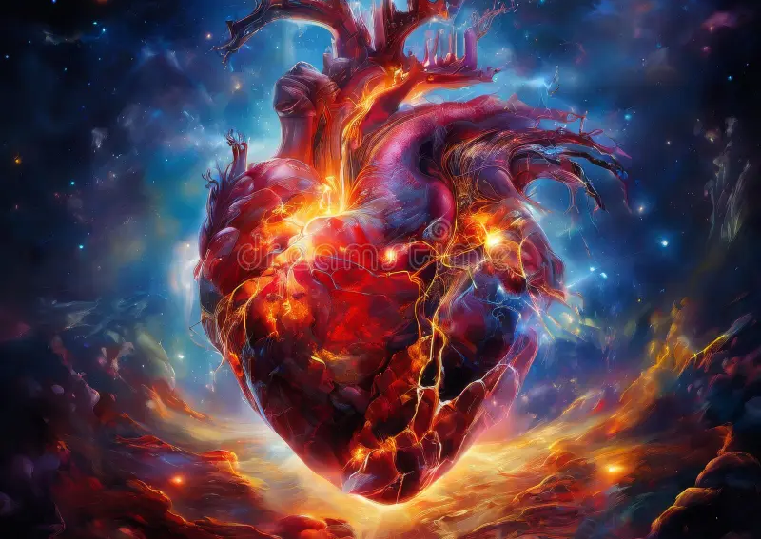
A cosmology that matches the size of what his cosmic heart had intuited
New consciousness reflected new images for divinity. “His use of gender-neutral, transpersonal terms expanded markedly: ‘the Absolute,’ ‘the Source of All That Is,’ ‘the Creator of All,’ ‘Ultimate Reality,’ ‘the Source,’ ‘the Divine,’ ‘Presence,’ ‘Isness.’
“And as his own interior life grew steadily more spacious and unboundaried, he delved even more deeply into the new cosmological models, whose sheer vastness and dynamism offered congenial new ways of imaging what he had already tasted inside. (p. 160) Increasingly, he found himself bumping up against the walls of the old ‘flat earth’ cosmologies on which so much of traditional Christian theology is based.” (p. 160)
He addressed the 2012 Contemplative Outreach annual conference (which became is 2019 book God is All in All), saying, “People cannot be expected to be impressed with belief systems that rely on a cosmology that everybody knows does not exist.” Like so many contemporary Christian mystics – Teilhard de Chardin, Beatrice Bruteau, Ilia Delio – he walked boldly into these new scientific waters in search of a cosmology that would match the size and the scale of what he had already intuited in his own cosmic heart. Science became more and more for him an authentic revelation of God. p. 161

Slide 15
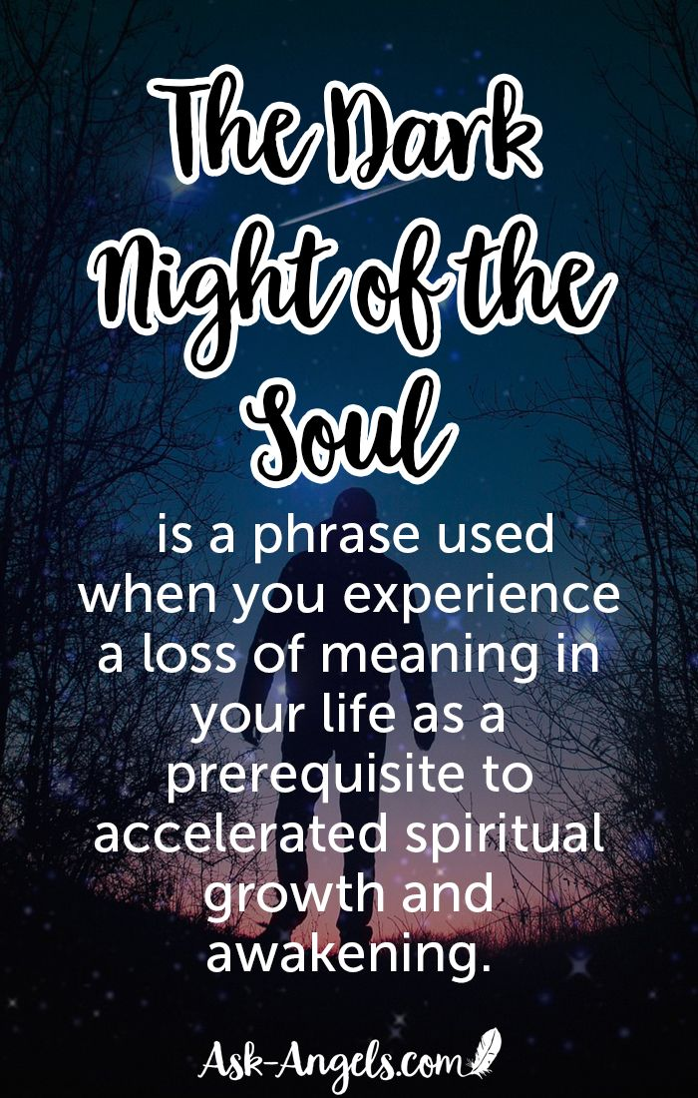
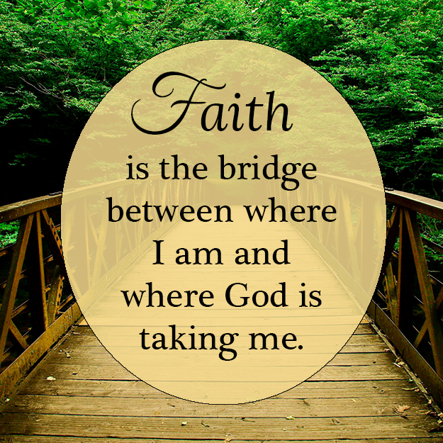
The "Relentless Stripping” away (often very painful) of “the God we thought was God” and who “no longer exists” so that you’re on the other side of the bridge where there is “boundless, bare presence”.
When all symbols, rituals, and former provisions of stability, consistency, even beauty and adoration are seen as “in the way of the bare presence….” p. 75
“When the mind is no longer processing the world through subjects and objects, symbols lose much of their force as connective links. They’re still a bridge, but you are already standing on the other side.” p. 75
“If there is a faint lining of hope in this relentless stripping, it comes in the very last line of the poem, in Thomas’s quiet recognition that it is not God who no longer exits – only ‘the God I thought I knew.’ There is a quiet visceral conviction that, like the earlier privation in the dark night of sense, this is merely about removing another layer of veils. Beneath the veils, the substance still holds. His disillusionment is not of the kind where one picks up one’s marbles and walks away.” p. 75
Keating is aware that “his concept of love is shifting from emotional reciprocity to something far more unconditioned, closer to what St. Paul once called living ‘by faith alone.’…this is a whole new territory, which neither his heart nor his mind can yet fathom, but which has his full attention.” p. 76
Note: JEB: walking by faith (entrustment) not by sight (human logic and understanding)? 2 Corinthians 5: 7
Keating’s “vulnerability and tenderness sear your heart. Beneath the bleak landscape of pain, however, you can also sense that something is starting to fill in. Barely, but yes. It peeks out from behind that presence-absence dialectic.” p. 77
In Poem 4, “It’s about abiding in the desolation until our eyes adjust to the dark and your spiritual night vision kicks in…. He is already beginning to realize that what he formerly called ‘absence’ is indeed a new and more subtle form of presence; with sturdy trust he commits himself to that unfolding….standing by …until what for now still registers as heartbreak begins to reveal itself – in the powerful words of poet T. S. Eliot – as ‘a further union, a deeper communion.’”(“East Coker” from Four Quartets) p. 78

Slide 16
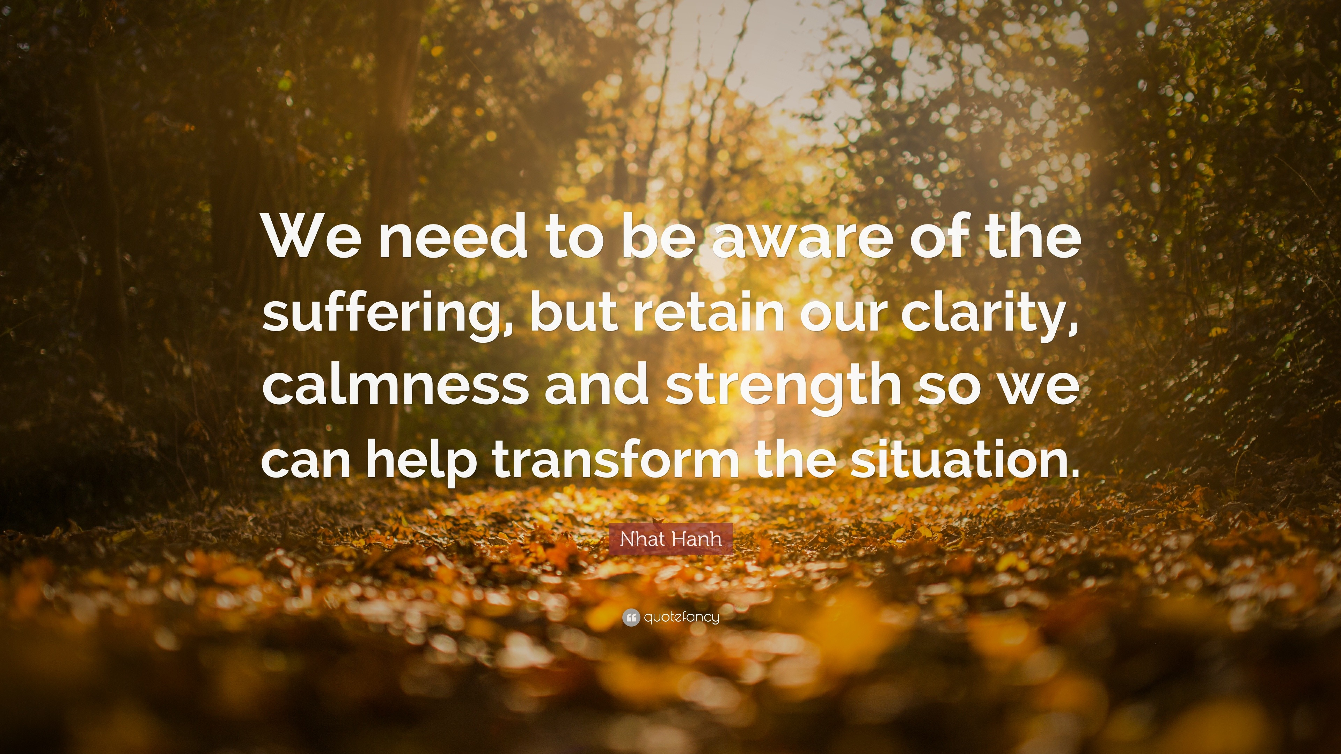
Christ Consciousness in Suffering (the third Christic touchpoint) and final clarity.
In January 2018, Thomas began to be racked with mysterious, agonizing pain that not only ended his mobility but also shattered the silence of his interior prayer. He immediately pivoted to processing this ordeal as “sharing in the suffering of Christ,” a well-worn path that has been followed by many other Christian mystics, but in his case a surprising return to a more traditional form of Christian piety. Isabel Castellanos kept careful summaries of her periodic phone calls with her friend, Thomas. On February 21, 2018, she wrote, “He knows his vocation now is to suffer identified with the passion of Christ and he is happy to live that vocation.” p. 202 He deteriorated such that he was flown on March 26, 20218 from Colorado monastery back to Massachusetts monastery where the infirmary was far better equipped to deal with his need.
On October 12, 2018, two weeks before his death, he requested assistance to sit upright in his bed after four days of what appeared to be a deep coma. He delivered his final message over the course of 11 minutes.
Dear friends: In the universe, an extraordinary moment of civilization seems to be overtaking us. Through the great discoveries of science and spirituality, we find ourselves in essentially a new and different place than ever before in history. It’s a time of enormous expectancy and possibility. We are called to start — not with the old-world contracts, now that we know that they are all lies — but [with] what we know as the truth as proved by silence and science. So I call upon the nations to consider this as a possibility: that we should begin a new world with one that actually exists. This is the moment to manifest this world, by showing loving concern for poverty, loving appreciation for the needs of the world, and opportunities for accelerated development. We need to find ways to make these really happen. I make this humble suggestion, that now arms-making is of no significance in the world. It hinders its progress. This will allow and offer the world the marvelous gift of beginning, [of] creating, of trusting each other, of forgiving each other, and of showing compassion, care for the poor, and putting all our trust in the God of heaven and earth. I leave this hope in your hands and hearts, coming as a real inspiration from the heart of God. What does [God] care about who has this or other lands, when the power to begin with the truest history is coming from religion as expression of the Source that has been realized for centuries? Buddhism, Hinduism, Sufism, Indigenous, and Christianity — all religions — oneness is their nature. Amen. p. 206

Slide 17
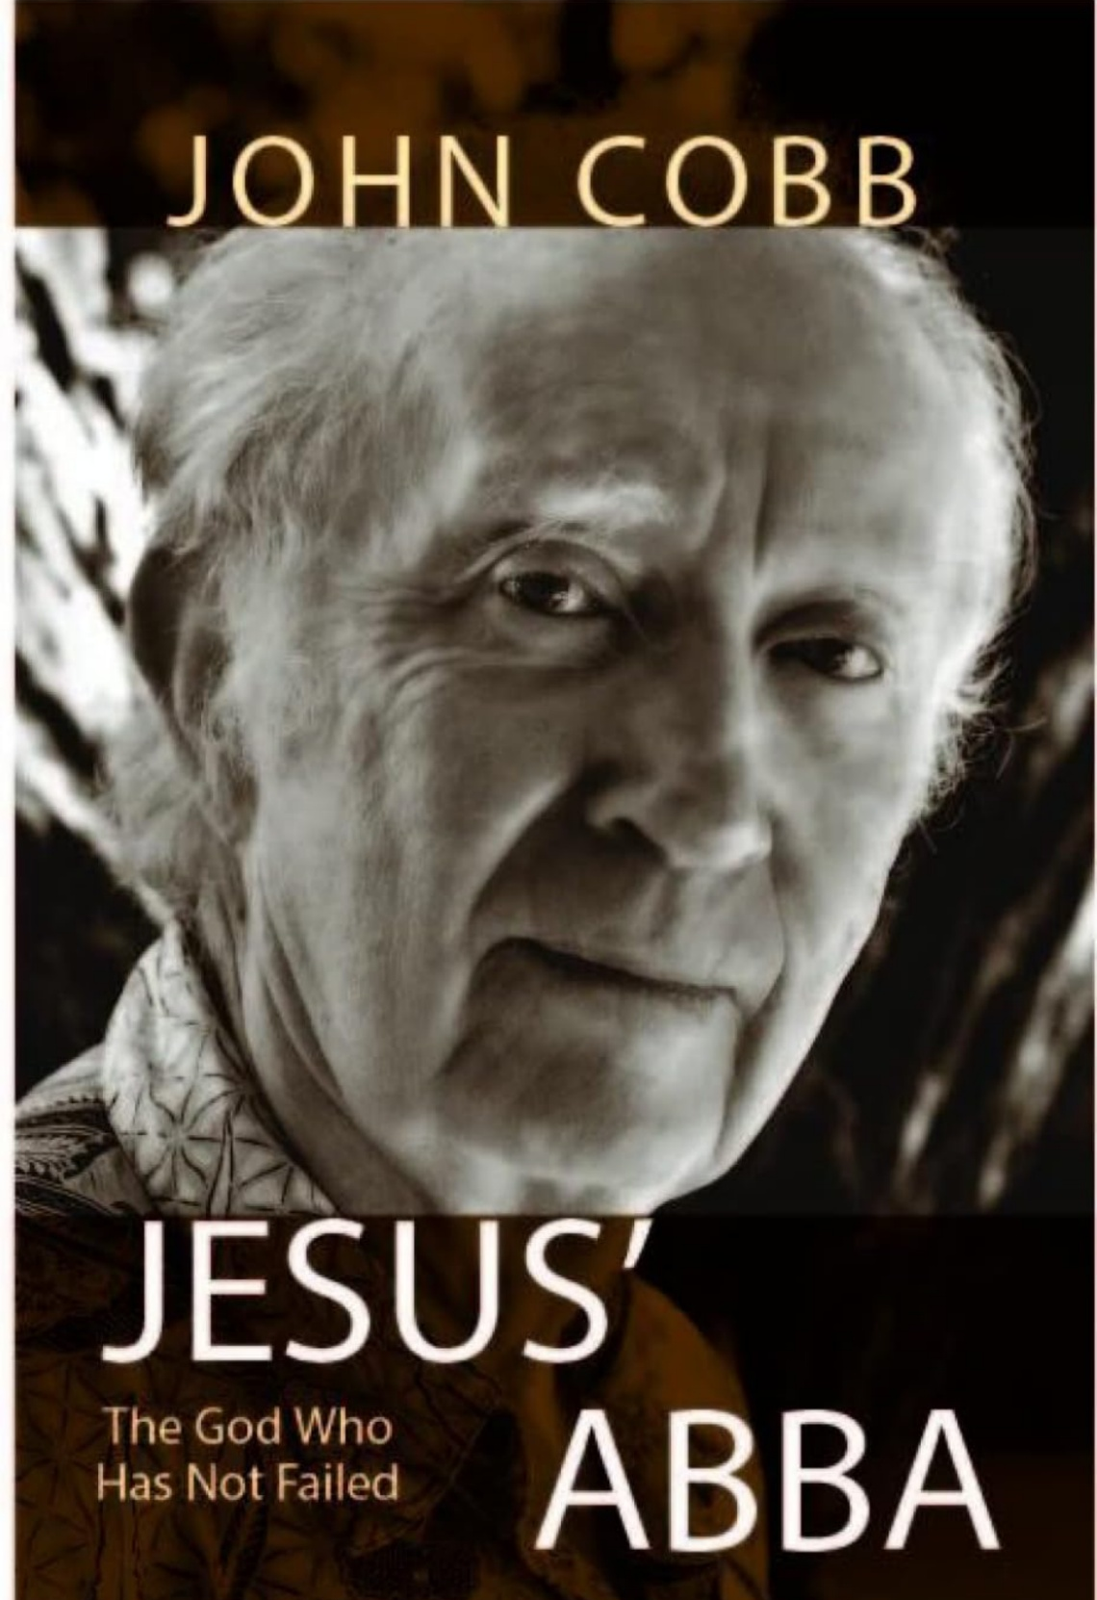
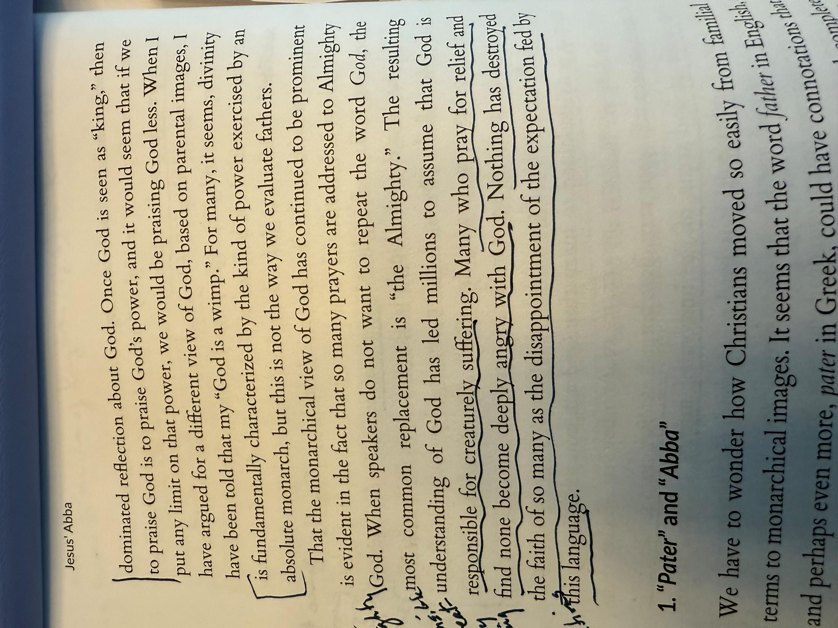
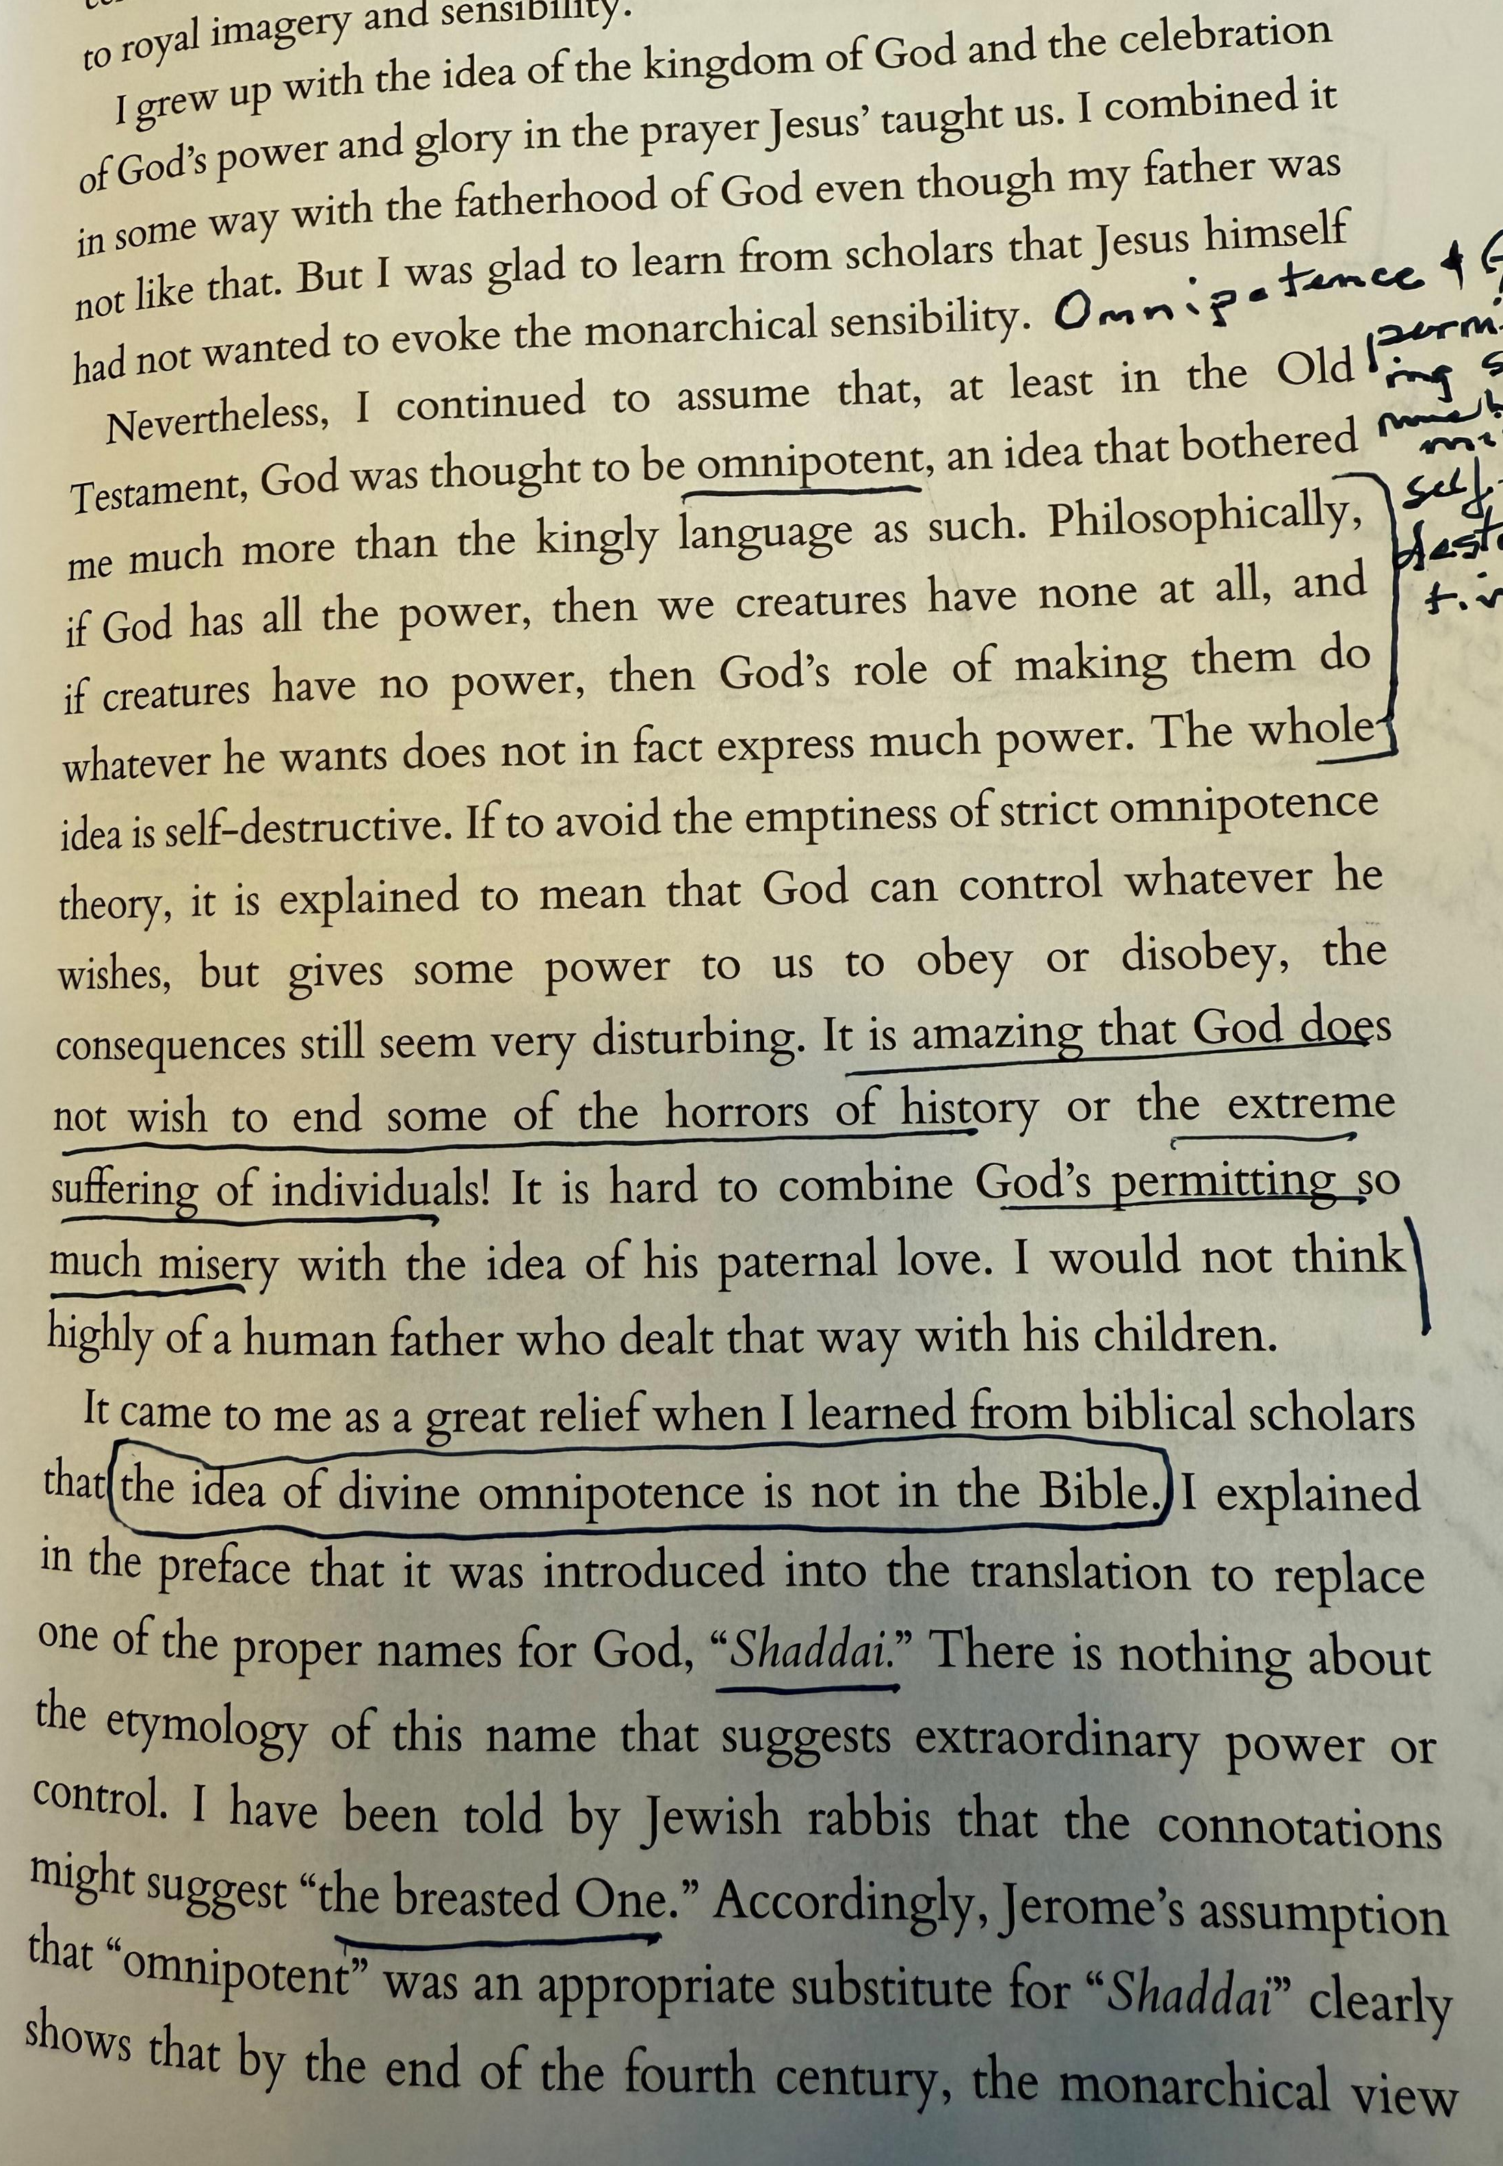
Nothing has destroyed the faith of so many as the disappointment of the expectation fed by the language of “Almighty God.”
The monarchical view of God or the parental view of God. God is not responsible for creaturely suffering.

Slide 18
“We need to keep in mind that the Chistian tradition, especially since the Reformation, has focused on doctrinal differences between the denominations rather than on the spiritual journey itself and actually practicing the contemplative dimension of the Gospel.” Keating, That We May Be One, p. 1 Richard Hauser: two models of Spirituality. Western Model of Spirituality and Scriptural Model of Spirituality.
“The Western Model is based on seeing Christian spirituality as the self-outside-of-God. The Christian mystics, from Pseudo-Dionysius, The Cloud of Unknowing, Ruysbroeck, Eckhart and the Dominicans, the Beguines of the 13th century, taught they self I in God.
Thus, there is a basic conflict in Christianity itself. In the last several hundred years priests have rarely been taught about the contemplative dimension of the Gospel or the Christian mystical tradition. The most they could usually find in a university or a seminary was the history of Christian spirituality.
In scriptural spirituality we are to become a sacrament of the presence of God. This presence in not a Sunday affair. It’s not a goodnight prayer, or a wakeup prayer. It’s all the time. That is the goal of the Christian life as laid-out in the Gospels. We are in God and our actions are to be motivated by the Spirit’s movement, inspiration, and guidance within us into oneness with the Trinity. P. 2
The Western Model of God-out-side-of-self describes a relationship that is at odds with the Gospel teaching. Until the beginning of the Second Vatican Council we rarely heard the doctrine that we are in God and that God is in us. This led to the idea, especially in Protestant circles, that God really was displeased with us.
The Scriptural Model acknowledges our sins but says very clearly that Christ has come to take them away and to unite us with himself. We cannot possibly exist without God being in us since God is everywhere. Although theology taught this doctrine in the Middle Ages, it was the mystics who took it seriously and grasped what it meant.
Here are some of the symptoms of the Western model of Spirituality: We initiate our good efforts and God rewards. Thus, we have an image of God sitting in the bleachers of an area watching our activities. If they are good, it’s thumbs up! If they are not, it’s thumbs down. Grace in the Western Model enables us to build-up rewards in Heaven, as long as we keep earning them through our good works. P. 3
There is a basic conflict in Christianity itself: God outside of self and God is in us and we are in God.

Slide 19

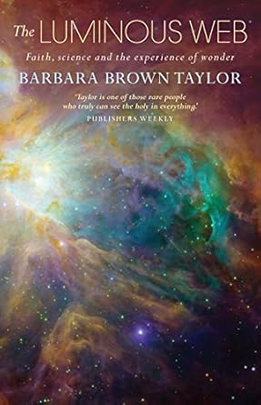
There is nothing that is not God
There is nothing that is not God. Everything in this world – every quark, atom, dust speck, heartbeat – quivers with the presence of God and is the presence of God. There is nothing but God goes the Sufi dervish’s La ilaha illallah.
That is the fourth dimension in Keating’s poem “The presence of God should become a kind of fourth dimension to all of life.” The fourth dimension kicks in when one suddenly grasps the whole thing as alive and vibrantly “one,” a single living sacrament reemerging in every nanosecond from the even engendering wellspring of God. Keating, p. 100.When the eye of the heart starts to open, a different vision of reality (JEB: consciousness? Mind of Christ?) becomes possible. Seeing from oneness doesn’t mean ‘It’s all one’ – no particularity, no differentiation. Rather, it means that all those individual bits and pieces are now suffused and harmonized within a greater whole, like light pouring through the individual shards of glass in a stained glass window. God is not simply the light but the entire stained glass window illuminated by the light, radiant in this dance of the formless with form. 101 (JEB: this is very different from turning your back on this sin-ridden world and directing your gaze only heavenward – dualistic consciousness, either/or mode of thinking). P. 100
In a memorable passage in her book, The Luminous Web, Episcopal priest and writer Barbara Brown Taylor describes this heart-awakening epiphany in her own life. Speaking of the radical shift in her image of God brough about by her exposure to quantum physics, she writes. p. 101) (See next slide for quotation)

Slide 20
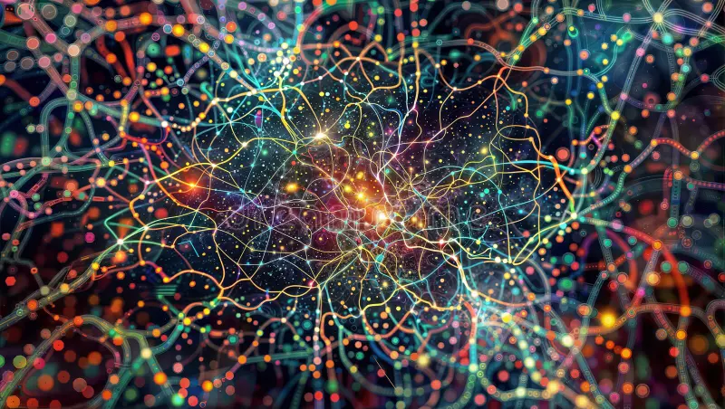
God is the unity.
There is only One.
This does not sound like the self-identification of a deity who stands over reality and sometimes stirs it with a stick. Instead, it sounds like the singular utterance of the only One who ever was, is or shall be, in whom everything else abides. For the moment, we see through a glass darkly. We live in the illusion that we are all separate "I ams." When the fog finally clears, we shall know there is only One.
Where am I in this picture? All over the place. Up there. Down here. Inside my skin and out. Large compared to a virus and small compared to the sun, with a life that is permeable to them both. Am I alone? How could I ever be alone? I am part of the web that is pure relationship, with energy available to me that has been around since the universe was born.
Where is God in this picture? All over the place. Up there. Down here. Inside my skin and out. God is the web, the energy, the space, the light -- not captured in them, as if any of those concepts were more real than what unites them, but revealed in that singular, vast net of relationship that animates everything that is.
It is not enough for me to proclaim that God is responsible for all this unity. Instead, I want to proclaim that God is the unity -- the very energy, the very intelligence, the very elegance and passion that make it all go. This is the God who is not somewhere (up there, down here) but everywhere, the God who may be prayed to in all directions at once. This is also the God beyond all directions, who will still be here (wherever "here" means) when the universe either dissipates into dust or swallows itself up again. Paul Tillich's name for this divine reality was "the ground of being." The only thing I can think of that is better than that is the name God revealed to Moses: "I Am Who I Am."
Barbara Brown Taylor, The Luminous Web.
Physics and Faith: The Luminous Web – Religion Online
Religion Online
Physics and Faith: The Luminous Web
by Barbara Brown Taylor This article appeared in the Christian Century, June 2-9, l999, pp 612-619. Copyright by the Christian Century Foundation and used by permission.

Slide 21

One God who is above all and through all and in all. Ephesians 4: 4-6
This is a very different picture of divine sovereignty than the one most of us were raised on. In the classical scheme, God is indeed above all, with a throne so high it cannot even be seen from this earth. The throne room is in heaven, which for most people is way up and out there somewhere. God sits above creation, above time, above space, above us. But we come next! As creatures made in God's image, we claim our own sovereignty, which places us above the rest of creation (with disastrous results, I might add). We sit above animals, trees, rocks, earth. This is a pyramid-shaped scheme, in which beings are ranked from greater to lesser with all the power on the top.
But what about the rest of that phrase from Ephesians? What about God who is not only above all but also through all and in all?
When I am dreaming quantum dreams, the picture I see is more like that web of relationships--an infinite web, flung across the vastness of space like a luminous net. It is made of energy, not thread. As I look, I can see light moving through it like a pulse moving through veins. I know the light is an illusion, since what I am seeing moves faster than light, but what I see out there is no different from what I feel inside. There is a living hum that might be coming from my neurons but might just as well be coming from the furnace of the stars. When I look up at them there is a small commotion in my bones, as the ashes of dead stars that house my marrow rise up like metal filings toward the magnet of their living kin.
Barbara Brown Taylor, Physics and Faith: The Luminous Web – Religion Online
Once, during a discussion between John Wheeler and Richard Feynman, two great physicists, Wheeler said, "Feynman, I know why all electrons have the same charge and the same mass."
"Why?" Feynman asked.
"Because they are all the same electron!" Wheeler replied.
The writer of Ephesians put it like this: "There is one body and one Spirit. . . one Lord, one faith, one baptism, one God and Father of all, who is above all and through all and in all" (4:4-6).

Slide 22
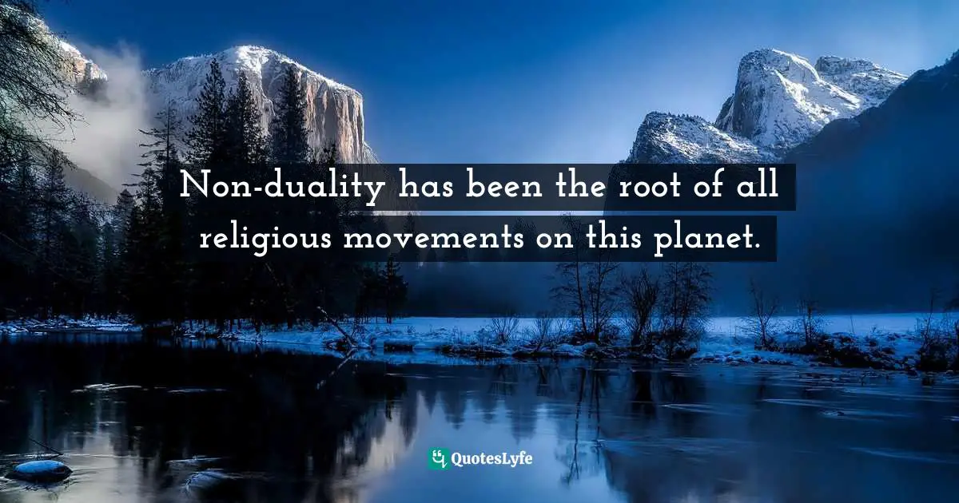
Once you arrive a “the unitive state,” or a “transforming union,” there’s still more to the journey: “UNITY CONSCIOUSNESS” or “NONDUALITY,” conferring the capacity to be directly in relationship with “that aspect of God that is un-manifest.”
Keating begins to speak about what he calls “unity consciousness,” which he describes as “as further development of consciousness beyond the transforming union. Broadly speaking it equates closely to what most of the interspiritual world would call “nondual consciousness” or “nonduality.”…But Keating says that “when fully activated, it confers the capacity to be directly in relations with “that aspect of God that is un-manifest.” Thomas Keating, Reflections on the Unknowable, p. 148
The night of self takes us there: “Being aware of ourselves and of God is a kind of duality.” “Even in the transforming union we are still two.” “the ultimate consciousness is the total oneness in which God is all in all.” Keating, That We May Be One, p. 54, 43
The Unmanifest is not higher, truer, more intrinsically holy than the manifest; they are interwoven aspects of the same oneness.. P. 139
Love requires both realms – manifest and unmanifest, “the source of all creation” and “infinite transcendence” __ in order to fully realize its own fullness. This is the “hidden purpose” of Ephesians 1:9 (God thought of everything, provided for everything we could possibly need, letting us in on the plans God took such delight in making. God set it all out before us in Christ, a long-range plan in which everything would be brought together and summed up in Christ, everything in deepest heaven, everything on planet earth.) It is a dance of love. Ultimately winding up not in no self but in true self, recognized as the flowing oneness it has always been. P. 141
The total oneness in which God is all in all

Slide 23
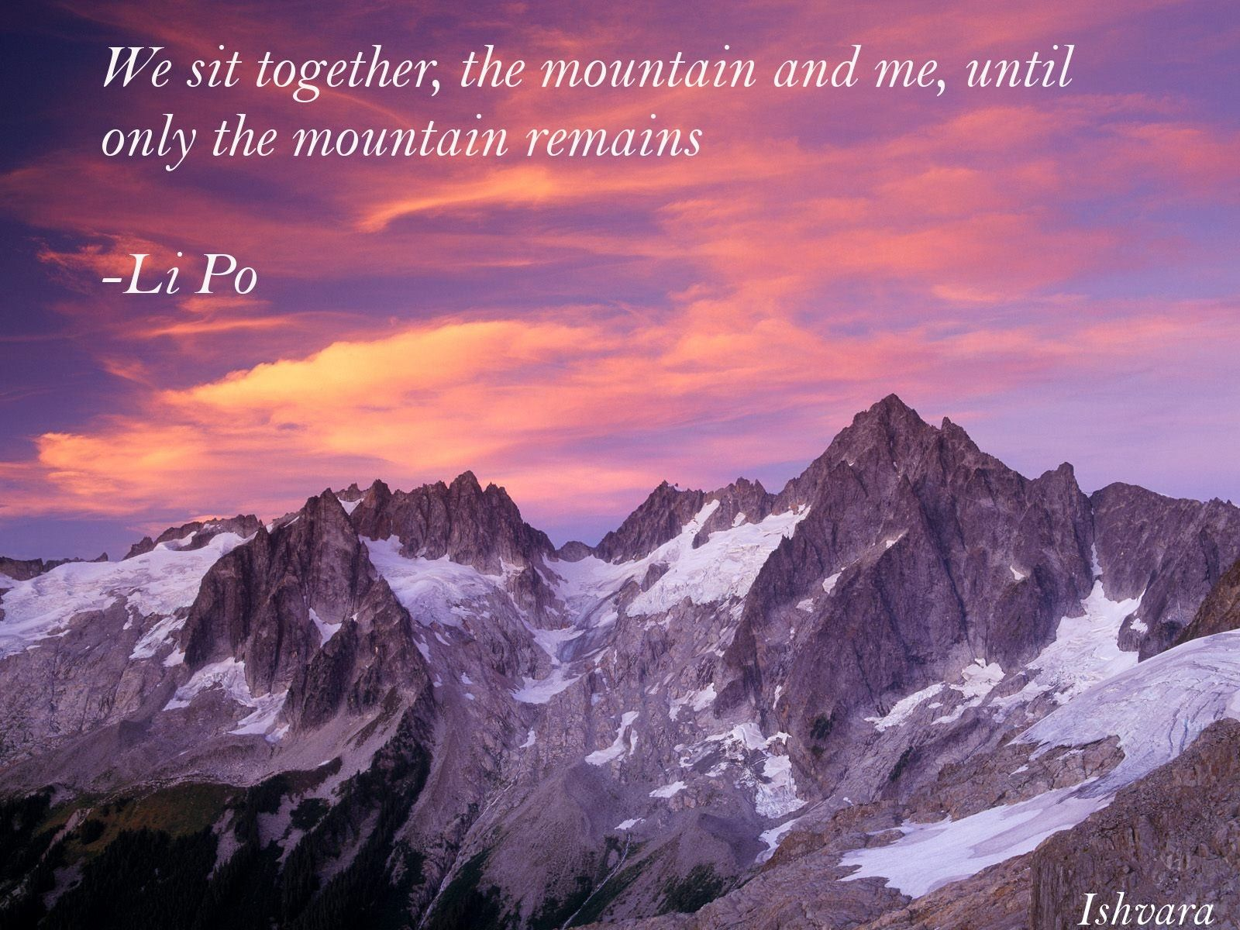
God coinheres interpenetrates everything; the whole thing is God; the sense of flowing oneness
“Now, at the end of the journey, Thomas is in a very different place. God coinheres, interpenetrates everything, the ocean-in-drop and drop-in-ocean constantly exchanging in a dance of endless fecundity. God is not the ‘author’ of creation, removed and overarching; the whole thing is God. There is not a single place in all creation where God is not, because God is creation itself, endlessly outpouring, endlessly receiving itself back.”
Bourgeault, Thomas Keating, pp, 68-69
Even in his earliest writings there are already passages that fully anticipate the sense of flowing oneness emerging from these late texts. Pp 69
“On the whole, however, it can be said that the poems in The Secret Embrace are situated solidly at the unitive, nontheistic end of the spectrum. With two singular exceptions, Thomas does not actually use the word ‘God’ anywhere in this entire collection. It is always ‘the Divine,’ ‘I AM,’ or ‘the source.’ He clearly did not want the cosmogonic spaciousness of what he was trying to unfold here co-opted back into conceptions of a distant, male gendered being sitting up there in the heavens. His eyes were on the bigger picture – the maximum bigger picture – not simply ‘the source of all creation’ but the ‘infinite transcendence’ enveloping it.” Bourgeault, p. 69
Richard Rohr, “Buddhism, Hinduism, Sufism, Indigenous, and Christianity—all religions—oneness is their nature. Amen.” [1] Thomas Keating, Fr. Thomas Keating’s Last Oracle (Contemplative Network: 2020), transcription (October 2018), YouTube video.

Slide 24
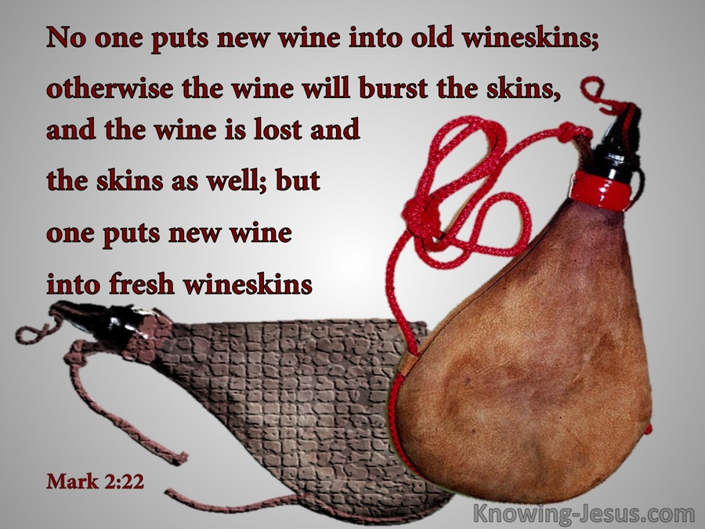
Let go of old wineskins to follow nondual flowing oneness into the world
Keating outgrew Christianity but not in the sense of rejecting it for a better form of religion, simply in the sense of having outgrown all need for form whatsoever…. The two intersecting lines, presence and kenosis, were what defined the field of Thomas’s mystical and nondual Christianity and what made it, to the end, a Christ-infused path…in the end it is a both/and; he both outgrew Christianity and he carried it right along with him, to new places…He did not abandon Christianity but steadily universalized it, expanded its nondual fluency, and prepared it to assume a more mature and spiritually enlivened role in the quantum leap of consciousness that our one human family must now somehow make together or else shatter into jagged, bitter fragments of ‘me, myself, and mind.’ (what many refer to as identity ideologies or positions) pp. 207-208
My deepest hope in writing this book is for [others] be prepared if needs be to let go of even the precious spiritual legacy he so carefully entrusted to our safekeeping to follow the scent of his flowing oneness straight into the heart of the world – and the heart of God.” p. 208
“Therefore, if any are in Christ, they are a new creation. The old has passed away; behold, the new has come.” 2 Corinthians 5:17 Luke 5:33-38; Romans 6:14; 2 Corinthians 5:17; Ephesians 4:24; Revelation 21:5; Romans 7:6; Luke 5:33-38; Matthew 9:14-17, Mark 2:21-22, and Luke 5:33-39.

Slide 25
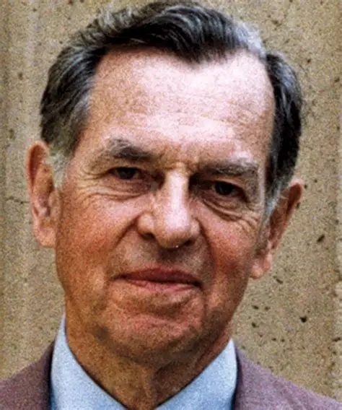
Have a Sacred Place. Bring forth who you are and what you might be.
“You must have a room, or a certain hour or so a day, where you don’t know what was in the newspapers that morning, you don’t know who your friends are, you don’t know what you owe anybody, you don’t know what anybody owes to you. This is a place where you can simply experience and bring forth what you are and what you might be. This is the place of creative incubation. At first you may find that nothing happens there. But if you have a sacred place and use it, something eventually will happen.”
― Joseph Campbell, The Power of Myth

Slide 26
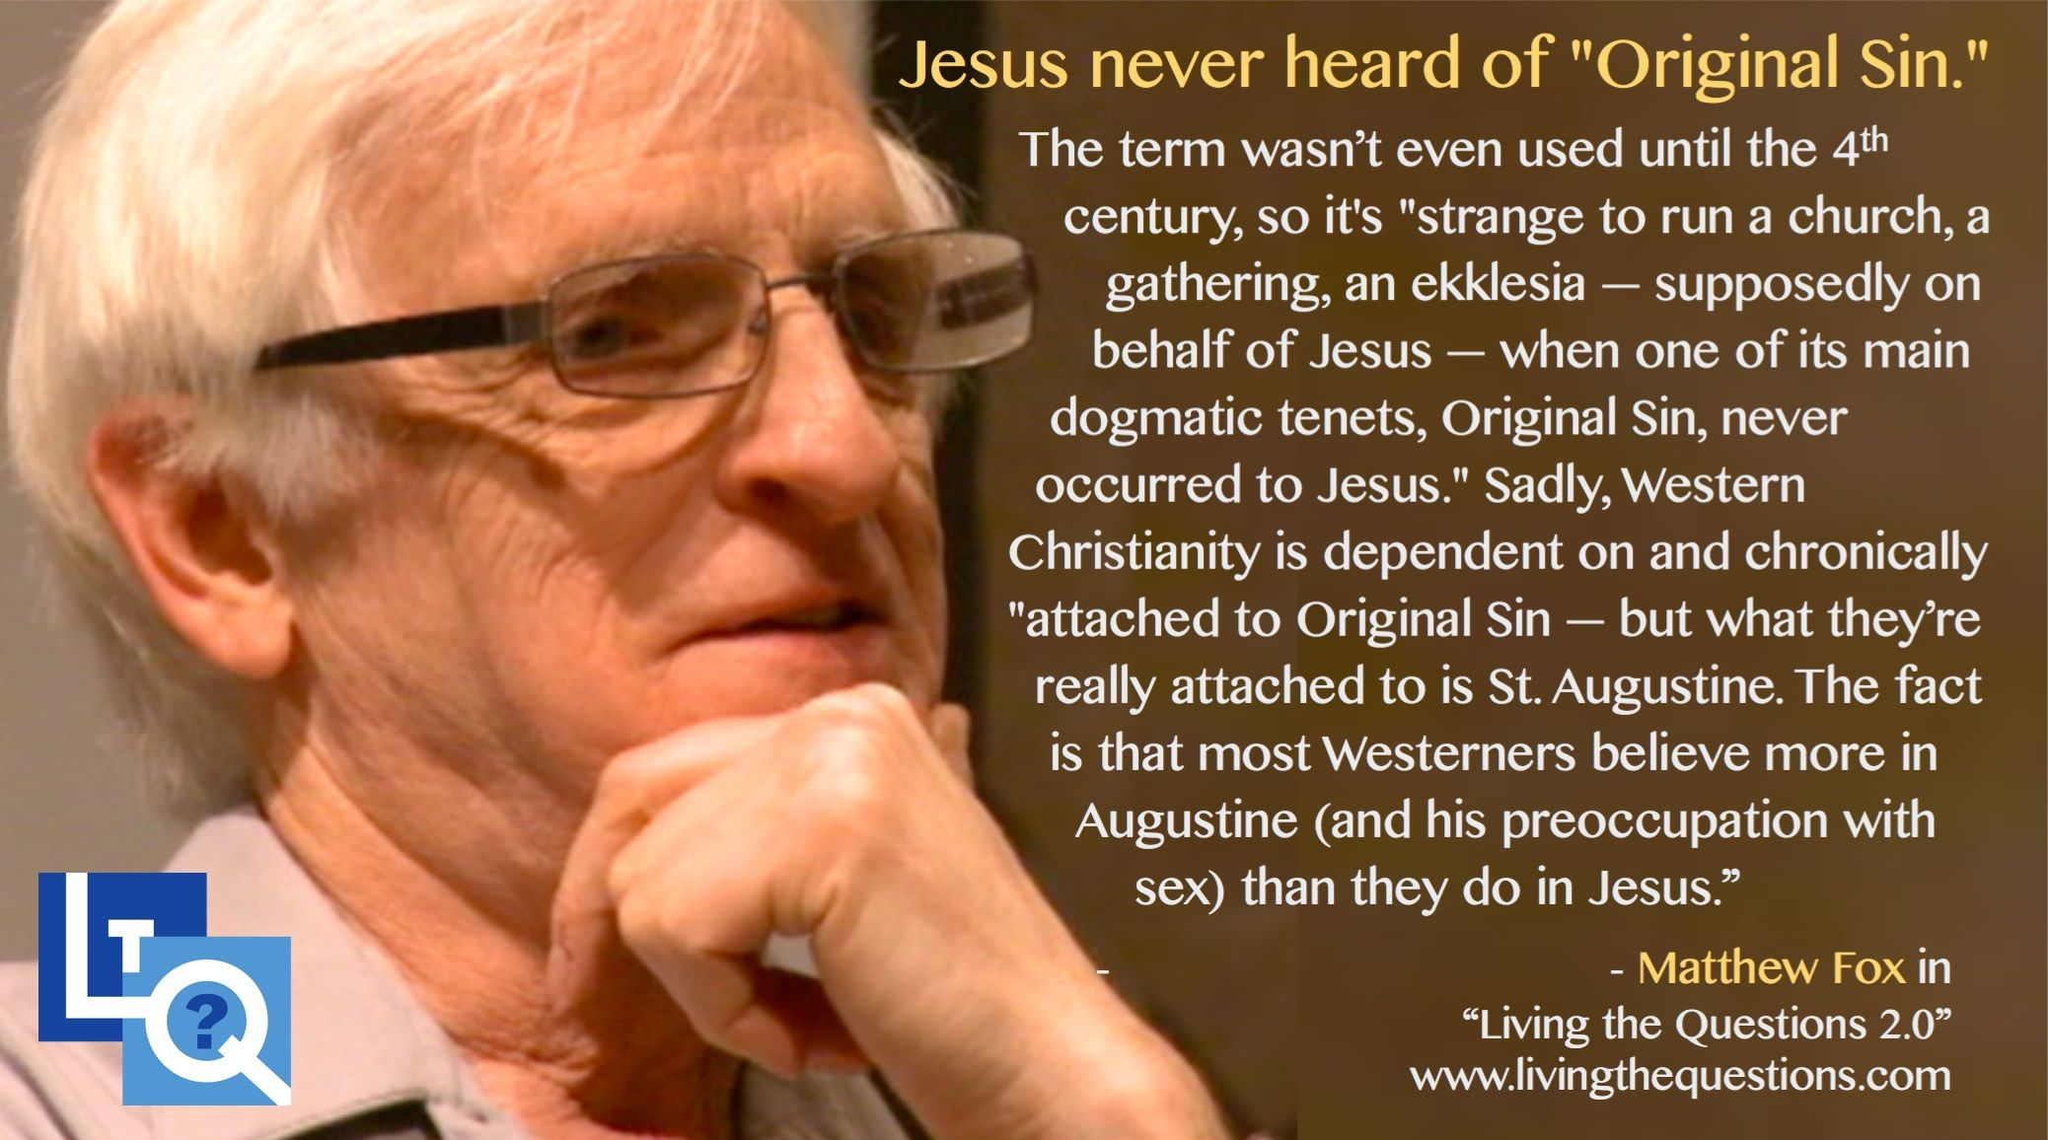
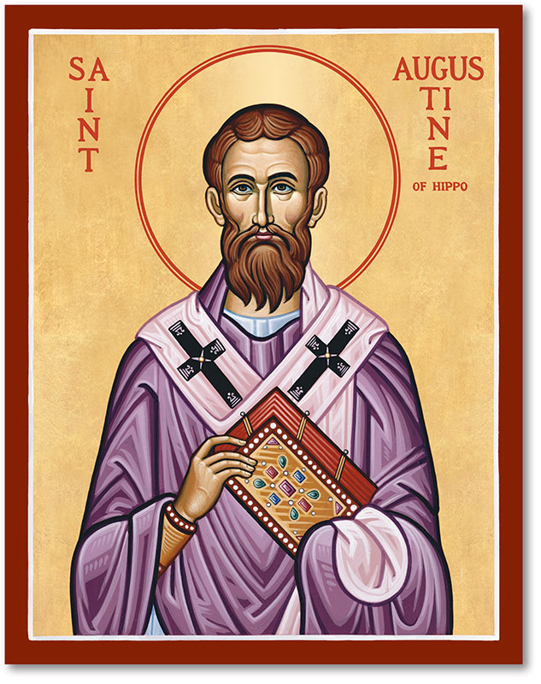
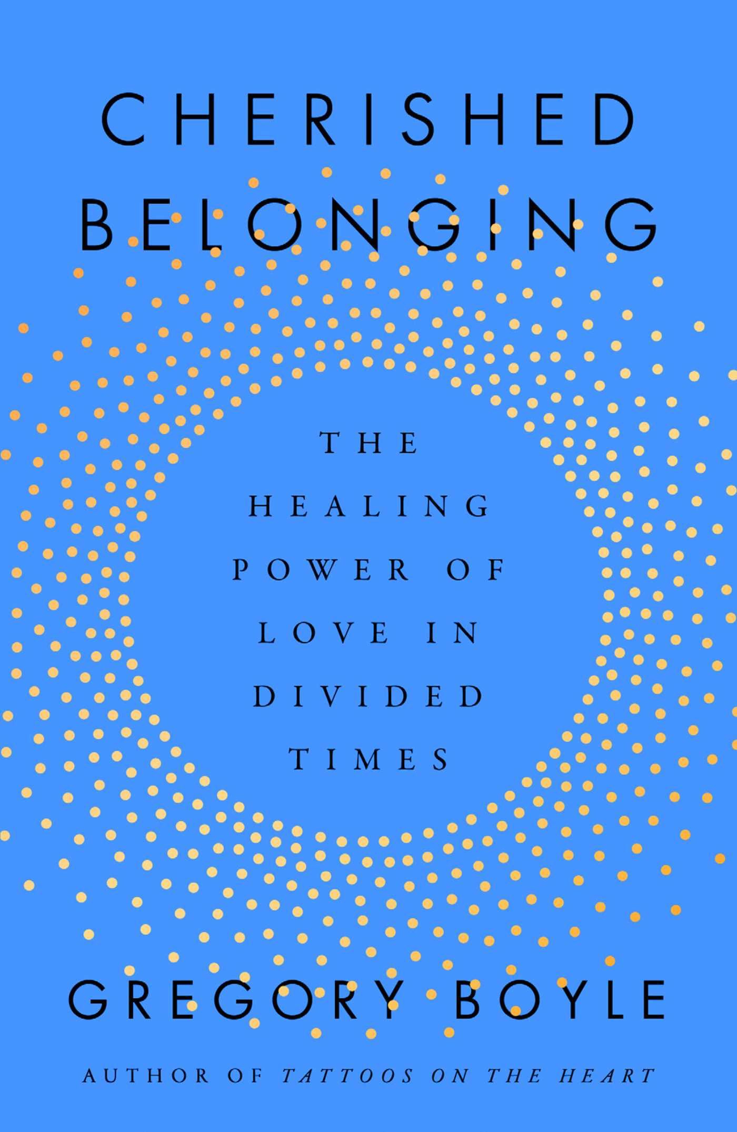
*Original Sin?
The specific doctrine of original sin was developed in the 2nd century struggle against Gnosticism by Irenaeus of Lyons, and was shaped significantly by Augustine of Hippo (354–430 AD), who was the first author to use the phrase "original sin". Influenced by Augustine, the Councils of Carthage (411–418 AD) and Orange (529 AD) brought theological speculation about original sin into the official lexicon of the Church.^{[5]} Matthew Fox and Original Sin
Matthew Fox's work on Original Blessing challenges the traditional Christian doctrine of Original Sin, which he believes has been misapplied to justify the actions of empire-builders. Instead, Fox advocates for a theology that emphasizes the inherent goodness and interconnectedness of all creation. His approach combines mystical theology with an activist's vigor, advocating for a more positive and inclusive spirituality. Fox's work has been influential in the modern reimagining of Christian thought, primarily through his articulation of Creation Spirituality. Center for Action and Contemplation
Fox's belief in Original Blessing is rooted in the idea that the sacredness of creation and our role in it is a starting point for a spiritual journey that celebrates beauty, compassion, justice, and creativity. His work has been translated into 68 languages and has sold millions of copies, attracting a diverse following. Daily Meditations with Matthew Fox
Fox's conflict with the Catholic Church over his questioning of the doctrine of Original Sin led to his expulsion from the Dominican Order in 1993. Despite this, he continues to inspire a broad audience with his teachings on justice, compassion, and ecological mindfulness.
“We are all unshakably good.” Fr. Greg Boyle.

Slide 27
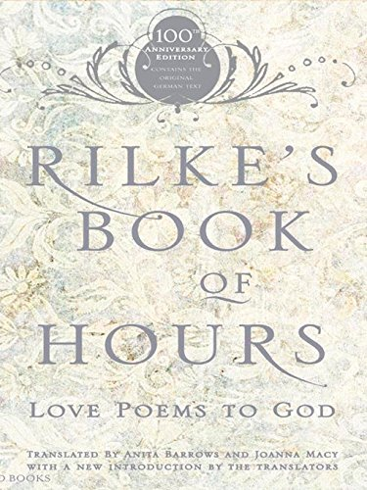
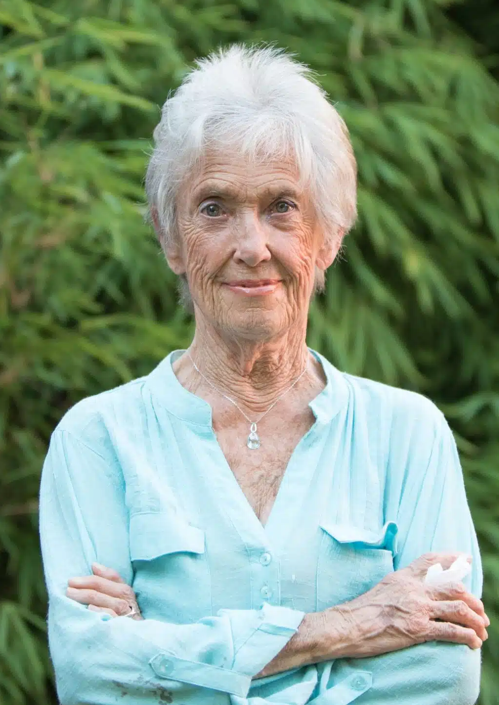
Joanna Macy 1929-2025
When I read, “I live my life in widening circles”… something immediately rearranged in the furniture of my mind.
I live my life in widening circles
that reach out across the world.
I may not complete this last one
but I give myself to it.
I have been circling around God, that primordial tower.
I’ve been circling for thousands of years
and I still don’t know: Am I a falcon,
a storm, or a great song?
She told Tippet of the encounter with the poem: "I identified completely with it, and I saw — it was just eight lines in that poem — that it could redefine that I was on a spiritual path, that because I wasn’t on the linear road, up the ladder, up Jacob’s ladder to get closer to God, that God had been there all the time, and I was orbiting around him, and that it had been happening, actually, for thousands of years."
Macy was the root teacher of The Work That Reconnects. Her books include Active Hope and four volumes of translated works of Rainer Maria Rilke, together with Anita Barrows: Rilke’s Book of Hours: Love Poems to God; In Praise of Mortality; and A Year with Rilke. Krista's previous "On Being” episode with her is “A Wild Love for the World.” That’s also the title of a lovely book of homage to Joanna that was published in 2020. a translator of Rilke, a Buddhist and scholar of Buddhism whose dissertation was on alignments between Buddhist thought and systems theory, an antinuclear and an environmental activist, a teacher and trainer whose creative and deeply interactive workshops helped many people face grief and fear in the face of environmental and then climate catastrophe and keep going, the author of seventeen books, and the mother of three children.
Macy said to Tippet in a 2010 interview, "There’s a song that wants to sing itself through us, and we’ve just got to be available.”

Slide 28
8 Agreements
Snowmass participants created a touching list of eight agreements with which they could all concur.
The world’s religions bear witness to the experience of Ultimate Reality, to which they give various names.
Ultimate Reality cannot be limited by any name or concept.
Ultimate Reality is the ground of infinite possibility and actualization.
Faith is opening, accepting, and responding to Ultimate Reality. Faith in this sense precedes every belief system.
The potential for human wholeness – or, in other frames of reference: enlightenment, salvation, transcendence, transformation, blessedness – is present in every human being. (Father Greg Boyle’s Goodness)
Ultimate Reality may be experienced not only through religious practices but also through nature, art. Human relationships, and service to others.
As long as the human condition is experienced as separate from Ultimate Reality, it is subject to ignorance and illusion, weakness and suffering.
Disciplined spiritual practice is essential to spiritual life; yet spiritual attainment is not the result of one’s own efforts but the result of the experience of oneness with Ultimate Reality.
(Contemplative Outreach News 40, no. 2 (June 2023) pp. 195-196

Slide 29
Separation becomes slaughter, severing humans from their cosmic roots produces catastrophe.
The twentieth century revealed that separation becomes slaughter, that severing humans from their cosmic roots produces catastrophe. Jung showed that the old religious containers have shattered. Teilhard pointed toward what must emerge: a new understanding of divinity as immanent creativity, a new faith in the world and in each other as expressions of that creativity, a new trust in relationship rather than external authority.
The question is whether we can complete this transition before the logic of separation completes its destructive work. Can we move from ego to Self, from transcendent deity to evolutionary emergence, from dependence to participation, from isolation to interconnection? Or will we continue clinging to the corpse of the old God while the world burns, unable to trust the deeper sources of meaning and connection available within ourselves and between us?
The twenty-first century is leaning on our answer.
The Logic of Separation: Genocide, War, and the Modern Mind
March 20, 2026/Ilia Delio/

