Slide 1

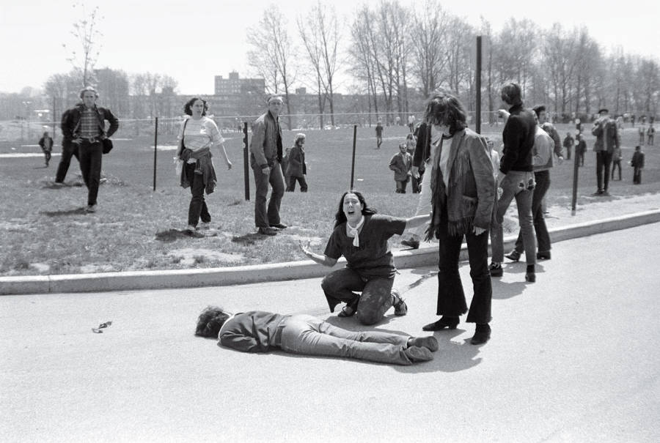
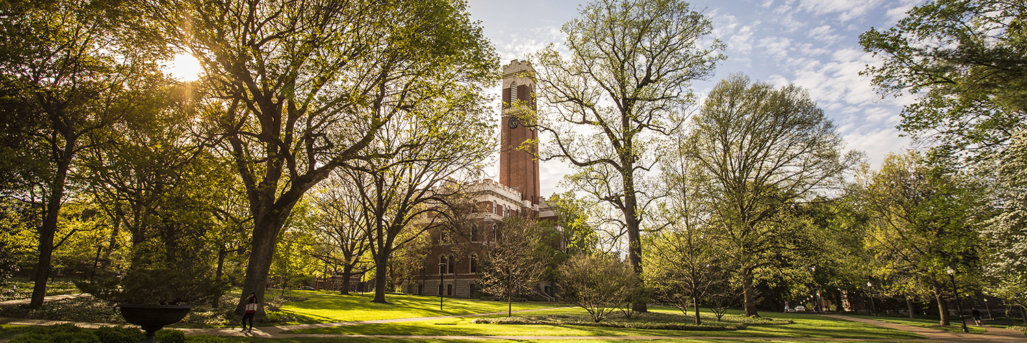
Contemplation Transforms; Let Me Count the Ways
Transformed Prayer, Persons, Theology, & World; the Energy of Contemplative Christianity 1
The story/journey, first
The Superpower Process, second
The Countertestimony, third
Contemplative Outreach Birmingham, April 11, 2026
Ed Bacon, revedbacon@gmail.com

Slide 2
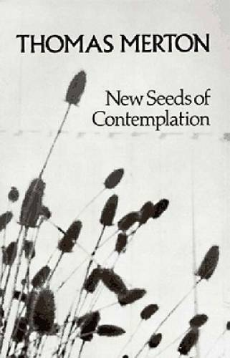
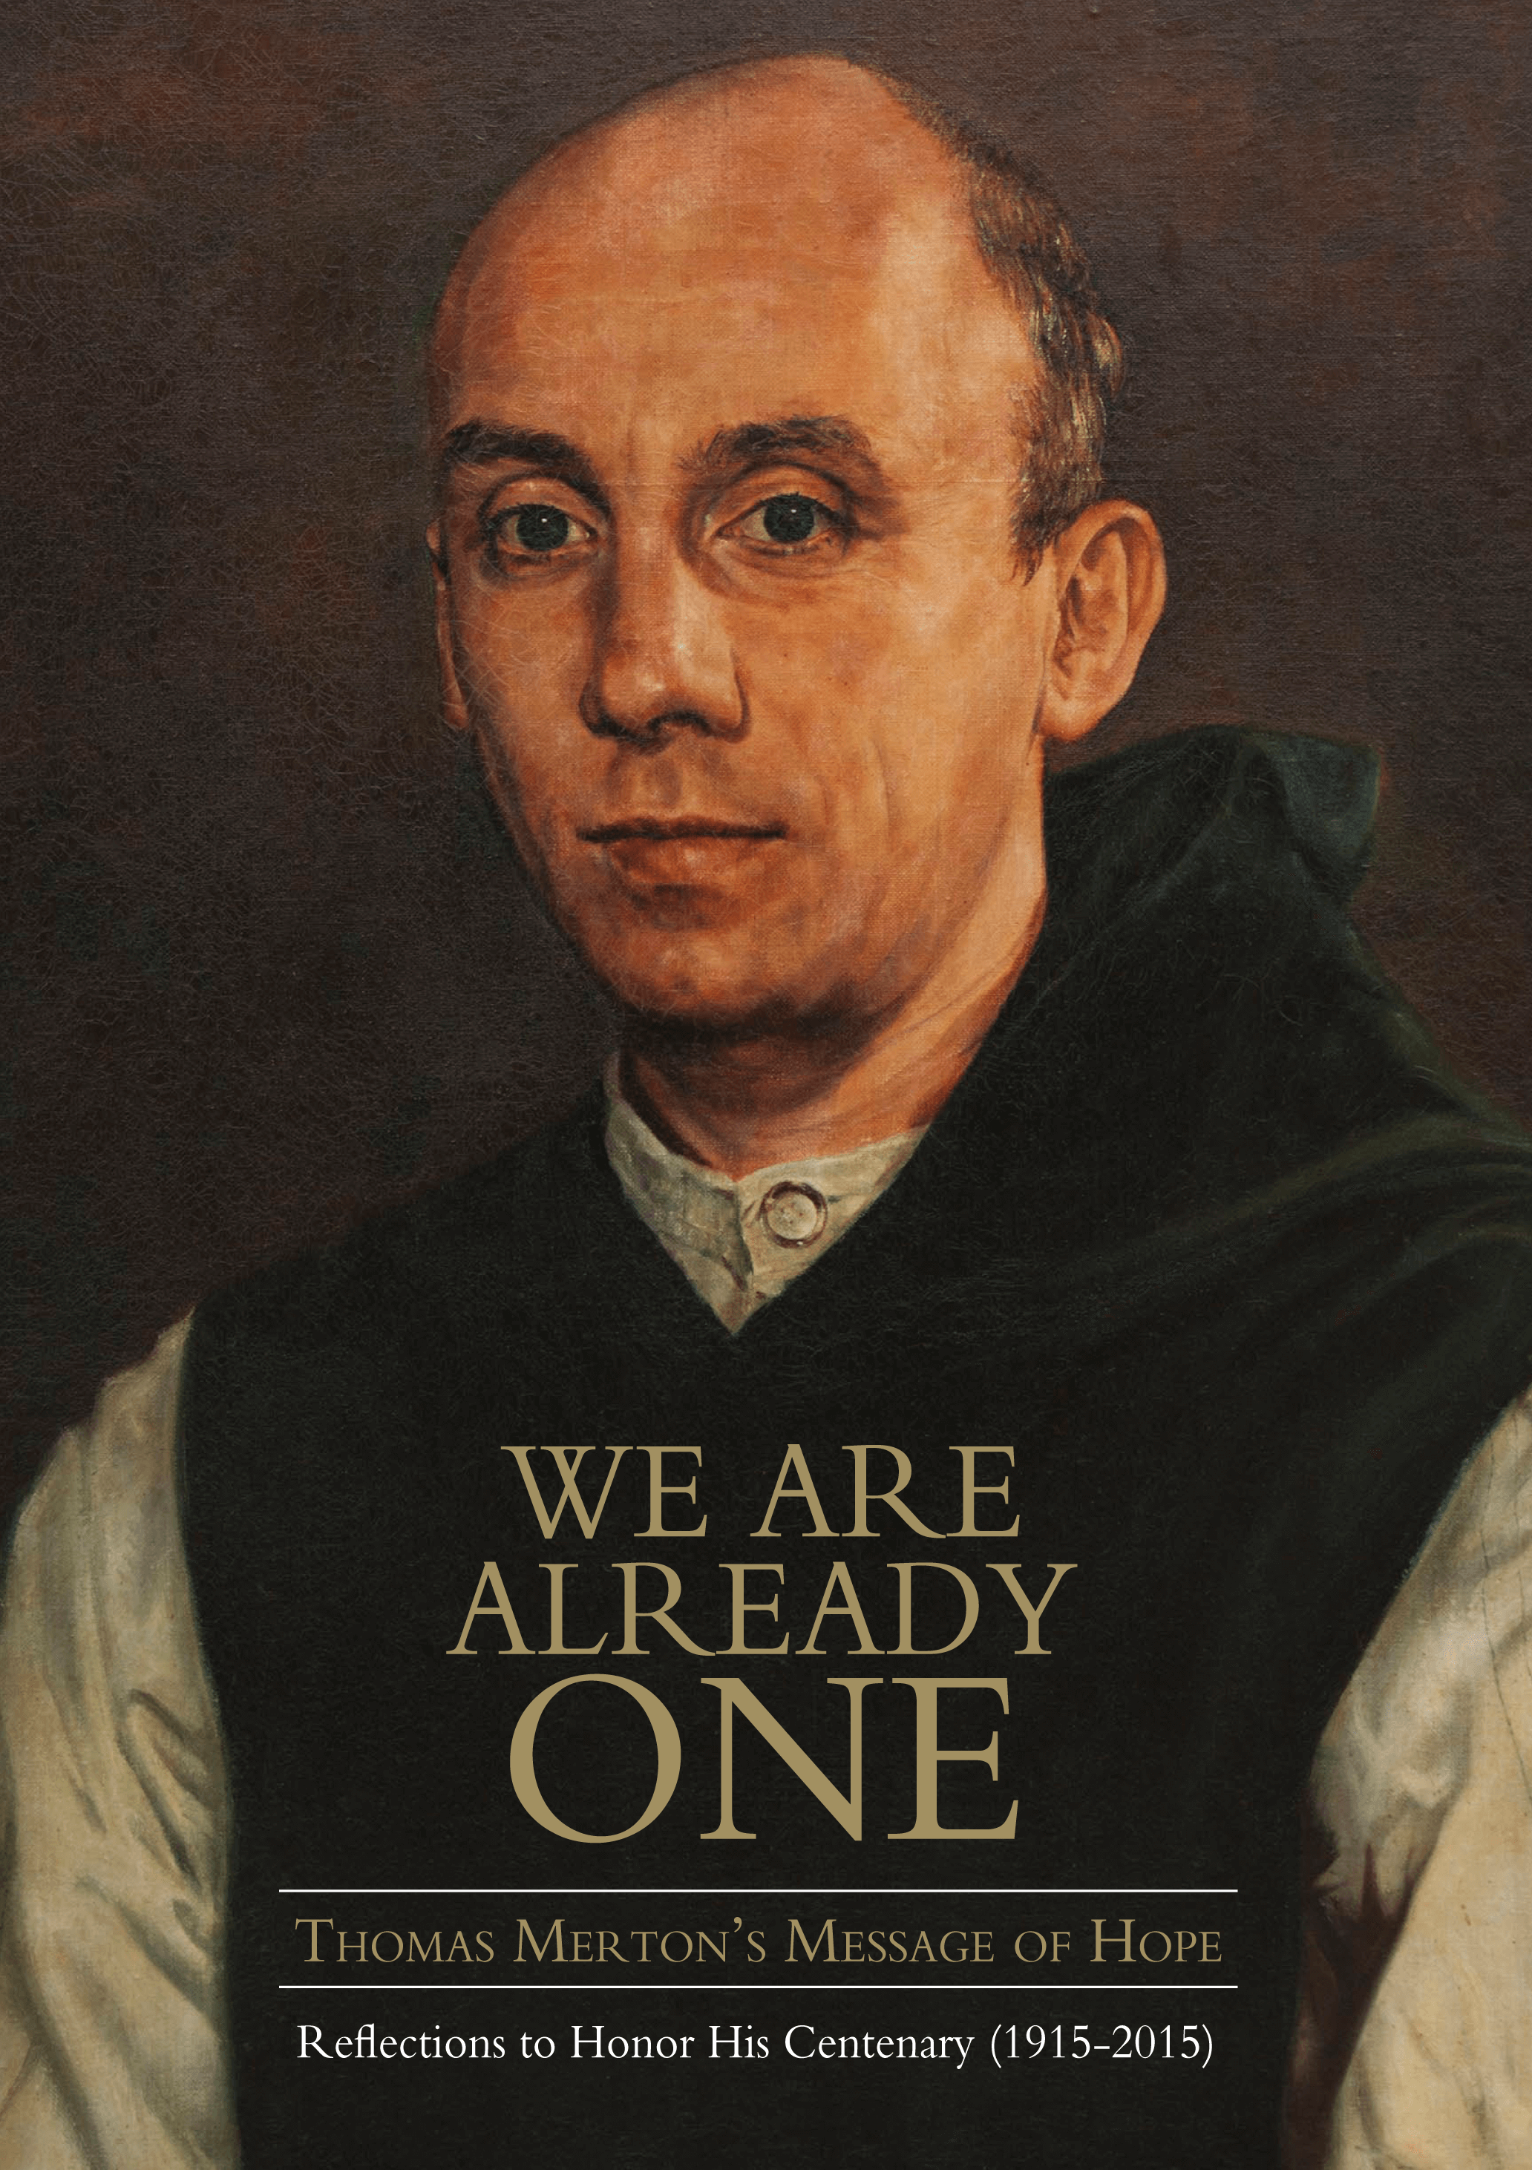

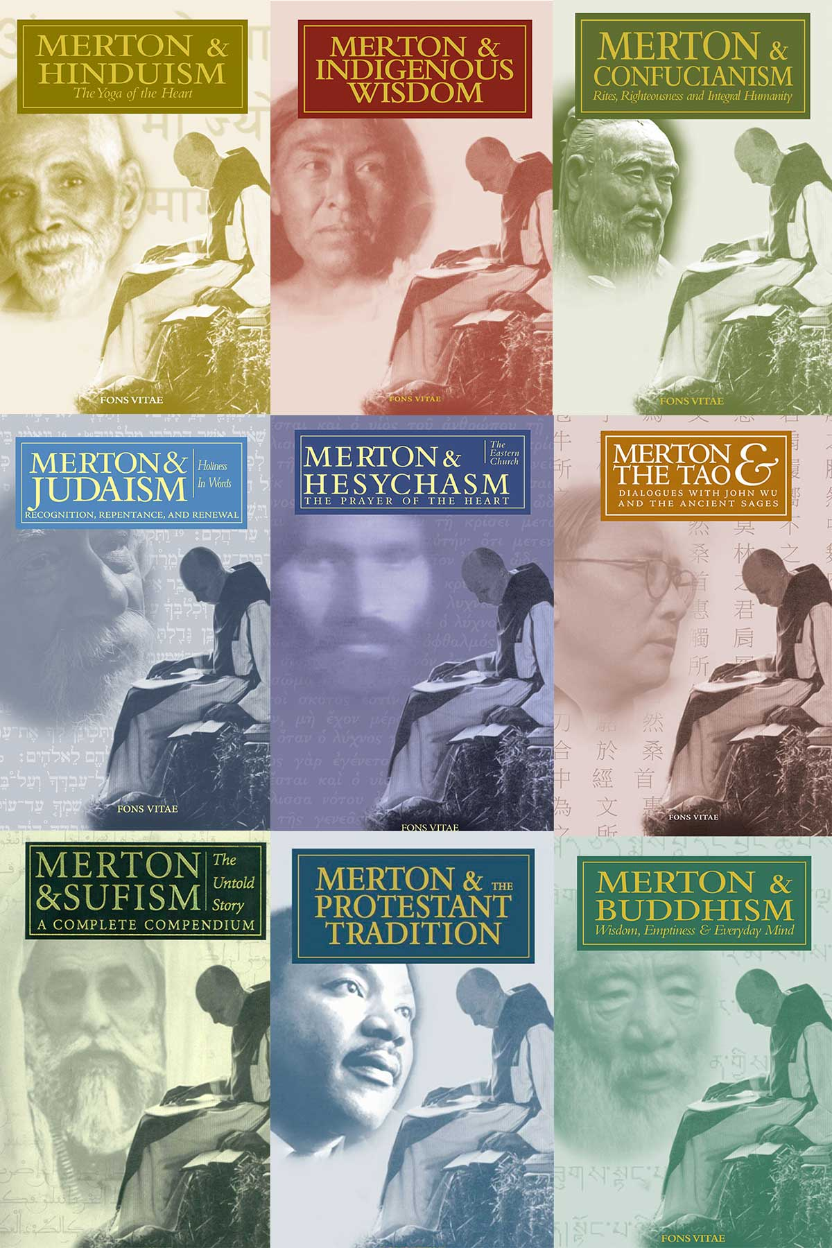

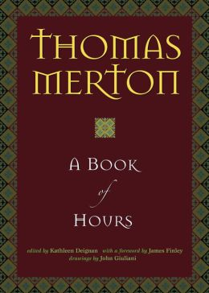

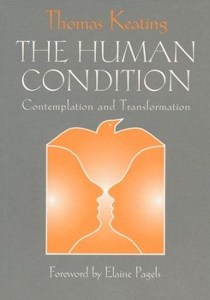
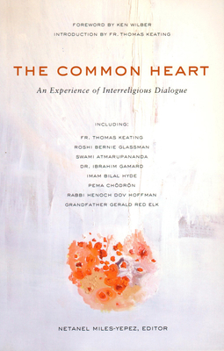
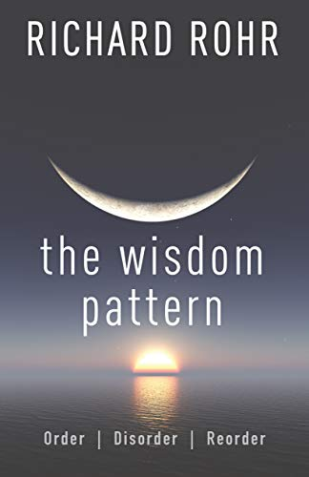
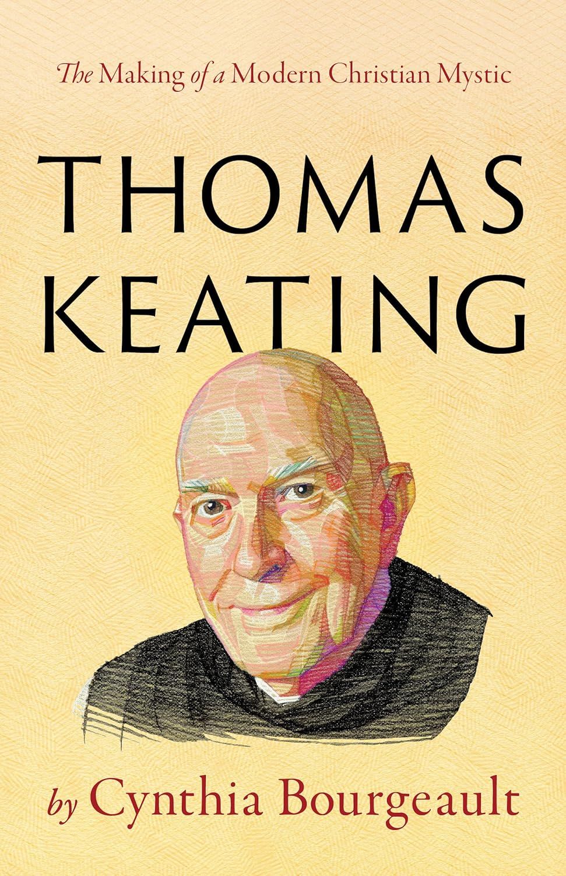
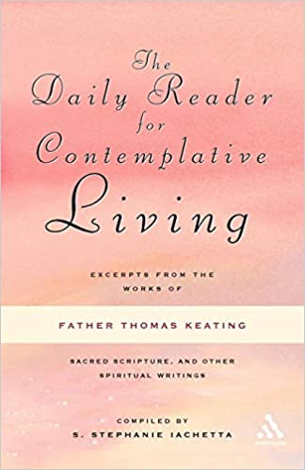
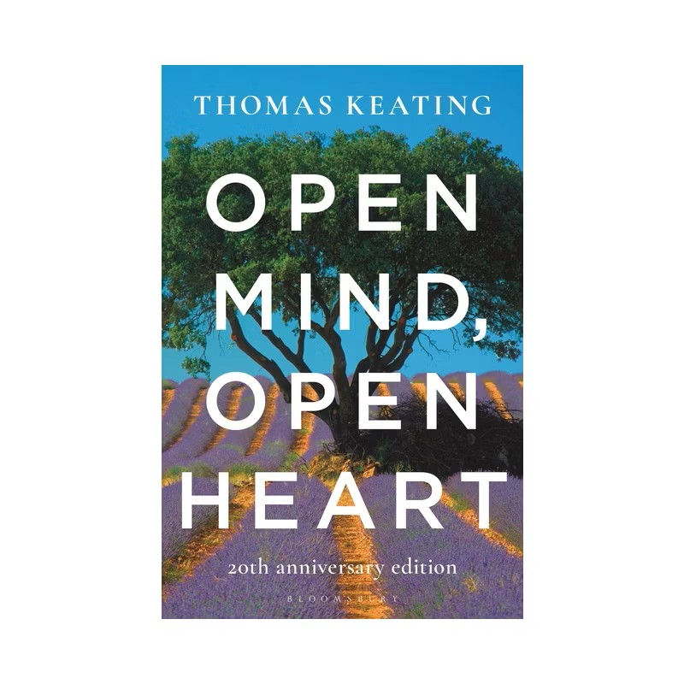
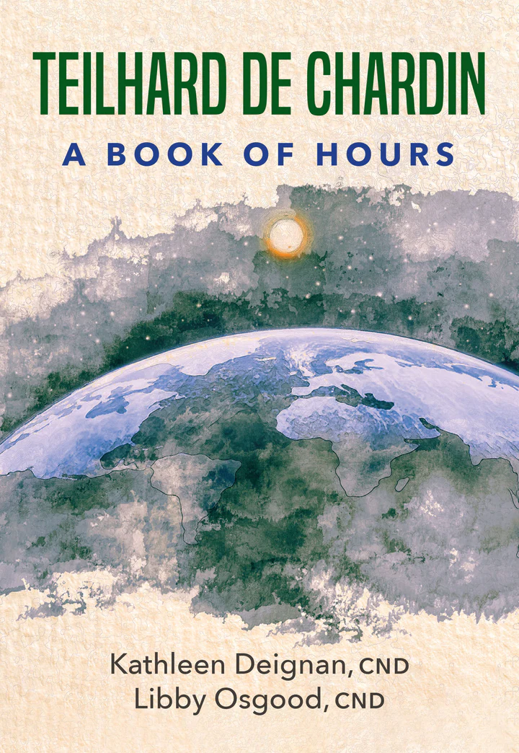
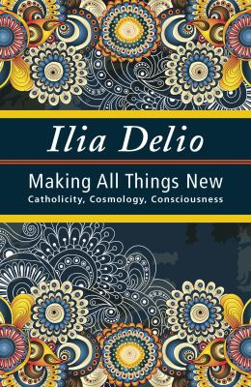
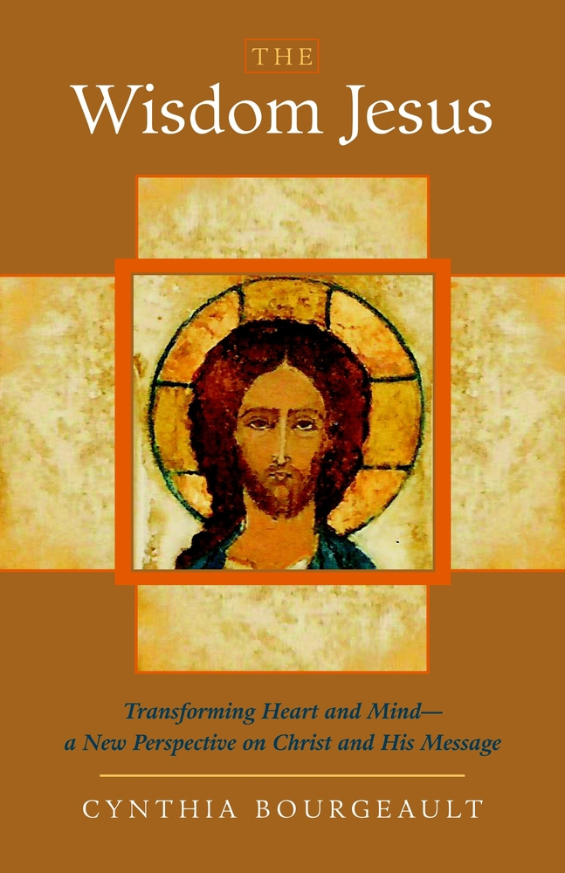
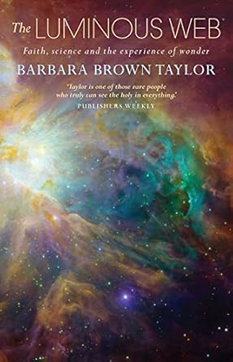
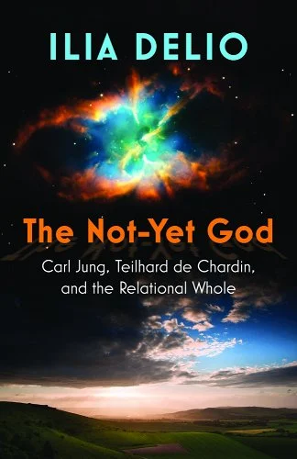
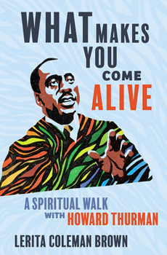
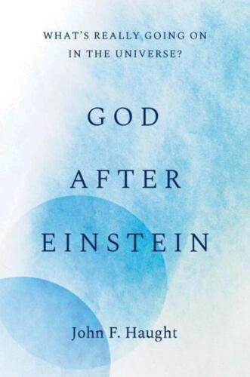

Slide 3
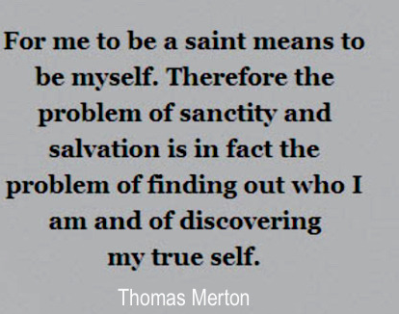
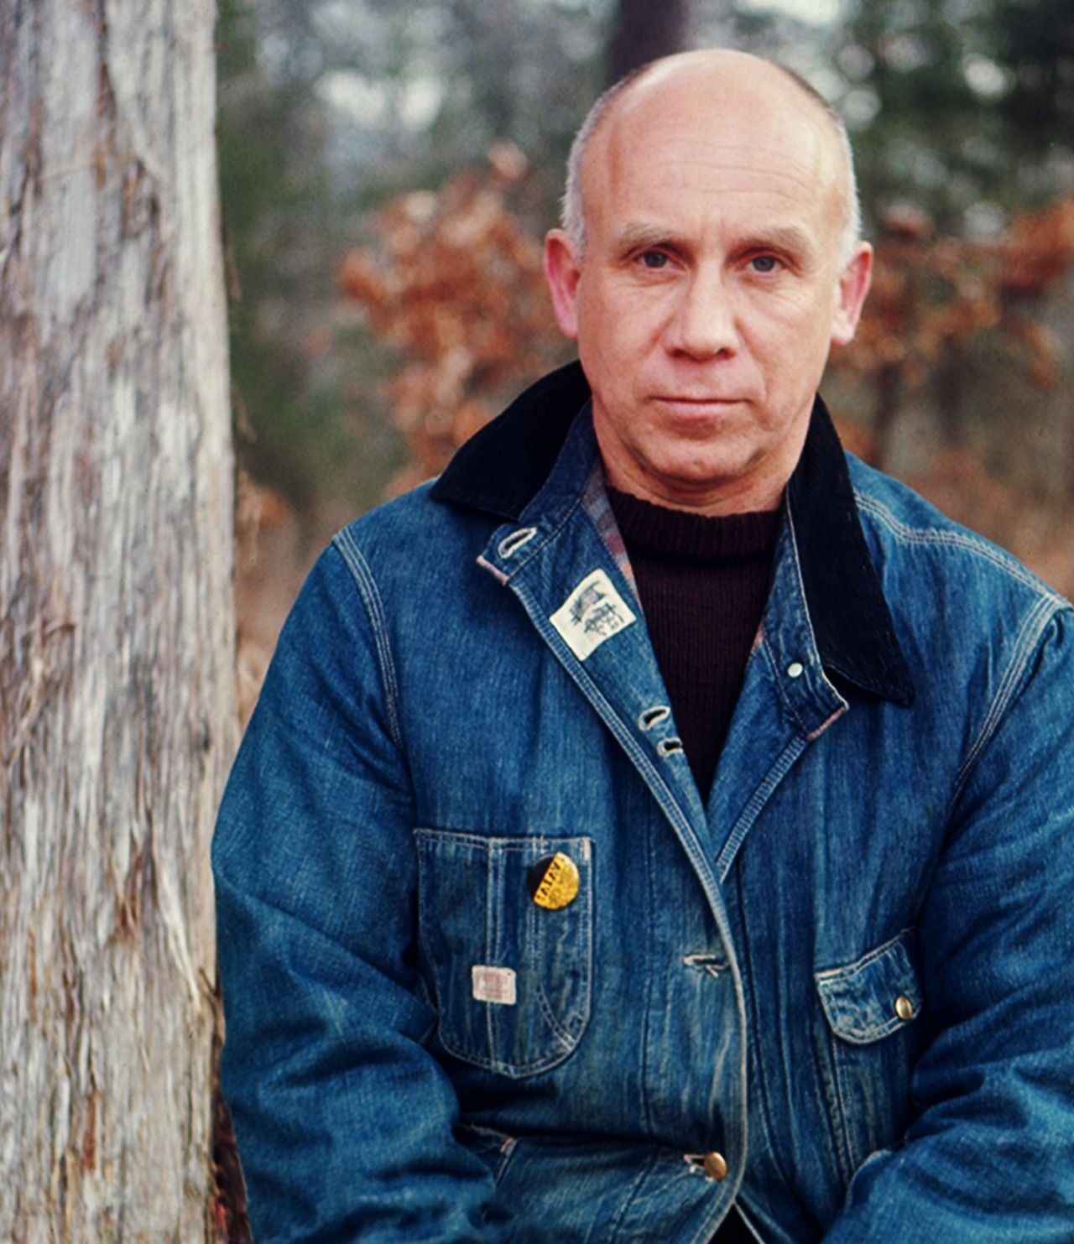
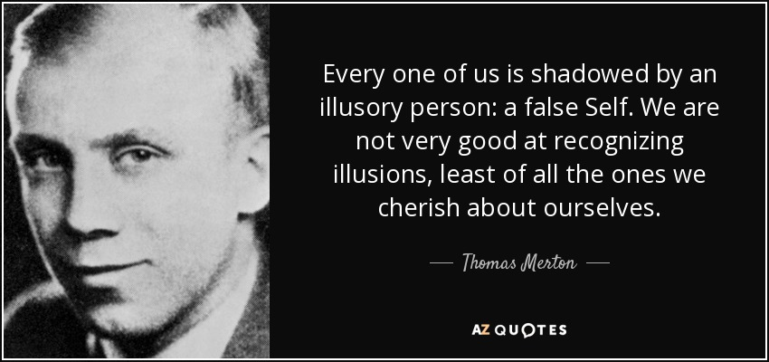

Slide 4
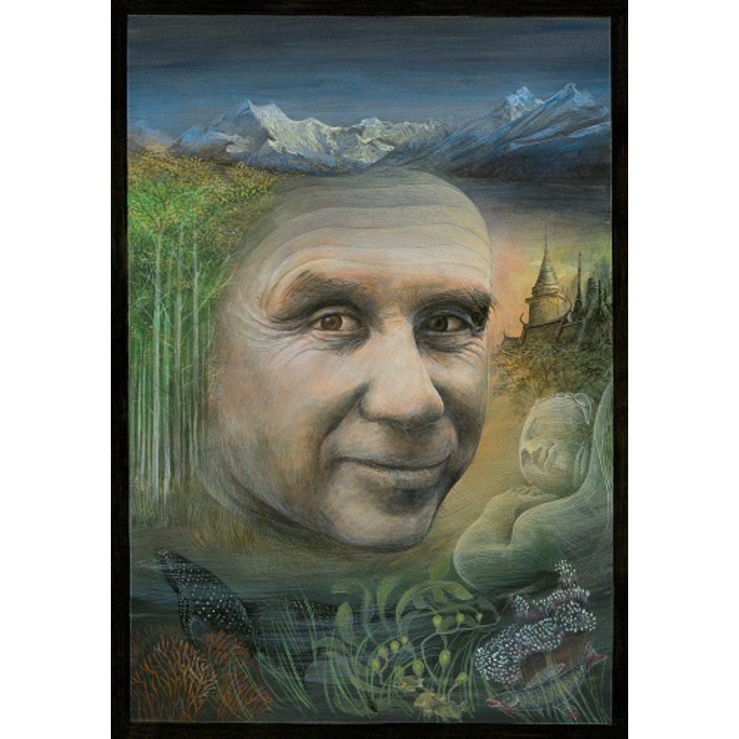
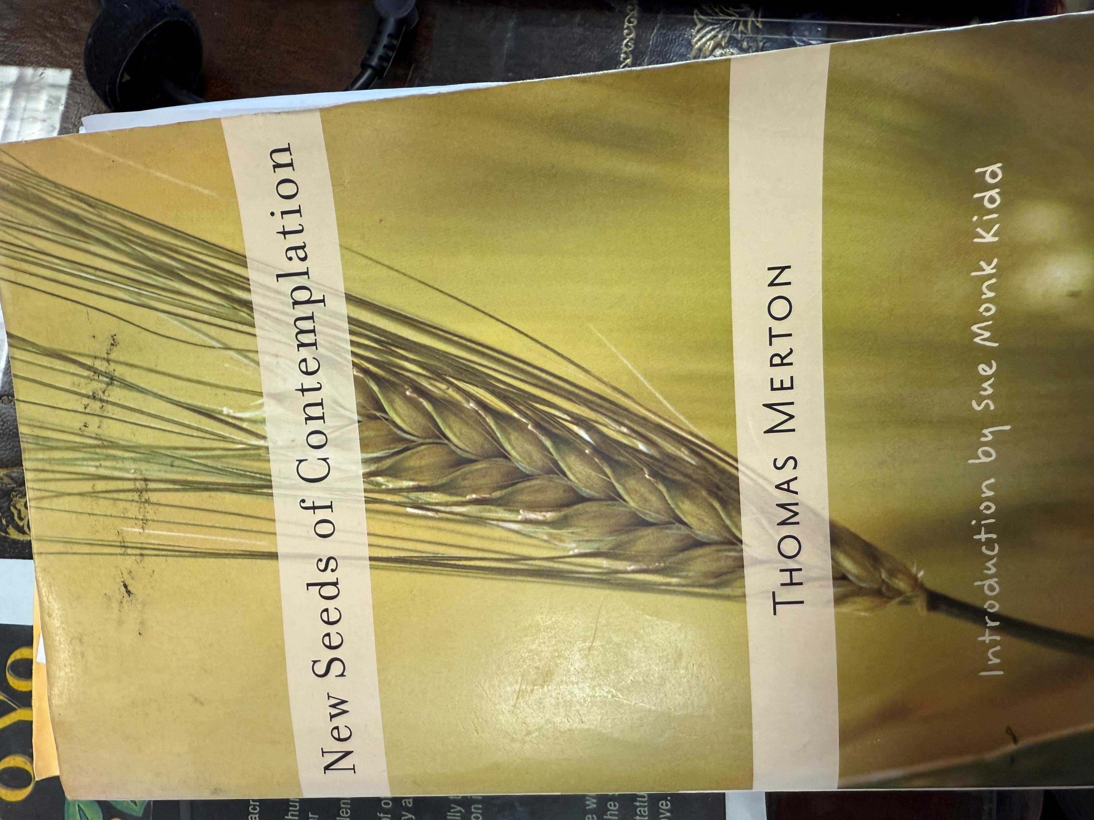
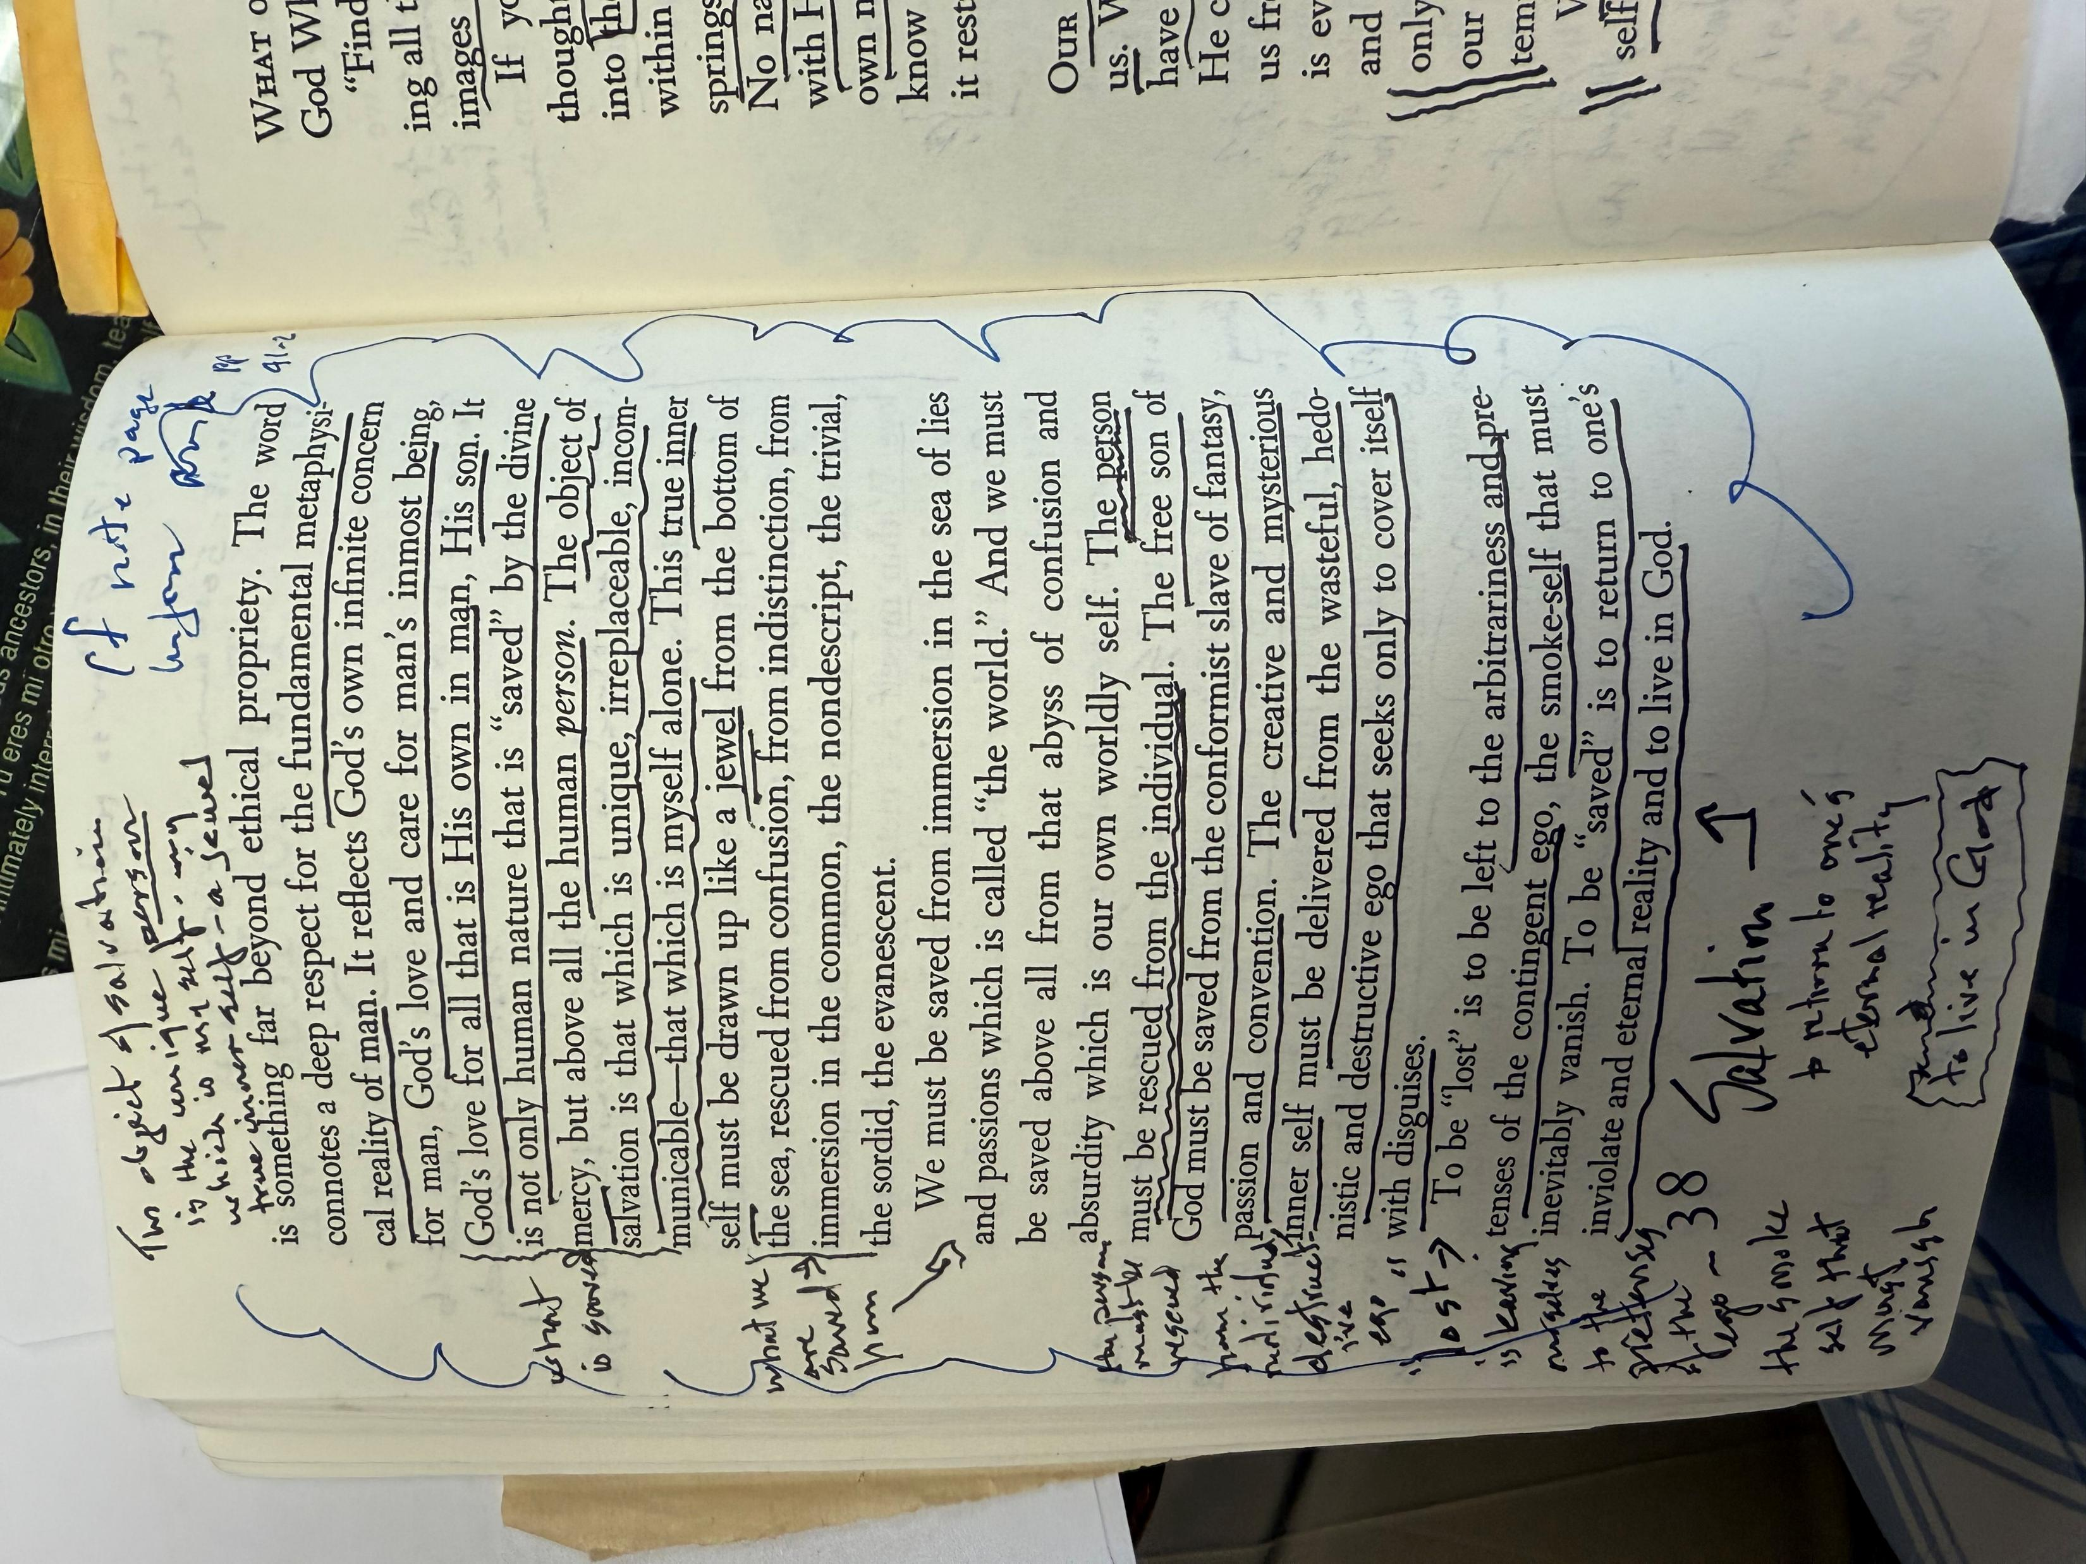
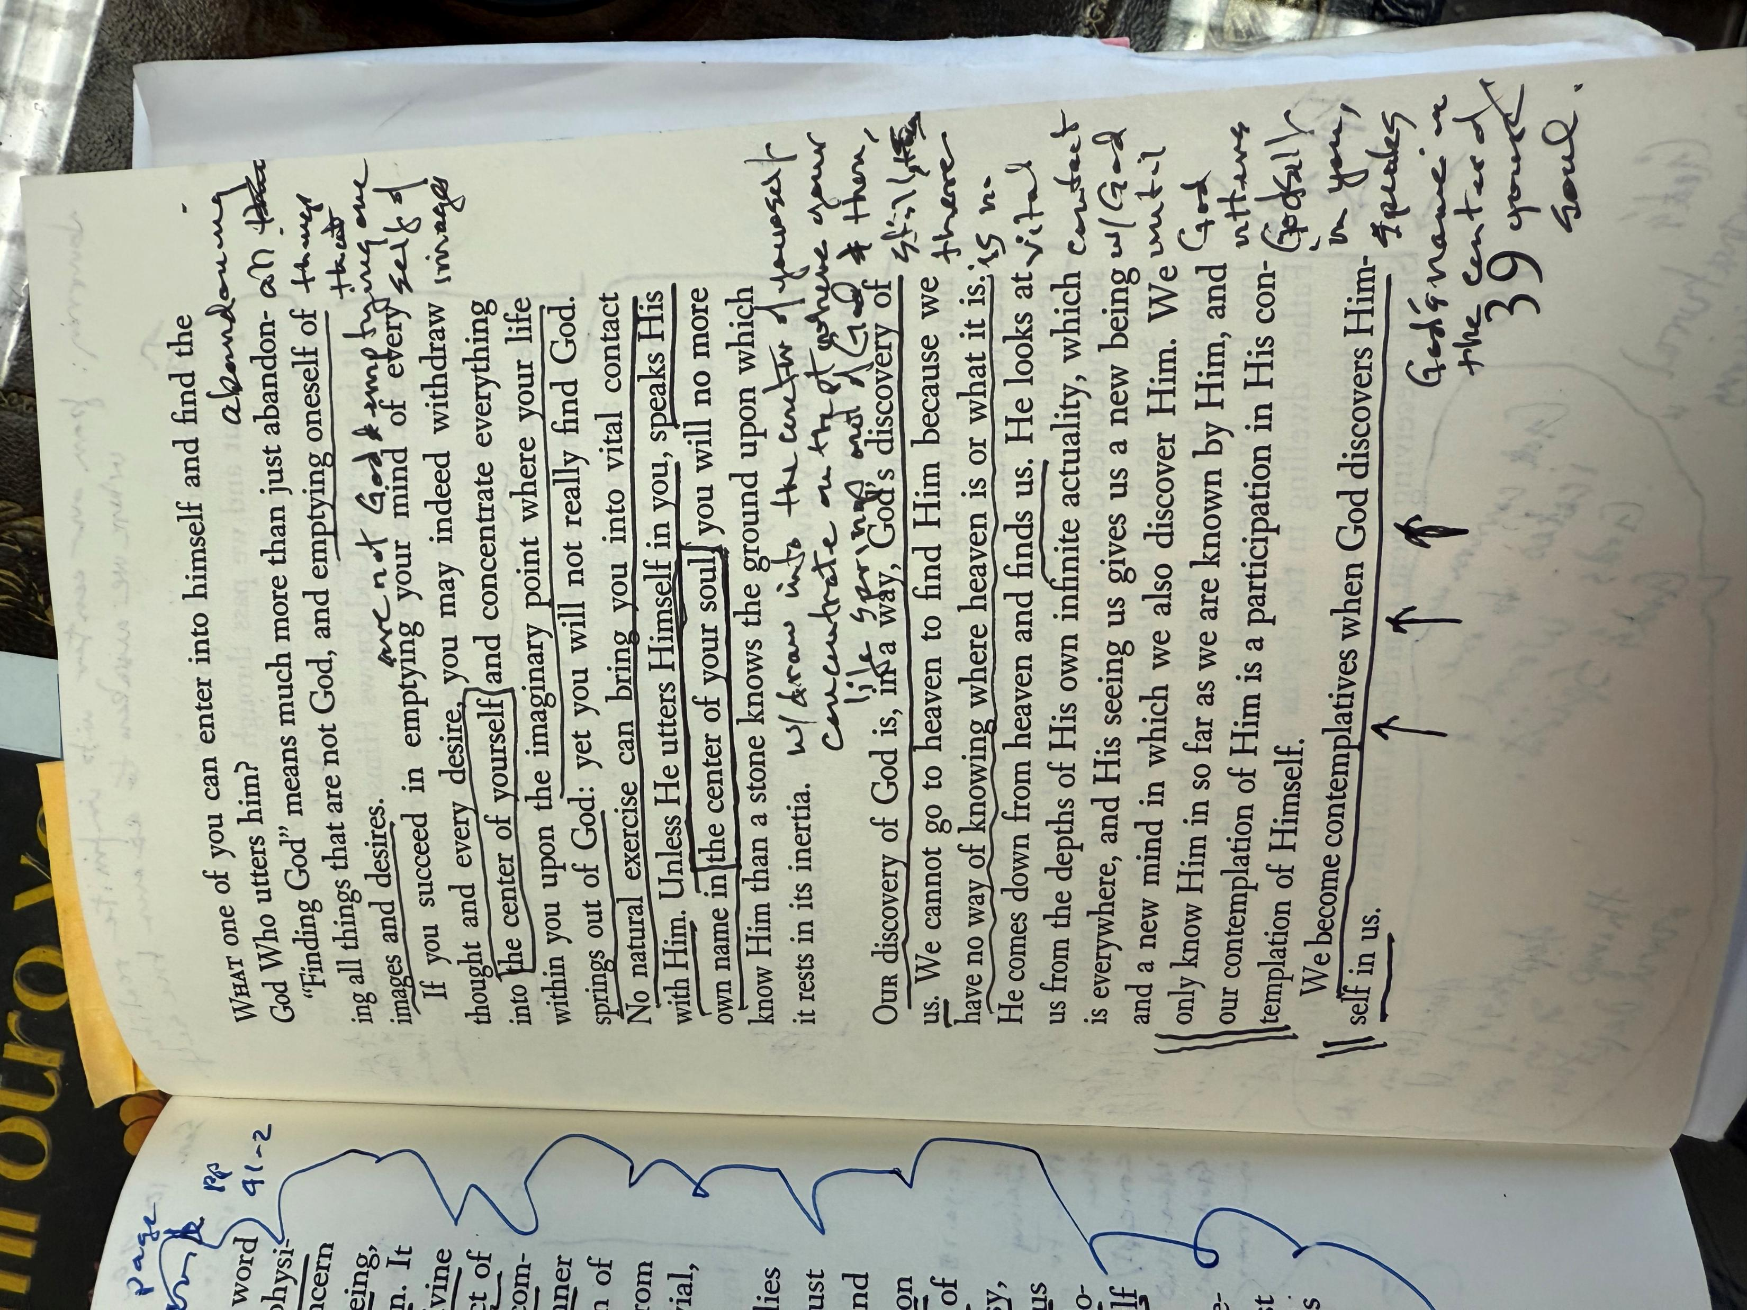
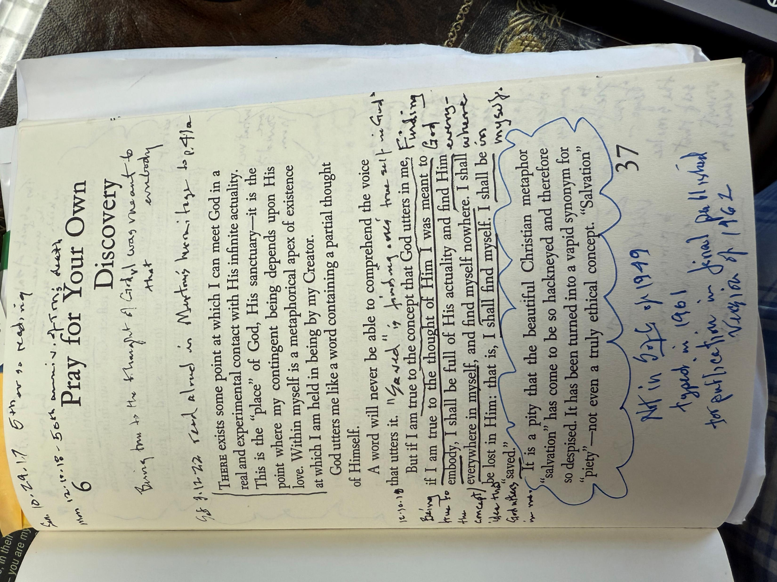
Thomas Merton’s view of self was two-fold: false self and true self

Slide 5

developing a “planetary” consciousness, become aware they are becoming a single somebody.
I’ve (JEB) been using Teilhard’s Book of Hours as my daily breviary for two years now. I’m moved by the confluence of the mysticisms of Keating and Teilhard both leading to what Teilhard calls “planetization.”
If people on earth, all over the earth, are ever to love one another it is not enough for them to recognize in one another the elements of a single something; they must also, by developing a “planetary” consciousness, become aware they are becoming a single somebody.
Teilhard de Chardin, A Book of Hours, 167; Teilhard de Chardin, Hymn of the Universe, p. 88-89
There is but a single fundamental feeling
underlying all mystical systems;
and that is an innate love of the human person,
extended to the whole universe.
Writing in a Time of War, 121-4; Hours, 18

Slide 6
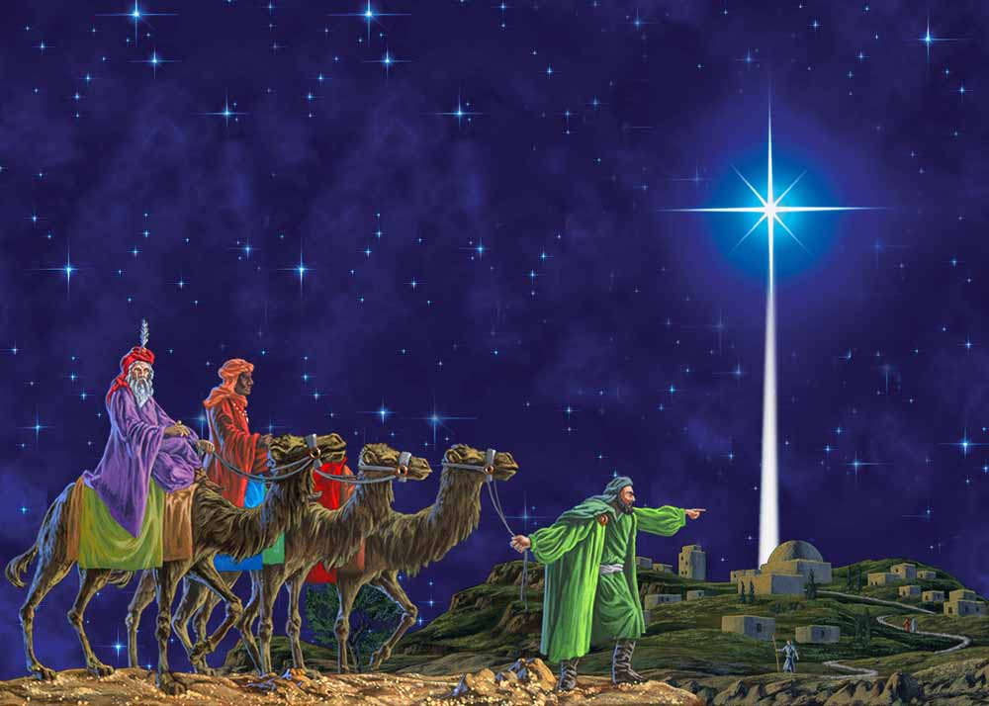
God as a moving center like the Magi and the star leads each of us differently, yet upward in common (Thursday Day, Hours, 124-125)
God is not a thing.
For us God is eternal discovery and eternal growth.
…
The one point at which the divine milieu may be born,
for each of us , at any moment
is not a fixed point in the universe,
but a moving center which we have to follow
like the Magi their star.
That star leads each of us differently, by a different path,
in accord with our vocation.
But all the paths which it indicates have this in common:
That they lead always upward.
Divine Milieu, 139; Hours, 124-125

Slide 7

Thomas Keating’s Journey:
Understanding the human SELF having five different states, with “systems,” and consciousnesses.
Understanding the “DARK NIGHTS” of human life that move us from one state of self to another.
Reunderstanding GOD not as punisher. Rather, nondual unity.

Slide 8
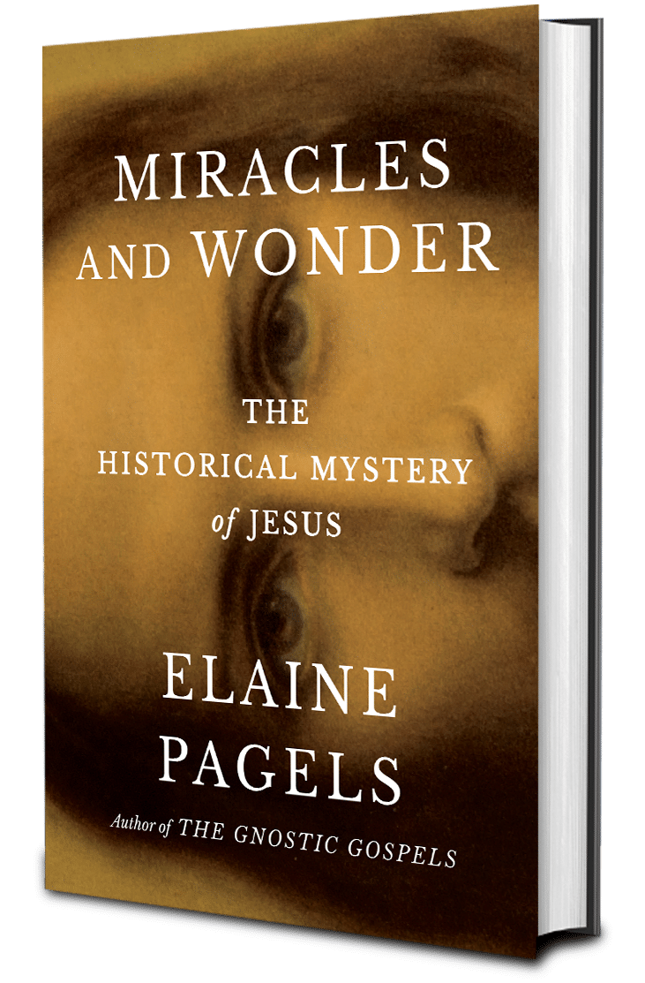
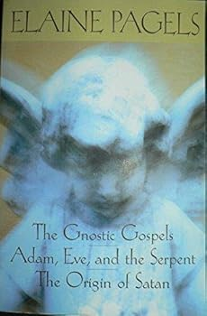
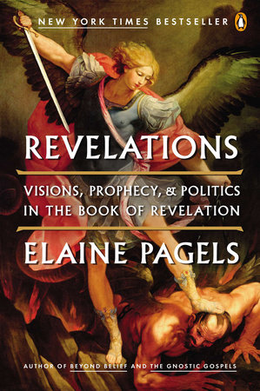
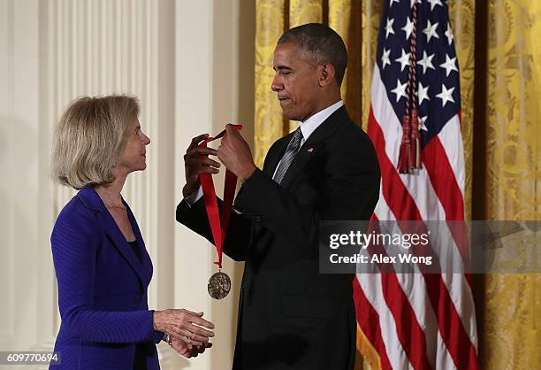
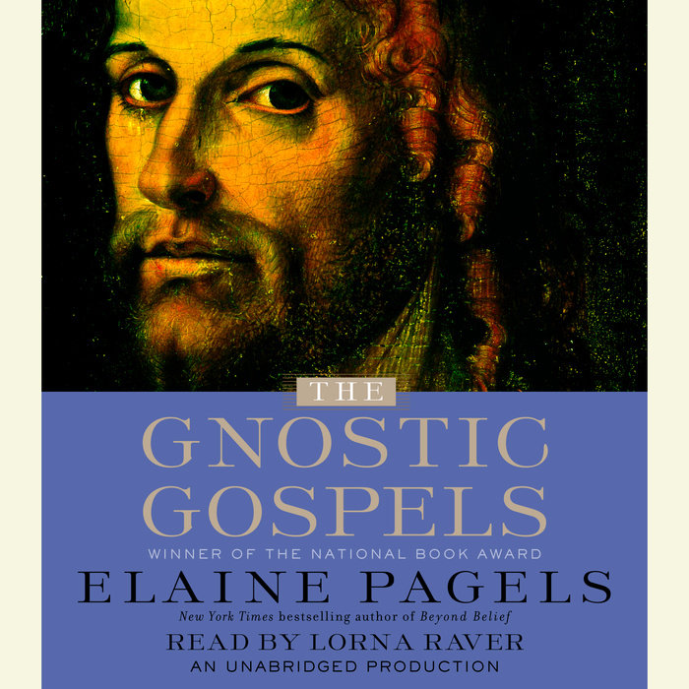
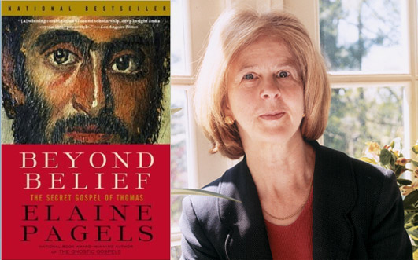
All Christians move through a variety of “Versions of Christianity”
Was Jesus an actual person or a fictional one? What do we, or can we, know about him, historically speaking? Etc.
Questions like these impelled me to head for graduate school, long after I’d given up on several versions of Christianity, starting with the Methodist church I knew as a child…..
When I was in high school a friend invited me to go to San Francisco to some kind of public meeting. To my surprise, we were on our way to a “Crusade for Christ,” where Billy Graham, then a handsome, charismatic preacher, addressed over eighteen thousand people packed into the sports stadium at Candlestick Park, while thousands more stood listening in the parking lot….
Then, as an enormous choir quietly began to sing “Just As I Am,” the preacher dropped his voice to hushed tones, speaking of our need for God’s love, promising everything, even eternal life: all we had to do was go forward and “accept Jesus into your heart.” Billy Graham offered nothing less than a new life: I could be “born again,” break out of my family and join the family of a heavenly father….who loved me anyway.
Having just turned 15 I found this invitation irresistible. Overcome with tears, I walked down to the front with thousands of others….I eagerly joined an evangelical church. There I could meet my “brothers and sisters in Christ,” and we would hug each other, pray, and praise the Lord….
A year and a half later, though everything changed. Suddenly devastated when one of my closest high school friends died in a car crash, I went to church in shock. Members of our close-knit group, at first sympathetic, asked, “Was he born again?” When I said, “No, he was Jewish,” they said, “Then he’s in hell." I walked out alone, devastated, and never went back. pp. 1-4 Elaine Pagels, Miracles and Wonders: The Historical Mystery of Jesus.; https://youtu.be/2eDcUq8FJzQ?si=44rtkcBiYZQsb_6U ; https://youtu.be/r6LJmPPDAlY?si=kUFu1ocHg80LOJ-n

Slide 9
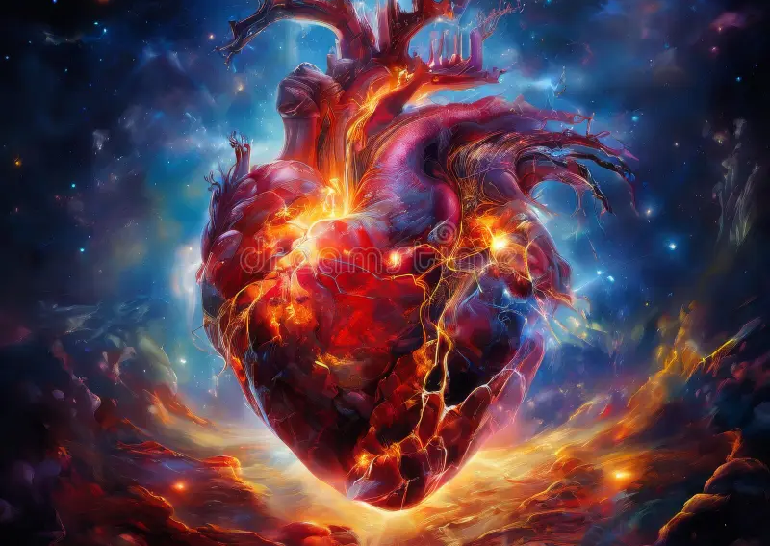
A cosmology that matches the size of what his cosmic heart had intuited
New consciousness reflected new images for divinity. “His use of gender-neutral, transpersonal terms expanded markedly: ‘the Absolute,’ ‘the Source of All That Is,’ ‘the Creator of All,’ ‘Ultimate Reality,’ ‘the Source,’ ‘the Divine,’ ‘Presence,’ ‘Isness.’
“And as his own interior life grew steadily more spacious and unboundaried, he delved even more deeply into the new cosmological models, whose sheer vastness and dynamism offered congenial new ways of imaging what he had already tasted inside. (p. 160) Increasingly, he found himself bumping up against the walls of the old ‘flat earth’ cosmologies on which so much of traditional Christian theology is based.” (p. 160)
He addressed the 2012 Contemplative Outreach annual conference (which became is 2019 book God is All in All), saying, “People cannot be expected to be impressed with belief systems that rely on a cosmology that everybody knows does not exist.” Like so many contemporary Christian mystics – Teilhard de Chardin, Beatrice Bruteau, Ilia Delio – he walked boldly into these new scientific waters in search of a cosmology that would match the size and the scale of what he had already intuited in his own cosmic heart. Science became more and more for him an authentic revelation of God. p. 161

Slide 10
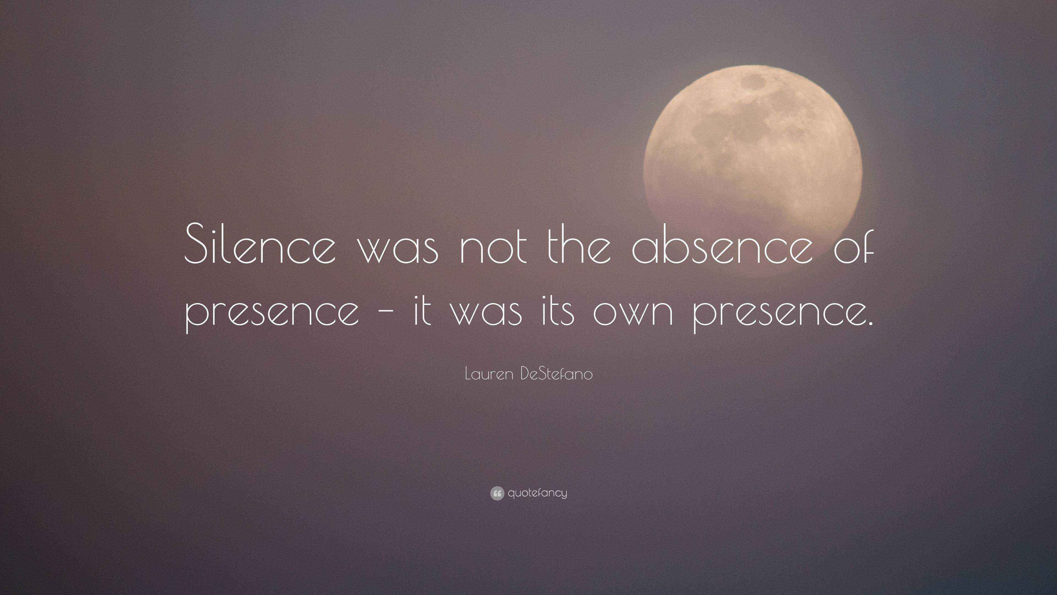

Contemplation occurs when interior silence morphs into presence
“It begins not in theory but in practice. One of the most significant transitions during the final decade of Thomas’s life is his increasing capacity to perceive silence not as an emptiness but as direct presence. It meets him, exchanges with him and has its own mode of aliveness that he can now directly engage. p. 161
In his 2017 book From the Mind to the Heart (sec.5): “Perhaps we could say that contemplation occurs when interior silence morphs into presence.” p. 162
“This presence, once established in our inmost being, might be called spaciousness. There is nothing in it but a certain vibrancy and aliveness. You’re awake. But awake to what, you don’t know. You're awake to something that you can’t describe and which is absolutely marvelous, totally generous, and which manifests itself with increasing tenderness, sweetness, and intimacy.” Thomas Keating, From the Mind to the Heart, (sec.5).
As this capacity opens in Thomas, he finds himself increasingly able to gaze directly into this formless spaciousness, and his teachings on the Unmanifest begin to take off. p 162

Slide 11
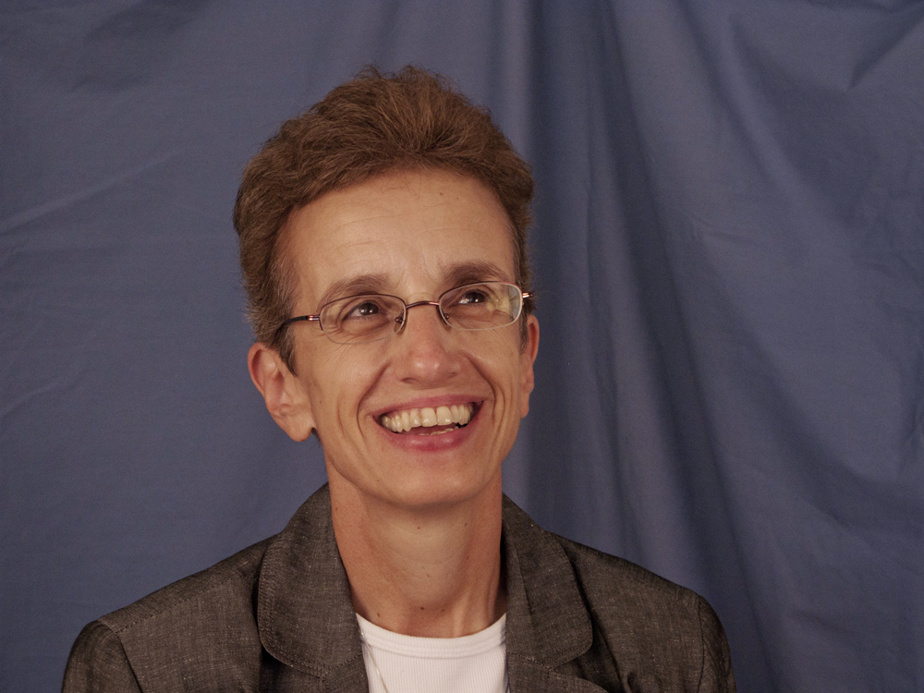
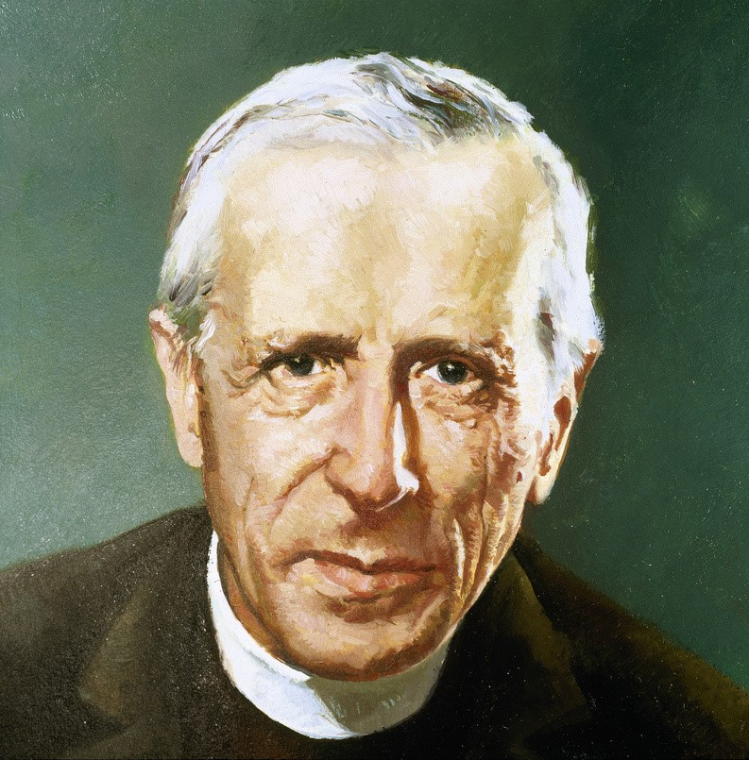
We are moving from the understanding of God as being or substance to a new understanding of God as relationship
Ilia Delio: “In a recent paper on AI and the question of God in evolution. I have been really fascinated by the question of artificial intelligence for quite some time and its theological significance.
“I begin the paper by saying that technology is not something extraneous to us; is not an outside force. It’s not a tool. It’s actually in my view part and parcel of biological evolution. Evolution has always been technological. It continues to develop tools and means of um artifices to optimize life. And artificial intelligence in a sense extends the technological aspect of evolution but now on the level of mind. And so, we find that we are on a new level of global consciousness. We have a much more interconnected world where consciousness has in a sense complexified with AI. The very principles of physics that give rise to AI also invite from a theological perspective a new understanding of God. I think we are in a sense moving from the understanding of God as being or substance to an understanding of God as relationship.
“Here I take the position of Teilhard de Chardin, a process thinker. I look at the way he relocated God as that center of love and wholeness that is emerging in evolution. In his view God and matter are in a sense united to the point where matter is the place of the absolute. So, he sees God as entwined or entangled in evolution…
“Artificial Intelligence and the Question of God in Evolution,” Ilia Delio.
https://youtu.be/1WotQQTujvo?si=SYG-VDyhF40UkHLV

Slide 12
A remarkable synthesis; Christian Non-Duality
In his “final final work,” (Bourgeault’s emphasis) That We May Be One, Cynthia notes that Keating “seems to pull out all the stops, sidestepping most traditional Christian starting points in order to speak directly from what he has come to know from an evolutionary perspective about
nonduality,
levels of consciousness,
the shortcomings of traditional Western spiritual models
present-moment awareness, and
the journey from rational consciousness and ego selfhood into unity consciousness,
experienced both as an interior state
and as an exterior manner of living in this world.
All told, it is a remarkable synthesis. p. 197
Keating moves beyond even the last vestiges of a sectarian model. His interest, unabashedly, is with 1) the evolution of consciousness and the
2) attainment of the next rung on the evolutionary ladder, in service of
3) our collective survival as a human species. …p. 198

Slide 13
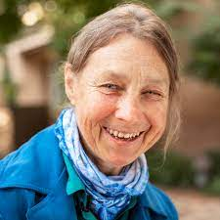
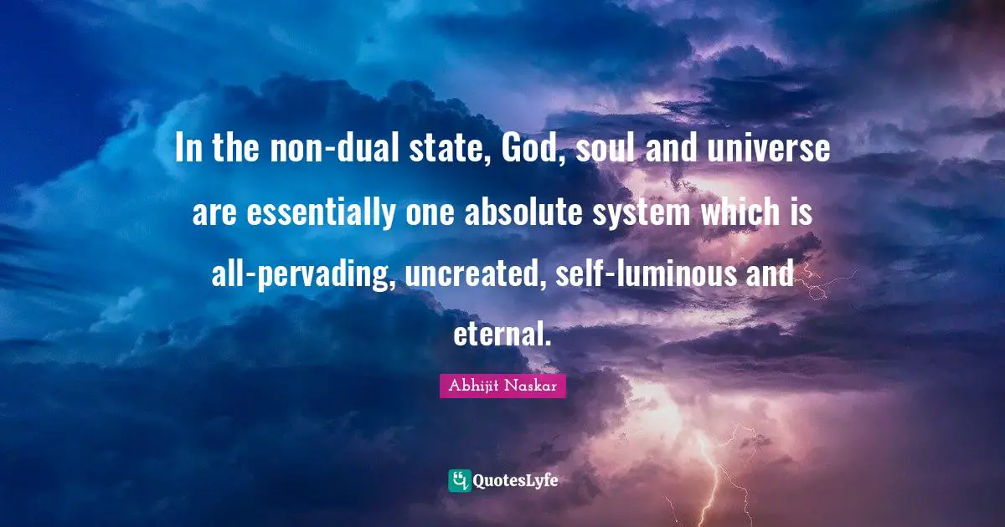
Keating’s final spiritual synthesis: Christ-Oriented Non-Dual Consciousness

Slide 14
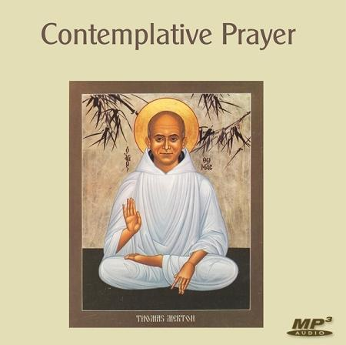
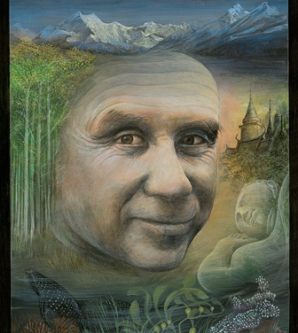
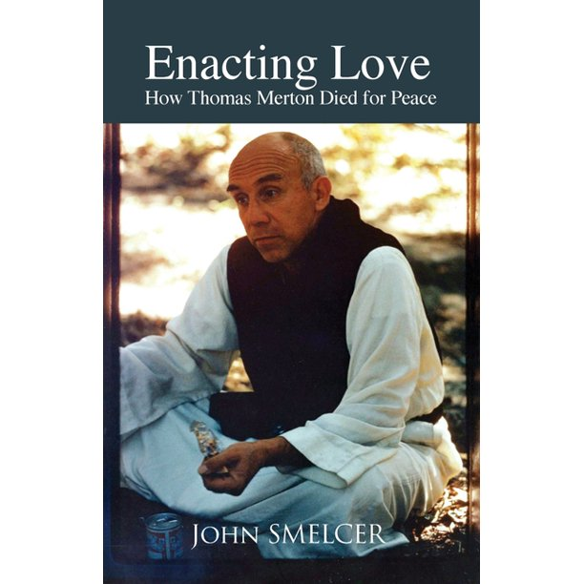
Thomas Merton’s outline of the meaning of Christian con-templation
The Christian is then not simply a person of good will, who commits oneself to a certain set of beliefs, who has a dogmatic conception of the universe, of humanity, and of humanity’s reason for existing. …Not simply one who follows a moral code of brotherhood and sisterhood and benevolence with strong emphasis on certain rewards and punishments dealt out to the individual (Teilhard: no more Christianity about individuals and heaven only). Underlying Christianity is not simply a set of doctrines about God considered as dwelling remotely in heaven, and humanity struggling on earth, far from heaven, trying to appease a distant God by means of virtuous acts. On the contrary Christians themselves too often fail to realize that the infinite God is dwelling within them, so that God is in them and they are in God. They remain unaware of the presence of the infinite source of being right in the midst of the world and of human beings. True Christian wisdom is therefore oriented to the experience of divine Light which is present in the world, the Light in whom all things are, and which is nevertheless unknown to the world because no mind can see or grasp its infinity. “He was in the world, and the world was made by Him and the world did not know Him. He came into His own and His own did not receive him.” (John 1: 10-11)
Contemplative wisdom is then not simply an aesthetic extrapolation of certain intellectual or dogmatic principles, but a living contact with the Infinite Source of all being, a contact not only of minds and hearts,, not only of “I and Thou,” but a transcendent union of consciousness in which humanity and God become, according to the expression of St. Paul “one spirit.” Though this contemplative union is an extreme intensification of conscious awareness, a kind of total awareness, it is not properly contained or signified in any particular vision, but rather in non-vision which attains the totality of meaning beyond all limited conception, by the surrender of love. God Godself is not only pure being but also pure love, and to know God is to become one with God in love. In this dimension of Christian experience, the Cross of Christ means more than the juridical redemption of humanity from the guilt of evil-doing. It means the passage from death to life and from nothingness to fullness, or to fullness in nothingness. The Cross signifies…in fact the liberation of those who have renounced this exterior self in order to dedicate their lives to love and to truth…for the Christian to be “on the way” is to be “in Christ” and to seek truth is to walk in the light of Christ. “for me to live," says St. Paul, “is Christ. I live, now not I., but Christ lives in me.” This is a summary outline of the meaning of Christian contemplation. Pp. 90-91, Japanese edition of New Seeds of Contemplation

Slide 15
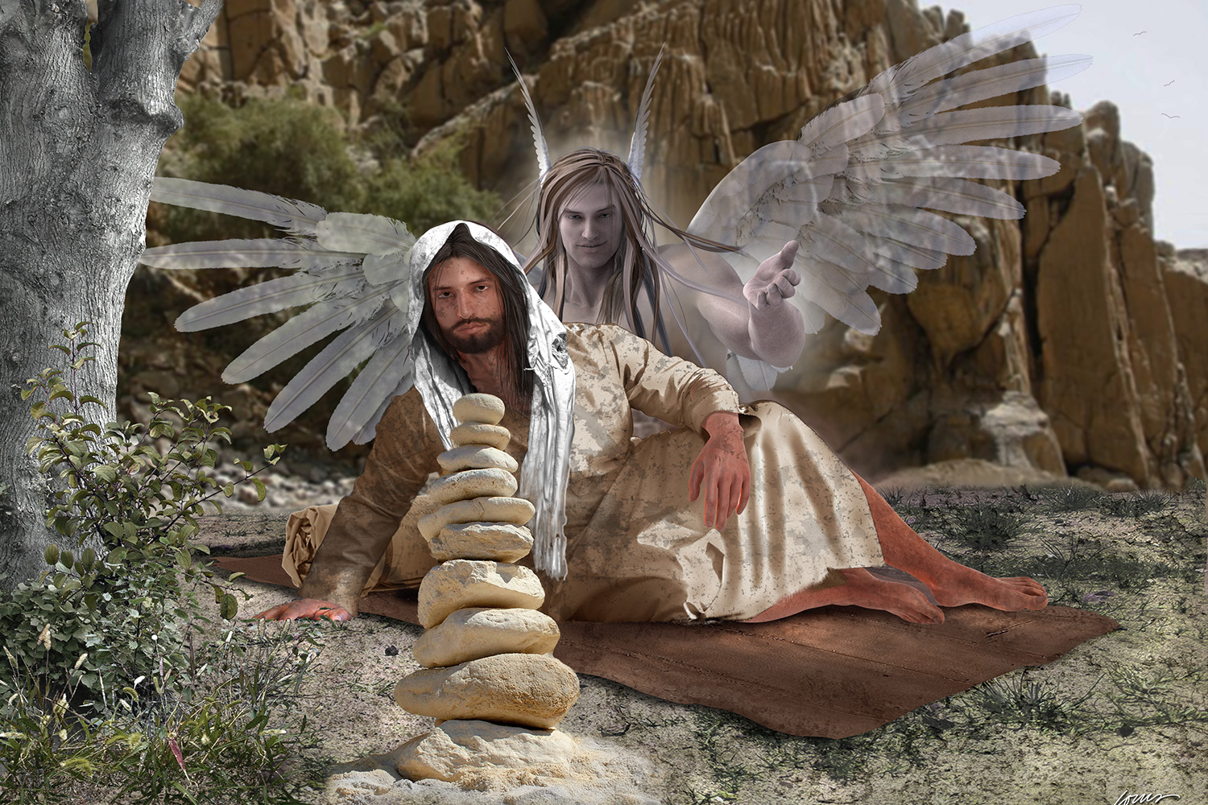
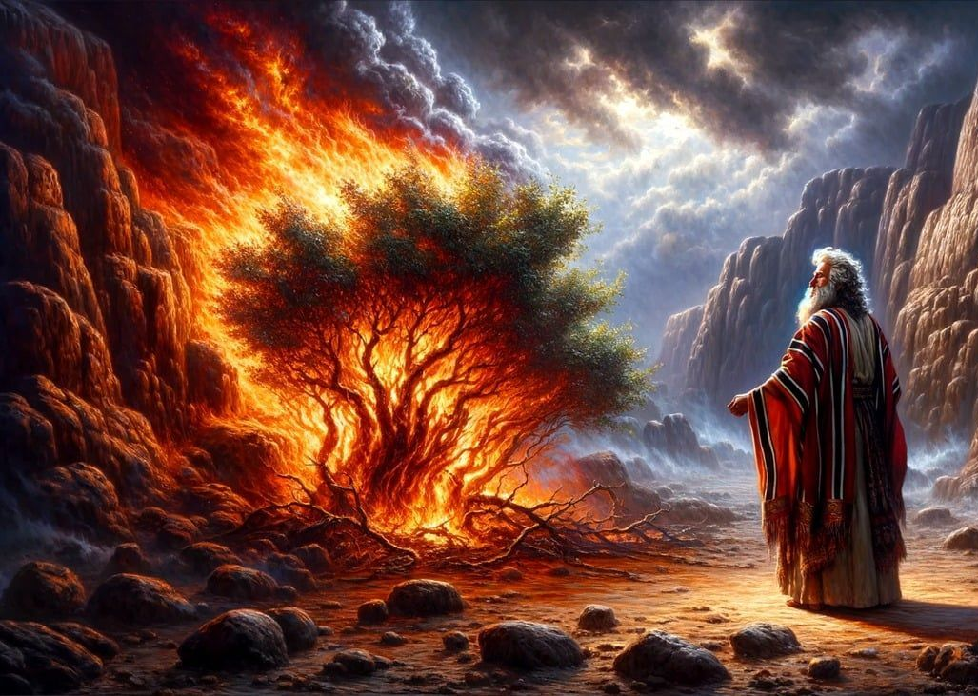
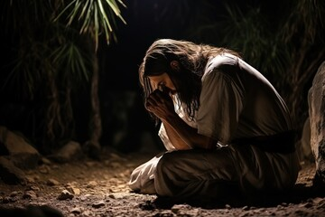
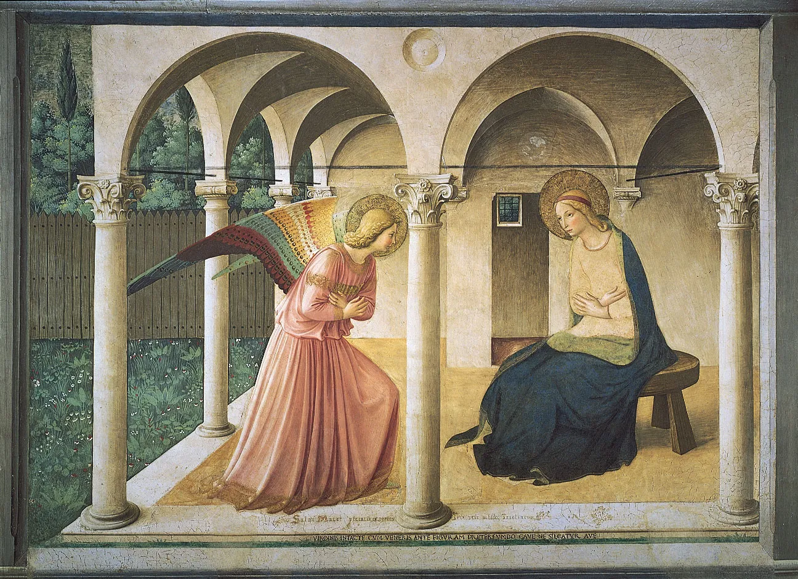
Discerning within tension
When seemingly caught between two realities in tension with one another, use that as a lectio divina. Go to Stillness and listen prayerfully to that tension, confident that that is how the Voice and Word of God inaudibly break through.

Slide 16
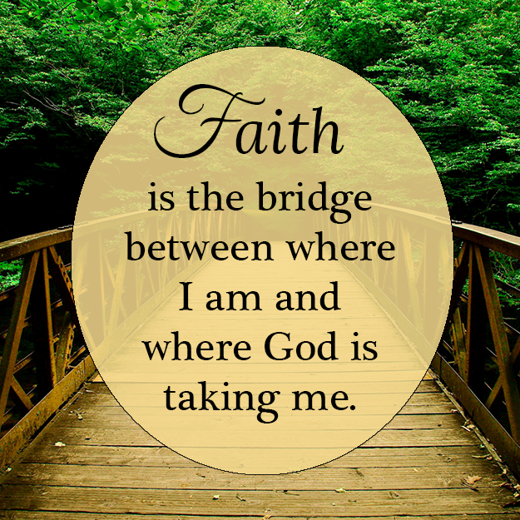
The "Relentless Stripping” away (often very painful) of “the God we thought was God” and who “no longer exists” so that you’re on the other side of the bridge where there is “boundless, bare presence”.
When all symbols, rituals, and former provisions of stability, consistency, even beauty and adoration are seen as “in the way of the bare presence….” p. 75
“When the mind is no longer processing the world through subjects and objects, symbols lose much of their force as connective links. They’re still a bridge, but you are already standing on the other side.” p. 75
“If there is a faint lining of hope in this relentless stripping, it comes in the very last line of the poem, in Thomas’s quiet recognition that it is not God who no longer exits – only ‘the God I thought I knew.’ There is a quiet visceral conviction that, like the earlier privation in the dark night of sense, this is merely about removing another layer of veils. Beneath the veils, the substance still holds. His disillusionment is not of the kind where one picks up one’s marbles and walks away.” p. 75
Keating is aware that “his concept of love is shifting from emotional reciprocity to something far more unconditioned, closer to what St. Paul once called living ‘by faith alone.’…this is a whole new territory, which neither his heart nor his mind can yet fathom, but which has his full attention.” p. 76
Note: JEB: walking by faith (entrustment) not by sight (human logic and understanding)? 2 Corinthians 5: 7

Slide 17
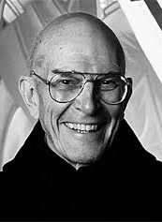
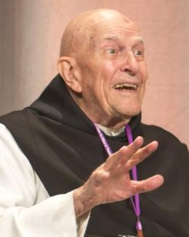
Where Keating wound up, focusing in 2018 at his death on “unity consciousness,” was significantly different from where he was in 1988
Keating kept on growing for another thirty years beyond his signature teaching – perhaps three more stages from his Calling’s midpoint schematic (and paradigm). “He experiences the full fark night of spirit, emerged into unitive awakening, and just toward the end, was bearing down hard o a stage yet more subtle, which he simply called ‘unity consciousness.’ Sailing off his own map, he began to explore a terrain that had been previously hinted at only in the most ‘out there’ of the Christian nondual mystics such as Meister Eckhart and, in our own times, Bernadette Roberts: a cosmogonic mysticism of the Unmanifest. (later unpacked in chapter 7).”
Bourgeault argues that Keating became significantly different both in the “depth of his knowledge but also int the luminosity of his being. He was simply not the same Thomas who crafted the masterful intellectual synthesis in the 1980s.” p. 9

