Slide 1


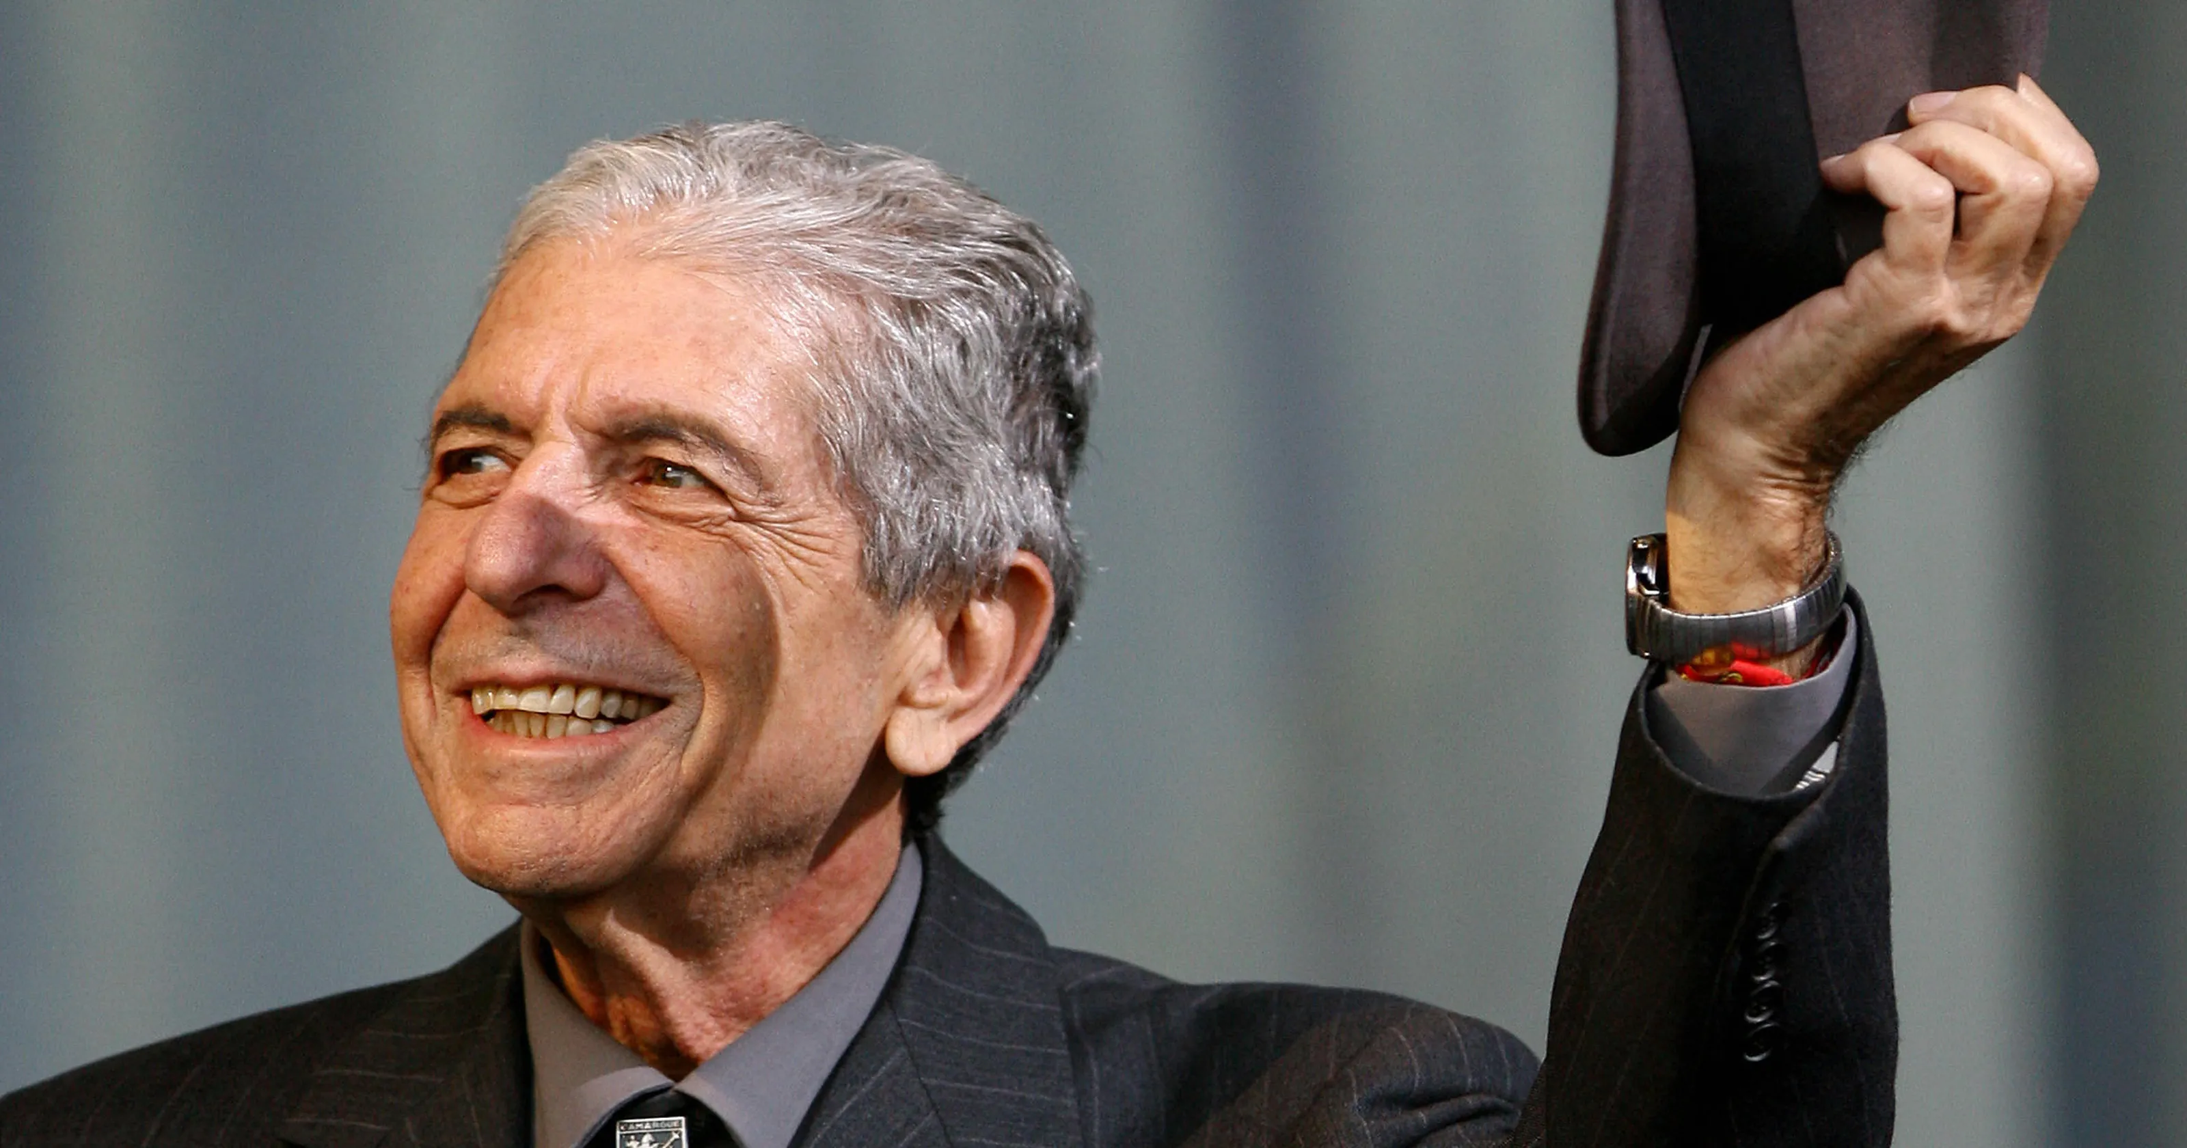
Contemplation Transforms; Let Me Count the Ways
Transformed Prayer, Persons, Theology, & World; the Energy of Contemplative Christianity 2
The story/journey, first
The Superpower Process, second
The Countertestimony, third
The Superpower: Kenosis, Letting Go, Emptying, Letting Come
Contemplative Outreach Birmingham, April 11, 2026
Ed Bacon, revedbacon@gmail.com

Slide 2
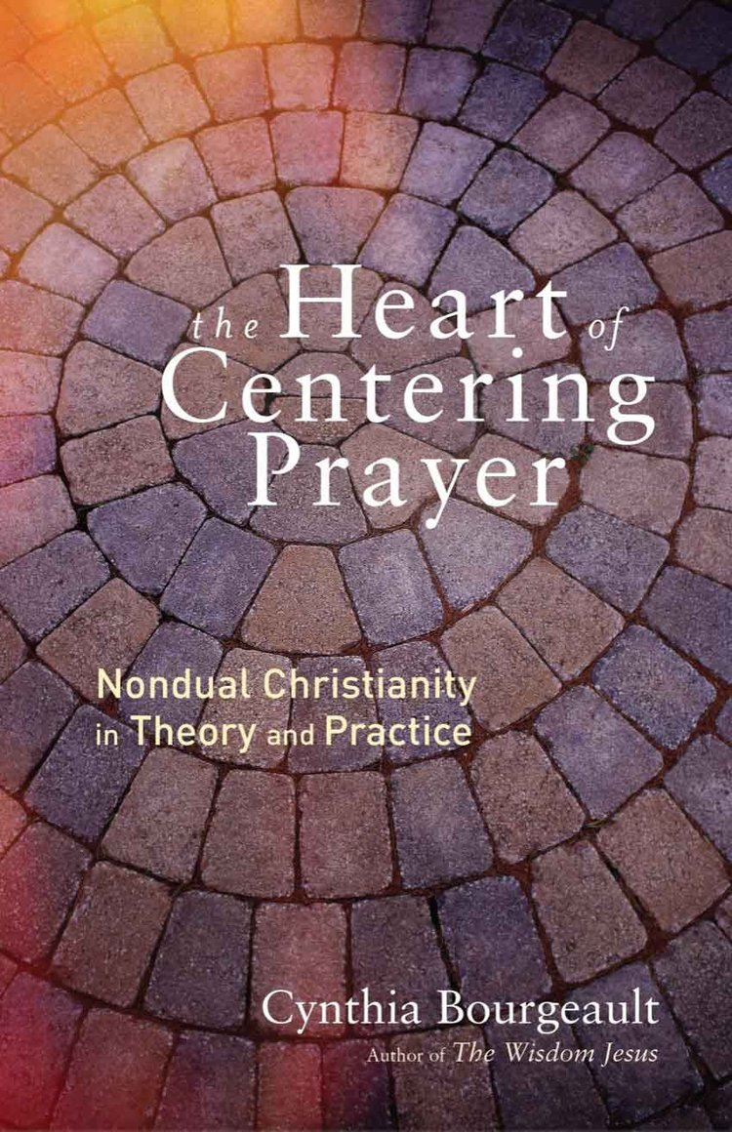
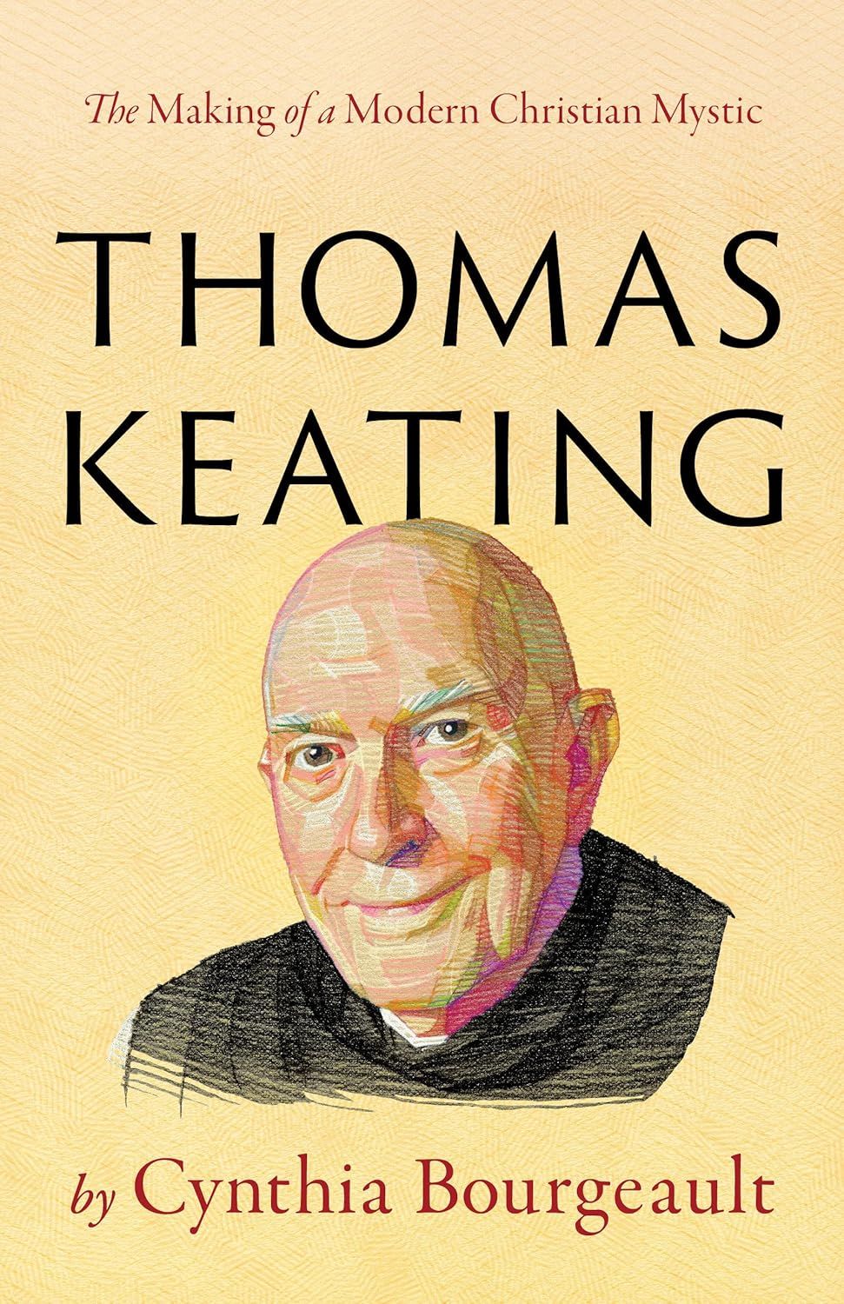
The Basic Method and “Official” Guidelines of Centering Prayer
Basically, the method of Centering Prayer consists in learning to withdraw attention from our thoughts – those incessant creations of our busy minds – in order to rest in a gentle, open attentiveness to divine reality itself. This gentle releasing of thoughts is known in Centering Prayer teaching as “consenting to the presence and action of God.” (within)
In Centering Prayer, a thought is defined as anything that brings your attention to a focal point (an idea, a vision, a memory, an emotion, or even an itch on your nose). If it captures our attention, it’s a thought, and the basic instruction is simply to let it go, gently releasing it from the grip of your attention. If another thought pops right back up to takes its place, that’s quite all right; let it go too. Cynthia Bourgeault, The Heart of Centering Prayer, pp. 14-15
“Official” Guidelines
1. Choose a sacred word as the symbol of your willingness to consent to God’s presence and action within.
2. Sitting comfortably and with eyes closed, settle briefly and silently introduce the sacred word as the symbol of your consent to God’s presence and action within.
3. When engaged with your thoughts, return ever so gently to the sacred word.
4. At the end of the prayer period, remain in silence with eyes closed for a couple of minutes. p. 29

Slide 3


The sacred word as a “wiper blade” of letting go of thoughts
“Letting go”, which Saint Paul specifies (in his famous hymn of Philippians 2: 6-11), is the very essence of “putting on the mind of Christ.” Each time you manage to disengage from a thought, you are doing so in solidarity with Jesus’s own kenotic (emptying) stance, in the process patterning that stance more and more deeply into your being until it eventually becomes your default response to all life’s situations. Cynthia Bourgeault, The Heart of Centering Prayer, p 128
…you do not disengage from a thought by replacing it with the sacred word – at least insofar as that instruction is heard as focusing on the sacred word. This misimpression is still prevalent among many practitioners of Centering Prayer – and in the early attempts to present the method of Centering Prayer there was indeed some lack of clarity around this point. But you can see how using the word as a replacement focal point for your attention would essentially turn it into a mantra, and in the Thomas Keating version of Centering Prayer the sacred word is emphatically not a mantra, merely “a placeholder for your intention.” The idea is not to stare at it, but merely to let it be the wiper blade that sweeps the windshield clean. The Heart of Centering Prayer, p 128

Slide 4


A Pathway of Return
Emphasis: Gentle releasing of thoughts (a thought is anything that brings you to a focal point – an idea, a vision, a memory, an emotion, an itch on your nose.)
A nun tried out her first twenty-minute taste of Centering Prayer and then lamented, “Oh, Father Thomas (Keating), I’m such a failure at this prayer. In twenty minutes I’ve had ten thousand thoughts!”
“How lovely,” responded Keating, without missing a beat. “Ten thousand opportunities to return to God.”
The essence of Centering Prayer is a pathway of return….every time we move from a smaller and more constricted state of consciousness into that open, diffuse awareness in which our presence to divine reality makes itself known along a whole different pathway of perception. (remember, the “new operating system”). Cynthia Bourgeault, The Heart of Centering Prayer, p. 14
The real work of Centering Prayer is to lay the inner foundations for an entirely different kind of spiritual attentiveness. Cynthia Bourgeault, The Heart of Centering Prayer, p 16

Slide 5
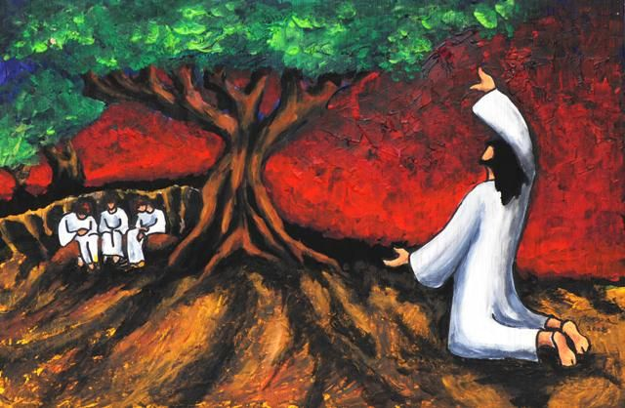
The Art of Letting Go, Self-Surrender That Heals the World
Leonard Cohen explained the success of his songs by saying, “For each song, I had to let go of my masterpiece in order to receive THE Masterpiece.”
This letting go of thoughts is seen as “consenting to the presence and action of God.” It carries that core sense of “not my will but thine be done, O Lord.”
Every time we’re willing to let go of our engagement with a thought, no matter how captivating, and return to that simple, open-ended awareness, we are in spirit participating – in solidarity with Christ – that great gesture of self-surrender through which the world was redeemed.
Recent neuroscience suggests that learning to let go of what we’re clinging to, mentally as well as emotionally, does indeed catalyze some revolutionary – and evolutionary -- changes in our neural wiring. p. 15
“…this ‘union of hearts’ (an affective union of hearts and wills between God and the individual soul) actually comes about through a gradual restructuring of consciousness that finally overturns the biologically hardwired illusion of a separate ‘I,’ or autonomous self-center.” From Bourgeault’s recent book, Thomas Keating, pp. xvi-xvii

Slide 6
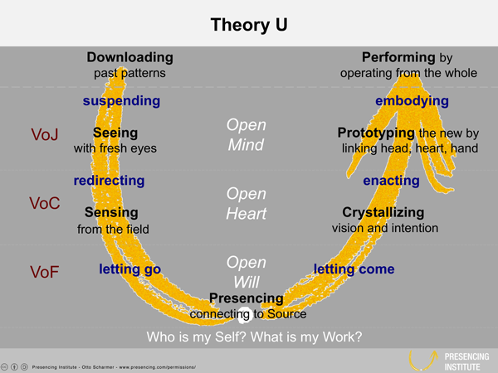
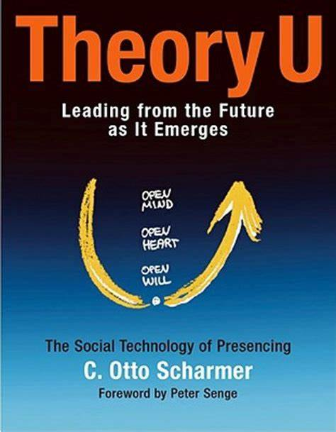
Letting go in order to let come. Not my will but Thine: Jesus
Leonard Cohen, Let Go of My Masterpiece to let come The Masterpiece
Letting go in order to let come
Letting go of My Ego System to let come Love’s Eco System
Centering Prayer is not about attention but intention: letting go of all thoughts (anything that brings one’s attention to a focal point). Method: use a “sacred word” during the prayer period to “break the flow of compulsive thinking.” The 14th century spiritual masterpiece The Cloud of Unknowing, was Keating’s immediate source. However, Centering Prayer’s “sacred word’ is distinct from The Cloud’s “love word” encapsulating one’s affective yearning for God. Keating’s “sacred word” was “a placeholder for your intention.” Centering Prayer’s intention is to LET GO OF ALL ‘THOUGHTS’, regardless of content.
“If the Blessed Mother herself were to appear before you during the time of prayer offering to remove that thorn from your flesh, the answer is ‘not now, Dearie, I’m doing my Centering Prayer.’”
Without using the Asian traditions’ phrase, “objectless awareness,” He was already on the track of the core insight that authentic contemplation requires an entirely different configuration of consciousness that is somehow blocked when attention keeps latching onto thoughts, even the most holy.” A DIFFERENT OPERATING SYSTEM
Cynthia Bourgeault, Thomas Keating; The Making of a Modern Christian Mystic, pp. 5-6, noting that even The Cloud of Unknowing emphasized letting go of thoughts because “any thought is between you and God” a separation between yourself and the unmediated divine presence.

Slide 7
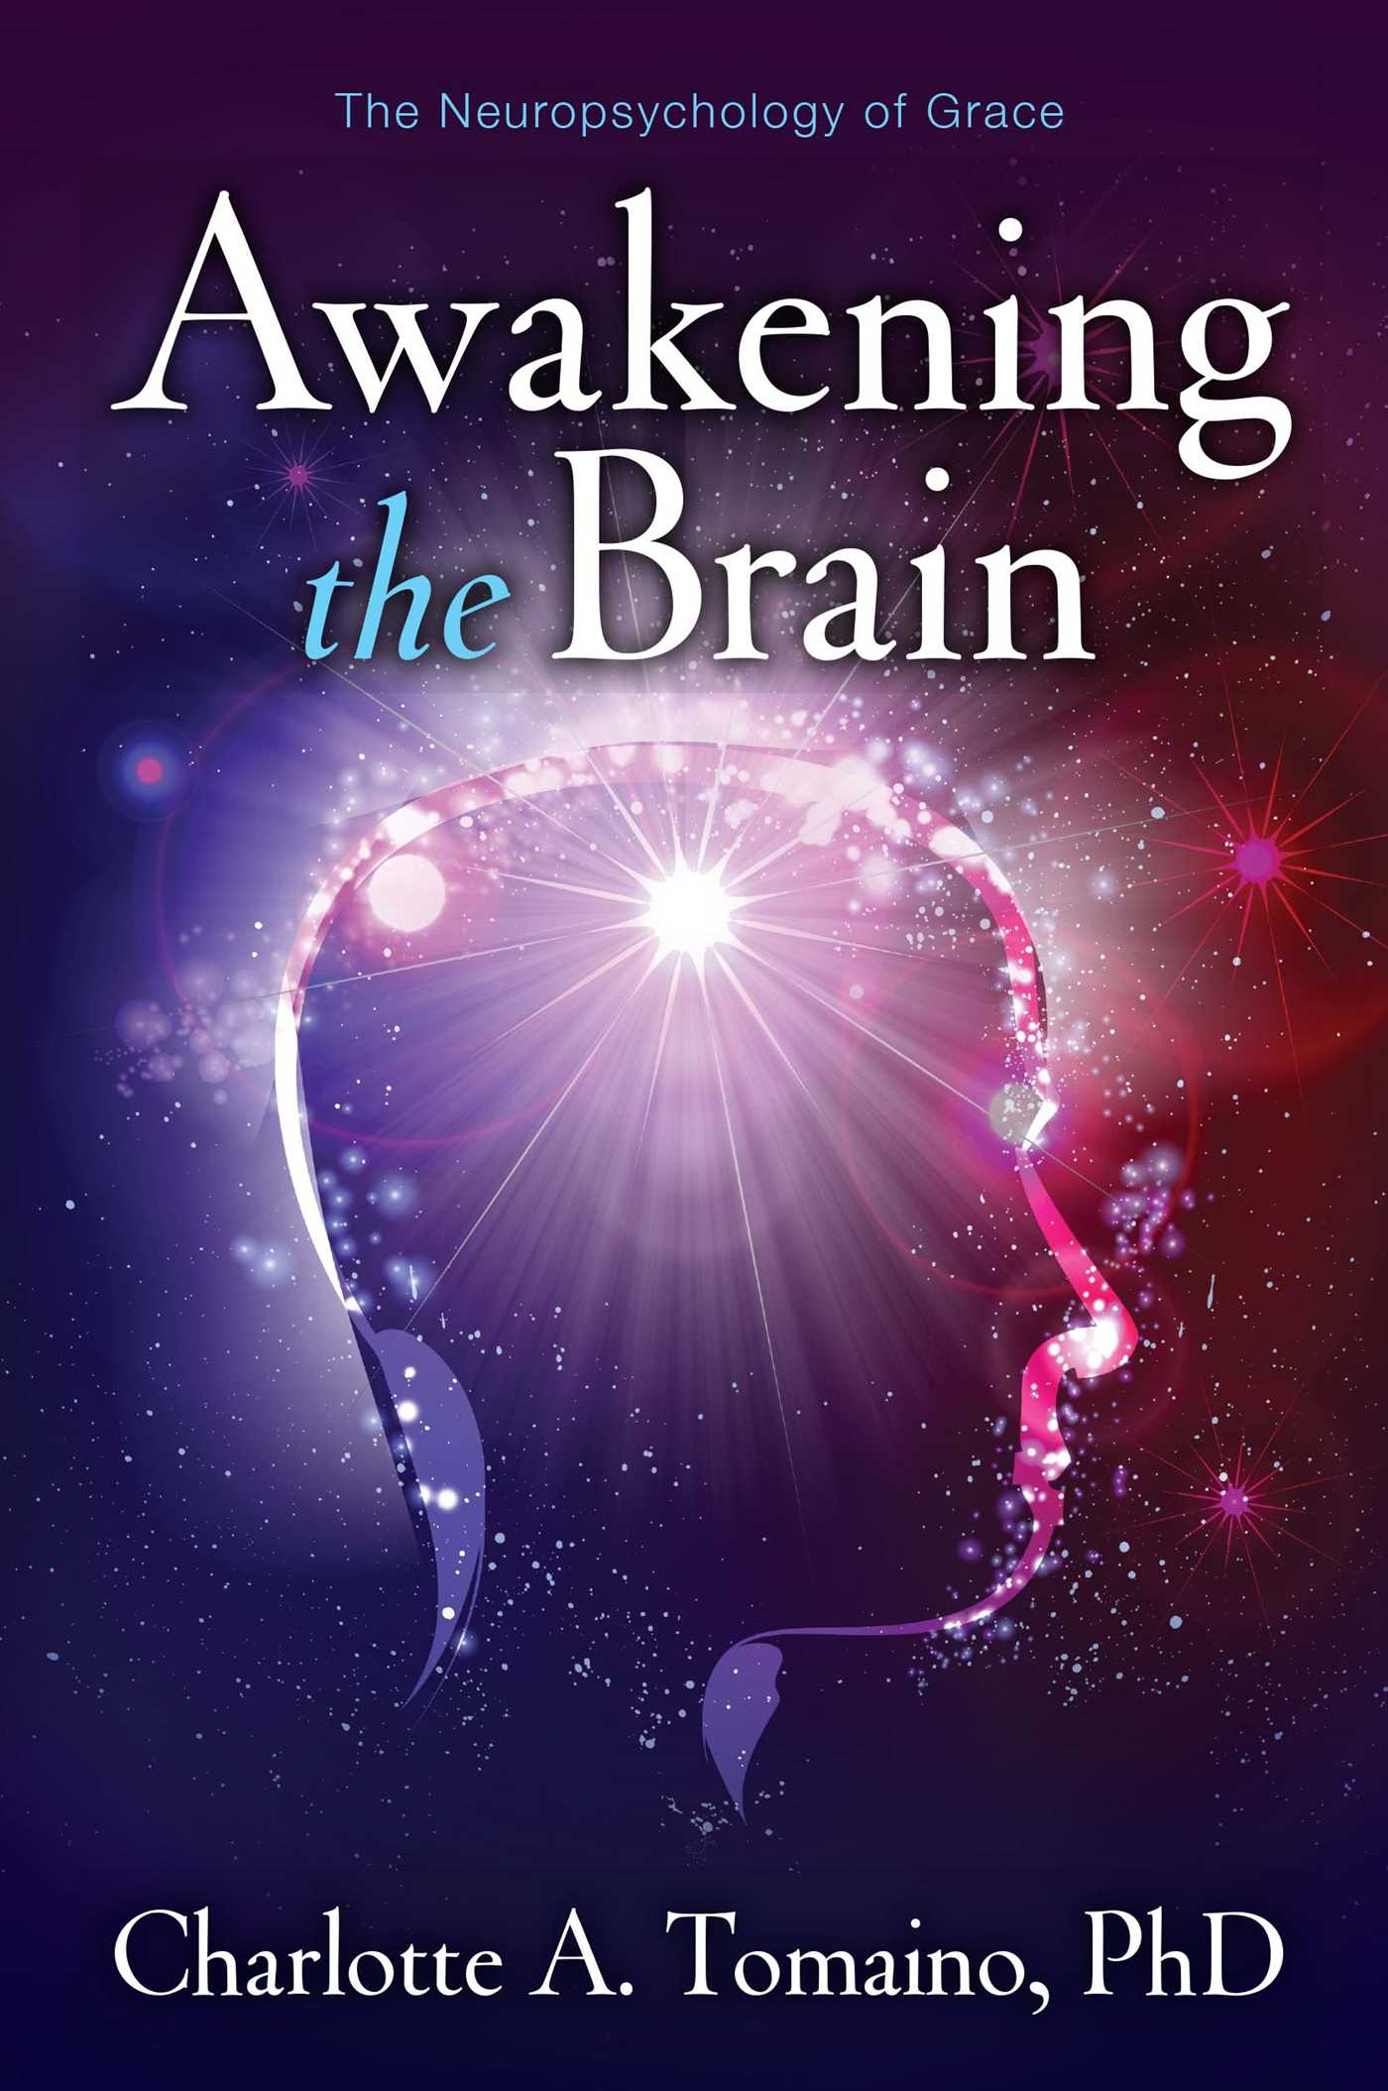
Making a choice for a personal thou, a personal God, a personal wholeness
Charlotte Tomaino's book, Awakening the Brain, on the neuropsychology of grace, is a fine, insightful book on how to make a choice for a personal thou, a personal God, a personal wholeness.
1. Charlotte says, “The way you think and what you believe can actually awaken your brain and expand your consciousness.” So as a neuropsychologist, she's keenly aware that the brain is very malleable. It is plastic, it can change shape. (also, see: How to rewire your brain for happiness - Fast Company)
2. She says each choice we make creates a focus for the brain and guides neurons to talk to each other, creating new connections or reinforcing old ones.
3. Charlotte speaks about neurochoice: bringing about change through choice; neural focusing. And that's, in a sense, what meditation can do. It can focus the brain.
4. It can, actually, literally help the circuits integrate into a more wholesome, integrative awareness. So, an awakened mind is one that is awakened to a wider sense of reality or awareness. In Buddhism, awakening (bodhi) is the understanding of the true nature of life and consciousness and is associated with enlightenment..
5. And so she talks about “developing a Buddha Brain.”
6. We also recognize that spiritual healing is about attuning to a larger consciousness and the meaning it reveals. Developing a sense of wholeness is very helpful, you know, for overcoming depression and anxiety.
Ilia Delio, “Making a Choice for a Personal God,” Webinar, June 3, 2024; Transcript 21, slide 54

Slide 8
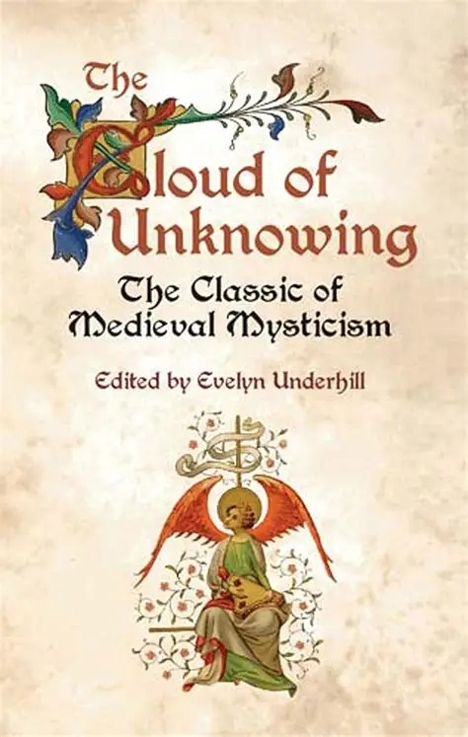
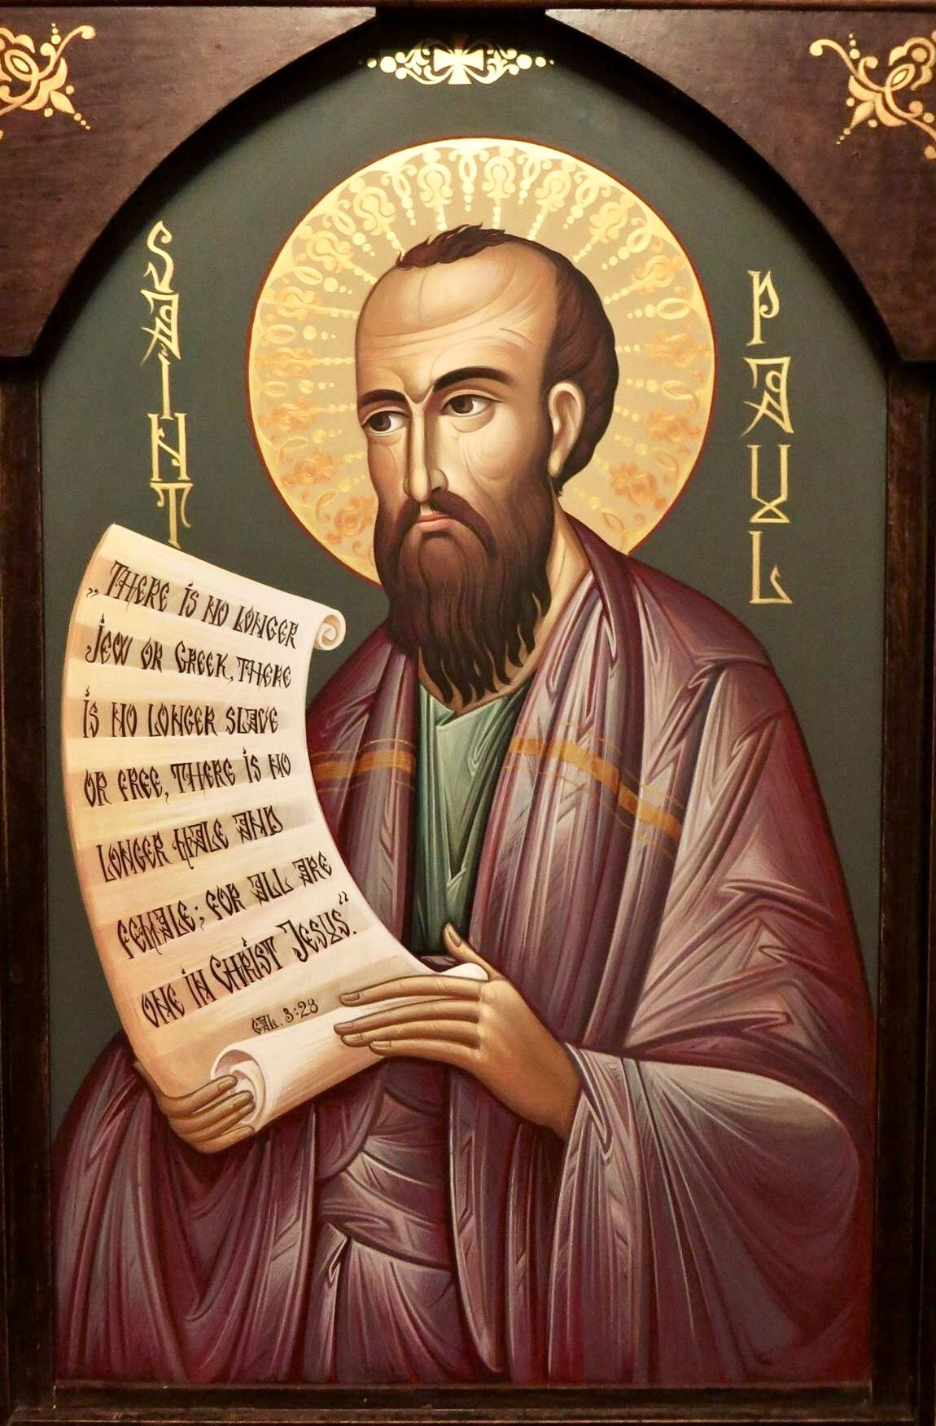
The Tap Root of Centering Prayer is “letting go” (kenosis)
“Whatever Centering Prayer may be (meditation, prayer, therapy, theosis), it is important to keep emphasizing that it is drawn entirely from the Christian contemplative tradition. Its major source is…The Cloud of Unknowing, with additional refinements provided by the Carmelite mystics Teresa of Avila and John of the Cross.” p. 191
Though there are external trappings from the Asian traditions, “The theological heart of the practice is entirely Christian-sourced…. The living core of the practice resides in the theological principle of kenosis, or ‘self-emptying,’ as it is explicitly laid out in St. Paul’s celebrated teaching in Philippians 2: 6-11…. These first three stanzas are from a liturgical version in active use at New Camaldoli Hermitage:
Though his state was that of God,
He did not deem equality with God
Something he should cling to.
Rather, he emptied himself
And assuming the state of a slave,
He was born in human likeness.
He, being known as one of us,
Humbled himself, obedient unto death,
Even to death on a cross.
In the original Greek, the verb for “emptying” is kenosein, from which the term kenosis derives. Centering Prayer is essentially kenosis in meditation form. The practice is entirely about self-emptying, which has always meant, both for St. Paul and for Thomas Keating, not simply “emptying the mind,” but a radical self-donation of one’s entire will and spirit.* Centering prayer is in service of that total delf-donation; step by step it creates the inner conditions through which one eventually becomes capable of it. “The intrinsic connection between self-emptying as played out in the microsurrender of one’s thoughts during a Centering Prayer period and in the macrosurrender of Christ on the cross is what gives Centering Prayer its core Christian identity. It is quintessentially paschal and Christic.”…Thomas’s own intense, intuitive sense of a living vonnection with Christ came to reside,”even when he “seemed to deemphasize many of the conventional elements of Christic piety. …Kenosis is really the hidden key that decisively settles the question of Thomas’s ultimage relationship to Christianity.”pp. 192-193) *putting oneself at the disposal of God’s Grace. “Take, Lord, Receive”

Slide 9
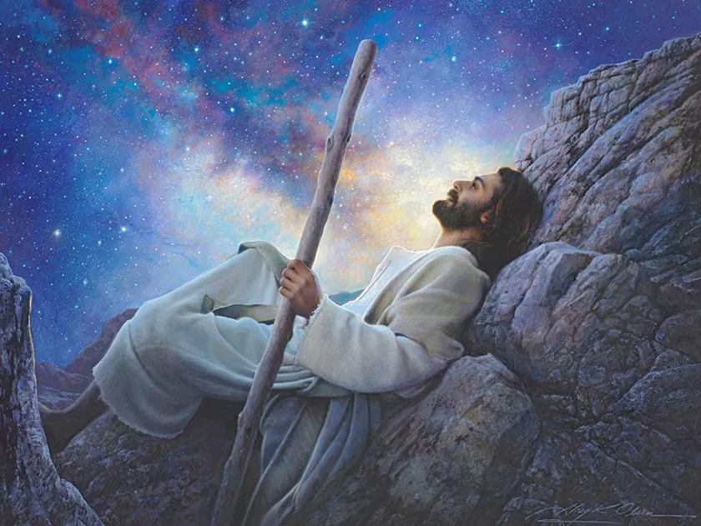
What is a Christian Contemplative Movement?
We could say that the Christian contemplative movement has been with us since the beginning. Jesus took time apart, withdrawing into solitude and then returning to live out the fruit of what he saw and heard in that quiet place. He trusted deeply in his relationship with God, and through that trust, power flowed. Healing happened. He confronted injustice. He lived nonviolence, not as an idea, but as presence – as love that relocated those around him in who they are in God.
We could say the movement was alive in the desert, in the mothers and fathers who walked away from a version of Christianity that was becoming too cozy with empire. It was there in Sant Benedict, building a new world, within the ruins of the old. It continued in Saint Francis, Dorothy Day, Catherine de Hueck Doherty, Howard Thurman, and Desmond Tutu, who prayed deeply and acted boldly. The movement was there in bell hooks, who remembered the love she experienced in the Black church and combined that with her Buddhist practice, insisting that love must be the foundation of any real social transformation.
All of that, I believe, is part of the Christian contemplative movement.
Greg Olsen created this beautiful image, “Worlds Without End” (click here to order a print)

Slide 10

Centering Prayer as a Dark-Night Passage. Trust that what is truly needed will be provided, and that what is provided is indeed truly needed
“Centering Prayer is (finally) all about releasing your attention from its subject-object configuration. That’s what it means, from a practical standpoint, to ‘consent to the presence and action of God.’ Anything that attracts your attention to a focal point qualifies as a ‘thought,’ and the instructions are to let all thoughts go. So the gradual fading of the subject-object dichotomy in favor of a different mode of spiritual attentiveness is already familiar territory, and you have begun to learn how to make your way within it. p. 78
“meanwhile, the repeated discipline of letting go of all thoughts during the prayer time (truly, ‘a thousand opportunities to return to God,’ as Thomas has described it) has gradually atterned into you the intuitive recognition that whatever you are clinging to is what is getting in the way. You have learned that the journey of transformation goes hands-free into the dark, trusting that what is truly needed will be provided, and that what is provided is indeed truly needed. You relax and let go into it. In the dark night of spirit, those two crucial pieces of training are what will guide you through. As they did Thomas Keating. p. 79

Slide 11

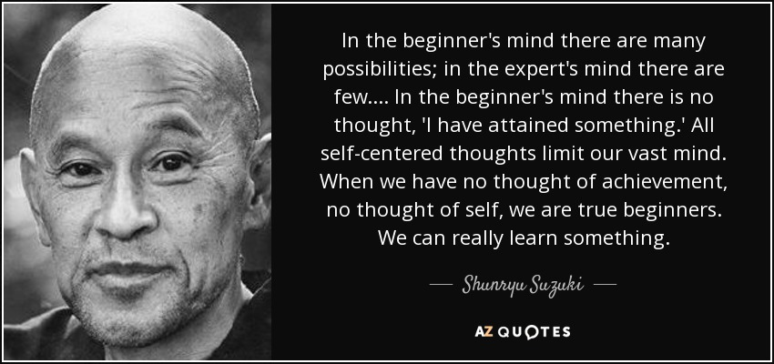

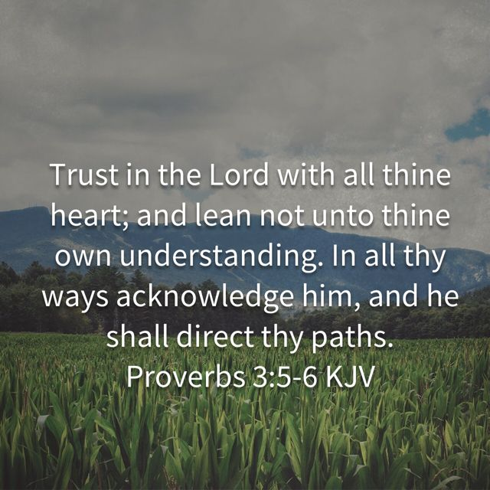
Four-legged stool of consciousness in stillness
THIRD STEP IN AA
Made a decision to turn our will and our lives over to the CARE of God as we understood God.

Slide 12
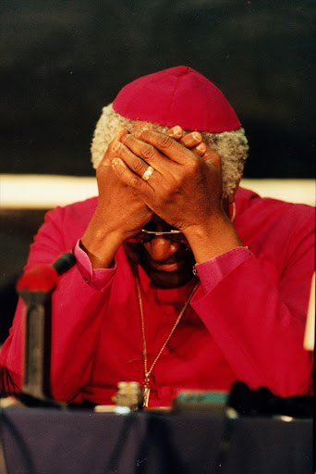
Contemplatives become God’s partners in transfiguring suffering and transfiguring the world.
It’s about letting contemplation overflow into our lives and into the world, bringing with it the best tools of social analysis, nonviolence, and a commitment to real change – not as add-ons, but as part of the contemplative path itself.
It’s my conviction that CAC (Richard Rohr’s Center for Action and Contemplation) can be a gathering place for contemplatives and communities who are awake to what this moment demands and ready to articulate a shared vision rooted in the wisdom of our traditions.
As Archbishop Desmond Tutu reminded us, any real contemplative experience, when it’s authentic, always sends us back into the heart of human suffering, so we can become God’s partners in transfiguring that suffering and transfiguring the world.
Adam Bucko is an Episcopal priest and teacher of contemplative spirituality. He is the author most recently of Let Your Heartbreak Be Your Guide: Lessons in Engage Contemplation. He serves as the Director of the Center for Spiritual Imagination and is a vowed member of the new monastic Community of the Incarnation.
Cover article for CAC’s The Mendicant, Summer, 2025
The Center for Spiritual Imagination is a ministry of the Community of the Incarnation, which prays, lives and serves at the Cathedral of the Incarnation, the Mother Church of the Episcopal Diocese of Long Island, serving Brooklyn, Queens, Nassau and Suffolk counties. Deeply rooted in the church, our Episcopal Visitor is the Bishop of Long Island.
But for this movement to really offer something to our world – when attention is hijacked by devices, when political crisis is a daily norm, when love seems to have gone missing from the decisions shaping our future – we may need to deepen and extend it. Not by starting from scratch, but by integrating that wisdom and discerning together what this moment calls for.
Maybe it’s time for Christian contemplatives to come together to begin naming and sharing the most vital insights that have been passed down to us.
This movement isn’t a brand or a spiritual spa. It’s also not about escaping the chaos of life for twenty minutes of calm. It’s about praying in and with our problems. It’s about holding the wounds of the world in our hearts as we sit before God – not to flee the pain, but to remain present to it in love.

Slide 13
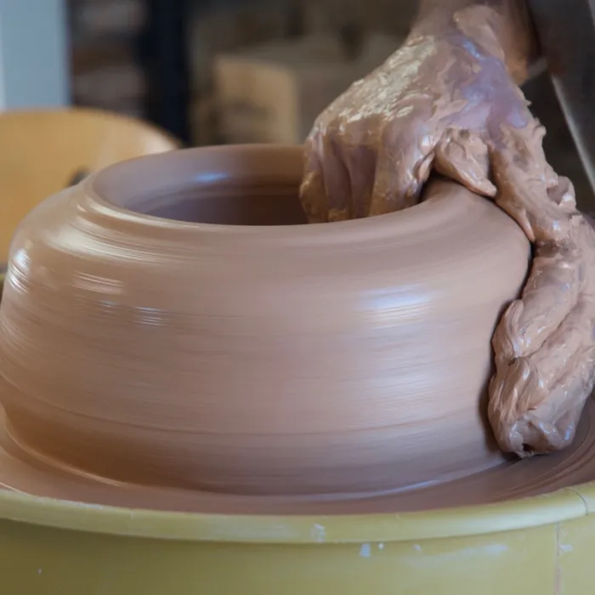
“There is a deep relationship between the inner revolution of prayer and the transformation of social structures and social consciousness. Our hope lies in the fact that meditation is going to change the society that we live in, just as it has changed us.”—RICHARD ROHR, CAC FOUNDER
“…more and more people are being drawn to contemplative wisdom because it not only supports personal healing but is also vital to human and planetary flourishing. Considering the unprecedented crises we face, the task of developing a way of being in the world together that bridges difference and embodies the reality that all life is sacred and connected is an urgent one.
More and more people are seeking out this new way of being. A momentous shift is underway, a historic breakthrough for contemplative consciousness, born from the pains of our collective evolutionary process. Fr. Richard refers to this shift as the “Great Turning,” a phrase we borrow from beloved CAC friend and former teacher Joanna Macy.”
The Great Turning is much bigger than any one organization or even any single spiritual tradition. But by introducing seekers to contemplative wisdom, we believe that the CAC will continue being a catalyzing force for this change of consciousness within Christianity and each of our communities. As Richard has said, “There is a deep relationship between the inner revolution of prayer and the transformation of social structures and social consciousness.” Our work seeks to bring Christianity’s greatest gifts alongside other spiritual traditions and movements in service to systemic change and a more life-sustaining future that serves all – ALL! — of us.
This work invites each of us to play a part — a whole body, a whole community, a whole movement of people grounded in a shared vision, values, and experiential knowing of God’s presence in our life showing up in the world together. Our hope is not in avoiding the realities of death and discomfort, but instead in choosing to live meaningfully as witnesses to the mystery of Love with whatever we are given.
As Richard has often said, “Transformed people transform people.” I would add: transformed people, working together, transform communities and systems. In this post, I will dive more deeply into how we understand this connection between inner and outer change, the personal and the systemic. This thread through Richard’s teaching is what drew me to his work in the first place, and it’s why I believe that by building on Father Richard’s work of introducing seekers to contemplative wisdom and practices, the CAC can not only support individual healing and growth but also be a catalyzing force for change inside Christianity and each of our communities — as part of movements of transformed people working together for a more just and connected world.
… new mission of CAC: to introduce Christian contemplative wisdom and practices that support transformation and inspire loving action.“Transformed people working with and for each other in service to a more just and connected world,” June 6th, 2022 Michael Poffenberger, Executive Director, Center for Action and Contemplation

